Slide 1




Notes:
Hello, this is Dan Schindler, product manager at Roberts-Gordon. In this video I will cover our full product offering and explain unique features of each product. Understanding the differences in each product we offer will help find the best infrared heating solution for your customer.

Slide 2
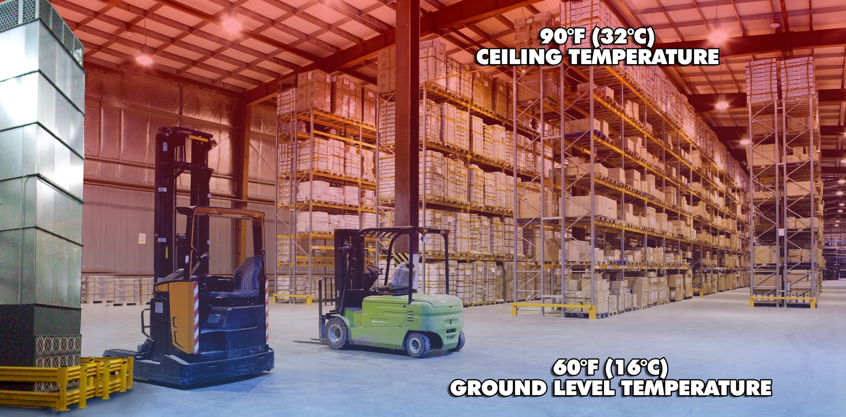
HOW WARM AIR HEATS A BUILDING
HOW WARM AIR HEATS A BUILDING

Slide 3
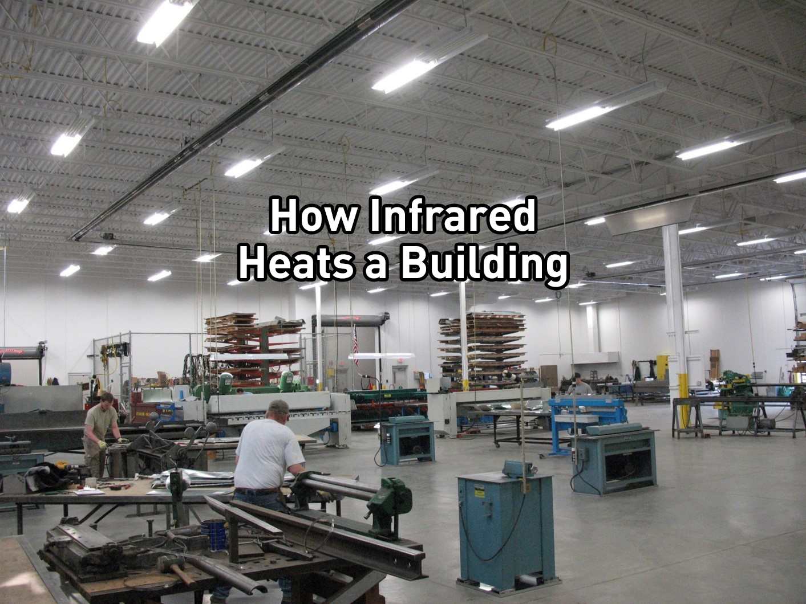

Slide 4
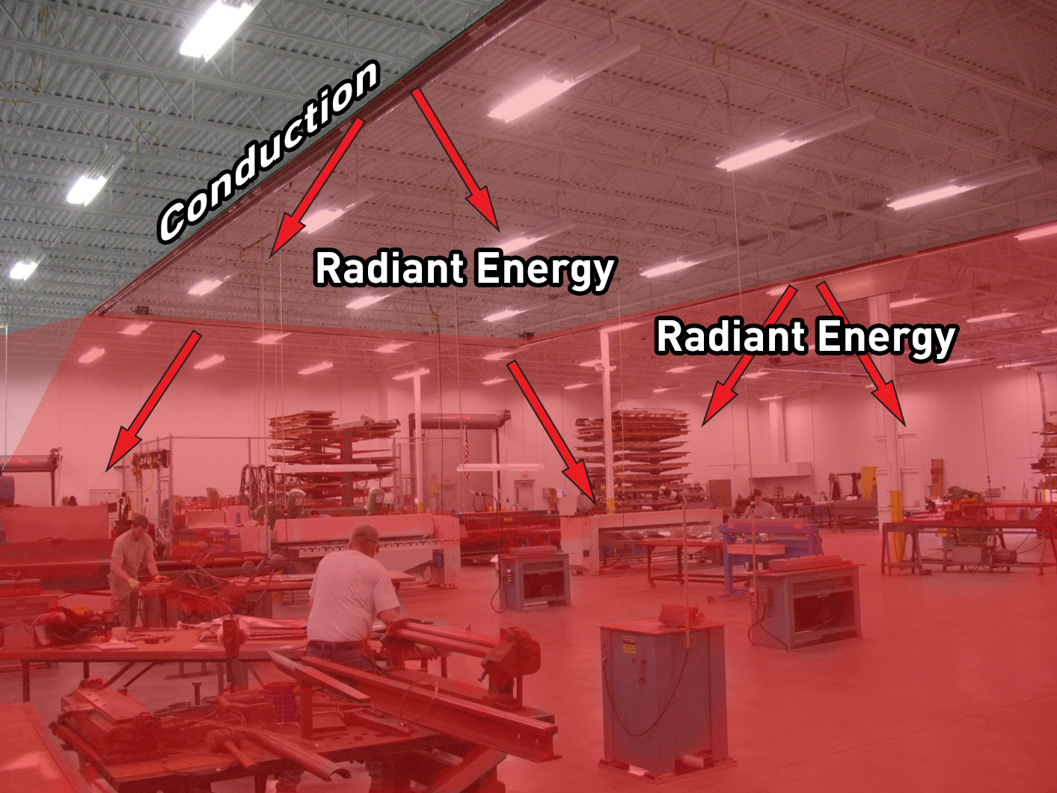

Slide 5


Slide 6
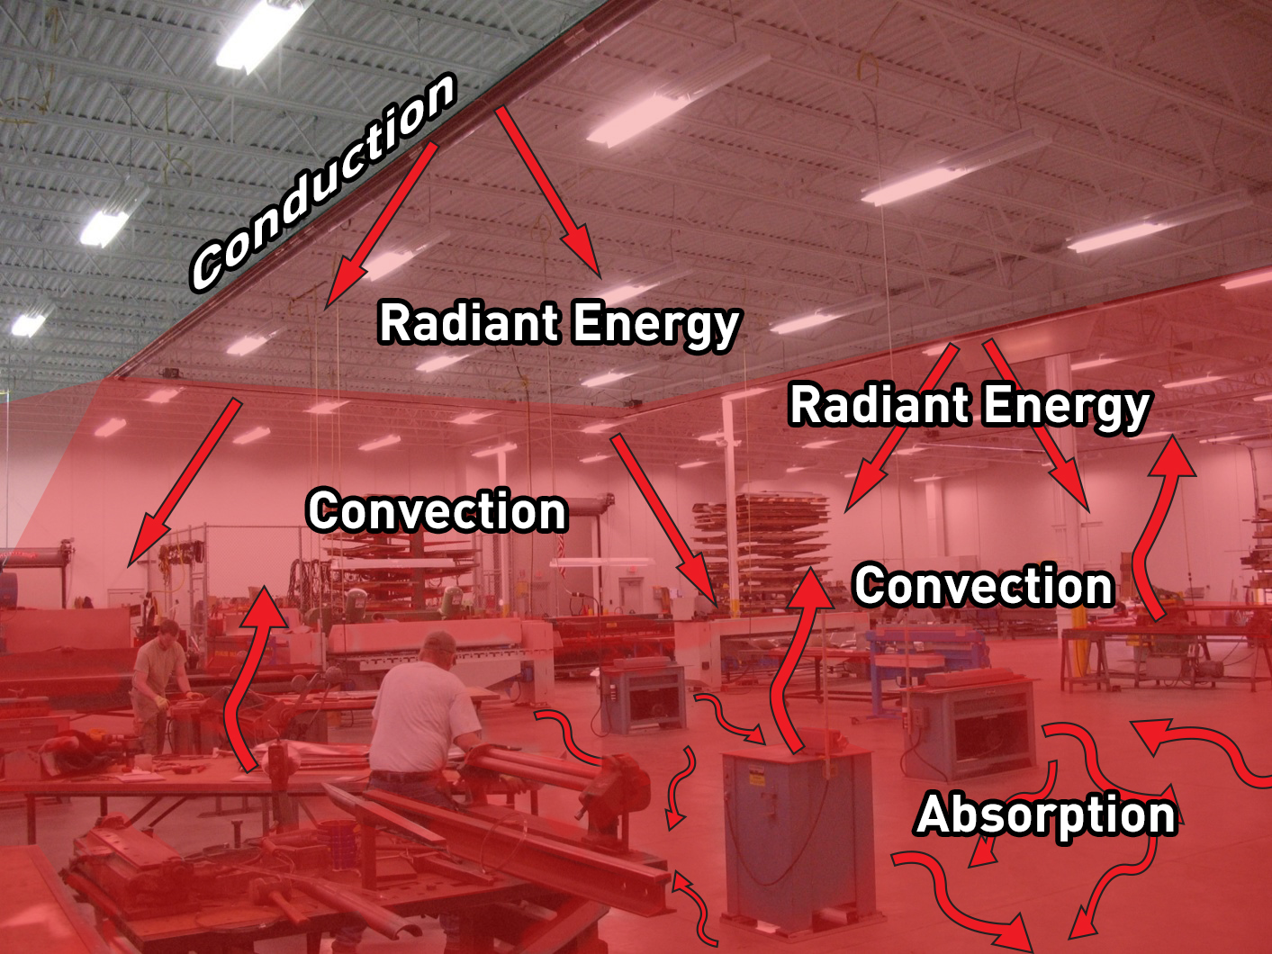

Slide 7
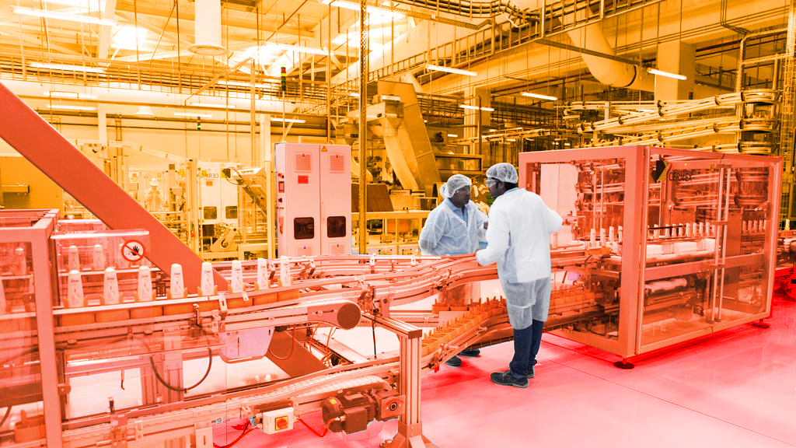
Increasing the Mean Radiant Temperature (MRT) improves the Operative Temperature (t_{o})
Notes:
Radiant energy received by the occupants directly from the heater or indirectly from the surrounding objects will help increase the Mean Radiant Temperature (MRT). Just like directly sunlight, the increased MRT allows the occupants to feel comfort at a reduced air temperature.
The Operative Temperature is largely influenced by the Mean Radiant Temperature. Radiant heaters are fantastic at increasing the MRT because radiant heaters heat objects directly. Those objects in turn absorb the energy and will then re-radiant that energy.

Slide 8

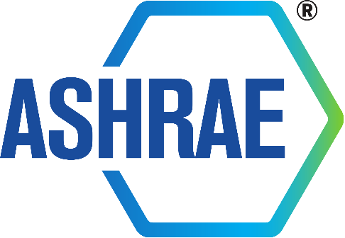
Adjustment Factor for
Infrared Equipment Sizing
“Recognizing the reduced fuel requirement for these applications, …. it is desirable for manufacturers of radiant heaters to recommend installation of equipment with a rated output that is 80 to 85% of the heat loss calculated by methods described in Chapters 17 and 18 of the 2013 ASHRAE Handbook – Fundamentals.”
- “Infrared Radiant Heating.” 2016 ASHRAE Handbook HVAC
Systems and Equipment. Atlanta, GA: ASHRAE,
2016. 16.1. Print.

Slide 9
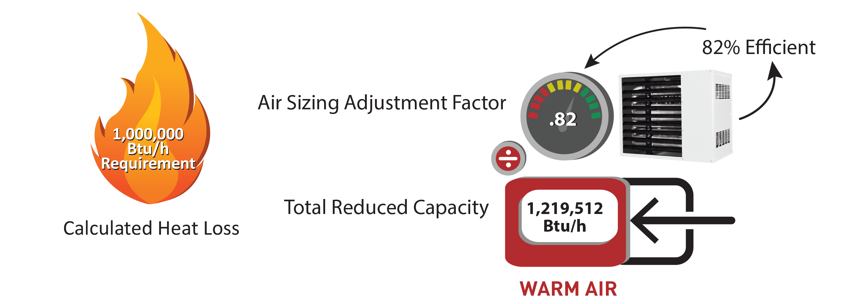
Adjustment Factor for
Air Equipment Sizing

Slide 10
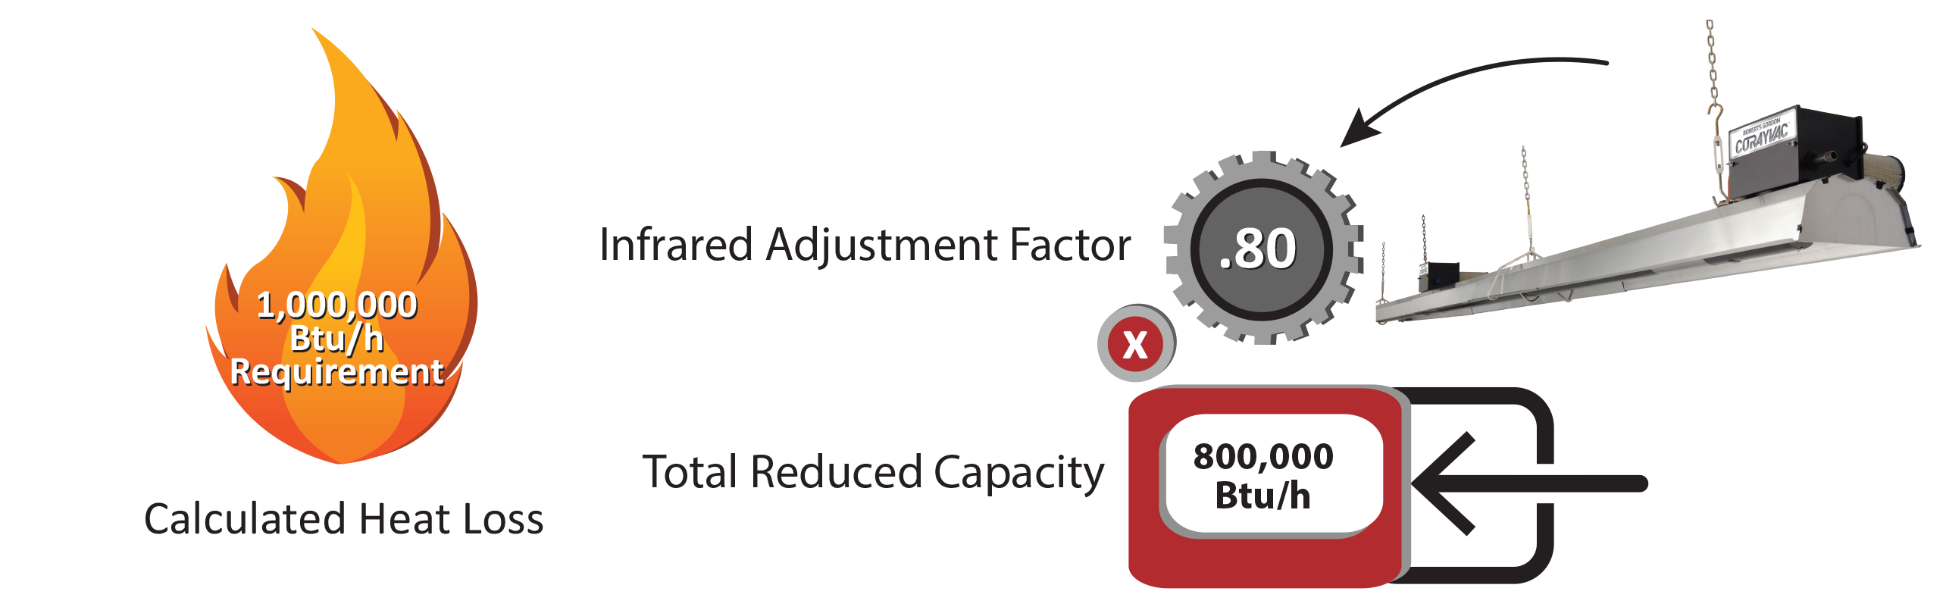
Adjustment Factor for
Infrared Equipment Sizing

Slide 11
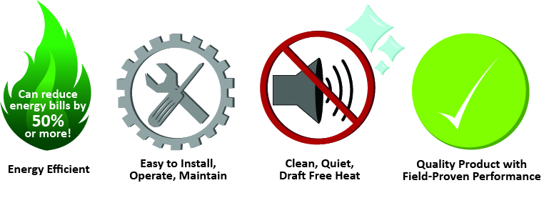
Benefits of Low-Intensity Infrared

Slide 12

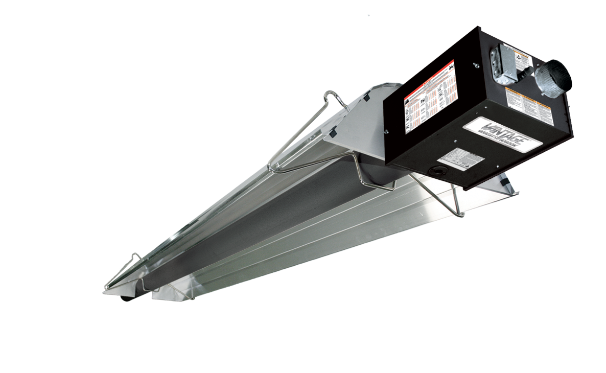
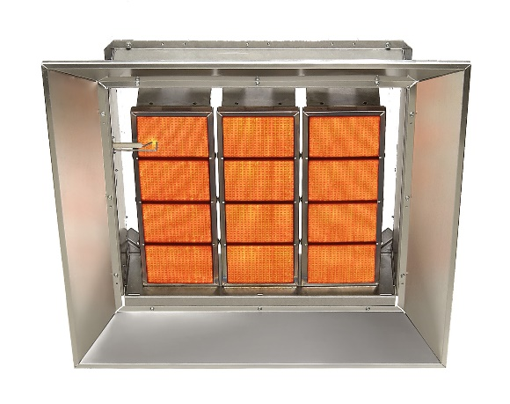
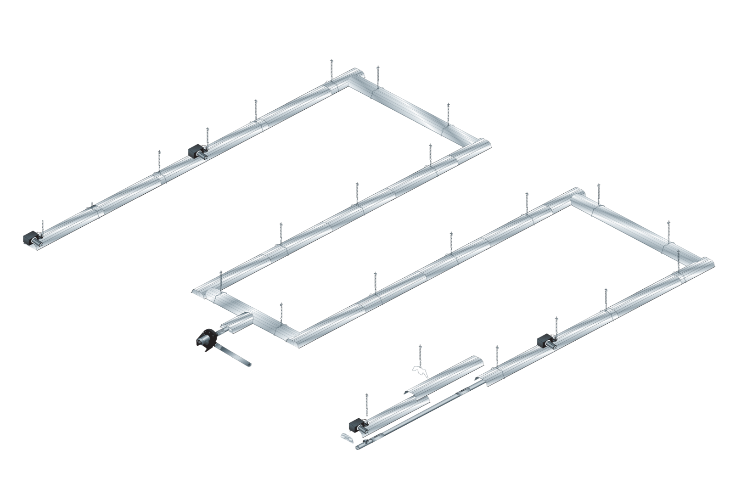
Gas-Fired Low-Intensity Infrared Heaters
Other types of infrared heaters (not offered under RG brand)
Low-Intensity Heaters Provide:
Flexible design options
Ideal for spot or general space heating
Lower clearances to combustibles
Low or high bay buildings
RG Offers:
Unitary heaters
IR heating systems
Single stage
Two stage
Fully modulating
Controls
High-Intensity (Gas-Fired)
High-Intensity (Electric)
Notes:
Infrared heating equipment is most widely available today in two forms. High-intensity and low-intensity. In the early 1960’s, Roberts-Gordon pioneered the concept of gas-fired low-intensity infrared heaters (or sometimes referred to as “tube heaters”). As and industry leader, we continue to manufacture the highest quality low-intensity infrared heaters today.
Available in the market in gas-fired or electric, high-intensity infrared heaters, not offered by Roberts-Gordon, are identified by a glowing emitter with a surface temperature greater than 1800­° F. High-intensity heaters focus heat in a relatively small area making them ideal for spot heating.
Low-intensity identified as a flame contained within a tube or network of tubes with a surface temperature below 1350° F. Low-intensity tube heaters provide more design flexibility than any other type of infrared heater with the ability to direct heat only where needed in spot heating applications. Or designed to heat and maintain high comfort levels for an entire space, including buildings with high ceilings.
Our broad product offering consists of single burner heaters also referred to as “unitary heaters”, and multiple burner infrared heating systems. We offer single stage, two-stage, and fully modulating products.
All of which are used in a variety of different commercial/industrial and agricultural applications.
As well as a number of difference accessories, Roberts-Gordon also offers a verity of controls that range from a simple on/off thermostat to a BACnet enabled control system compatible with existing Building Management Systems.

Slide 13
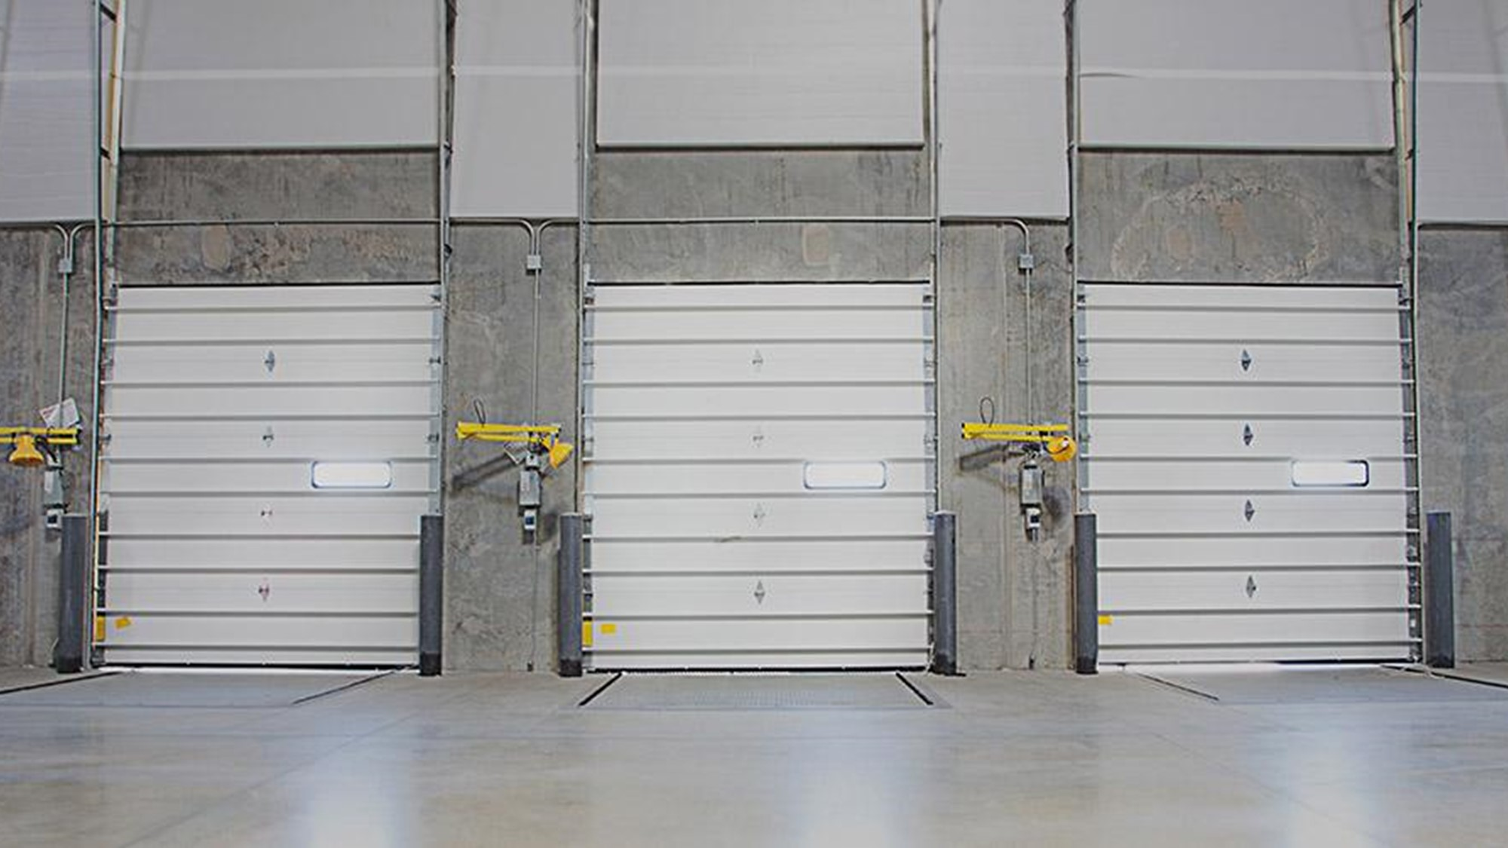
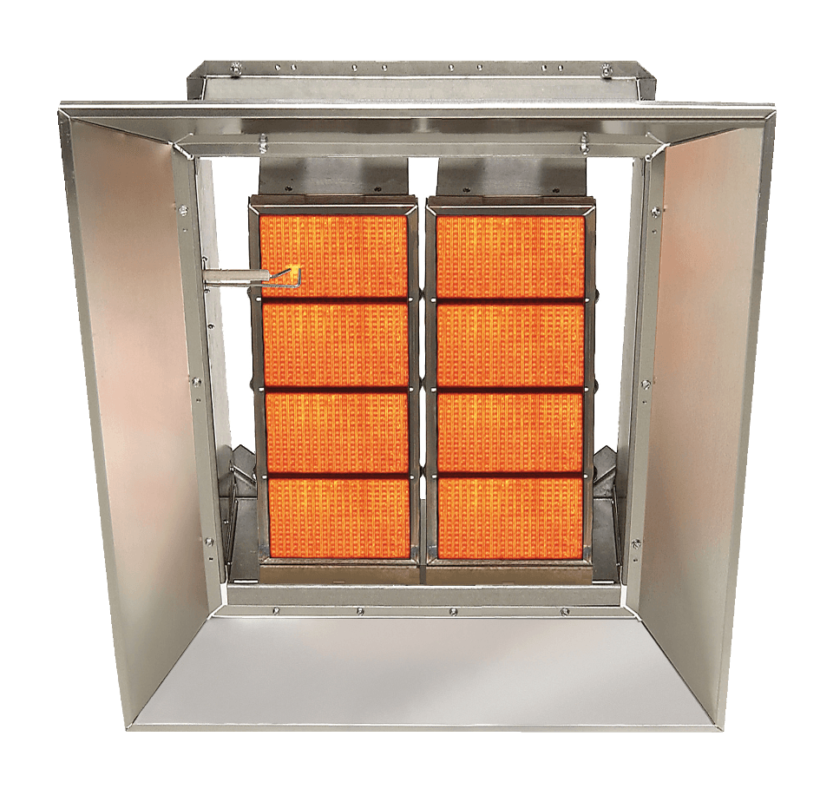
Absorption of infrared in
concrete
Vs.
70%
85%

Slide 14
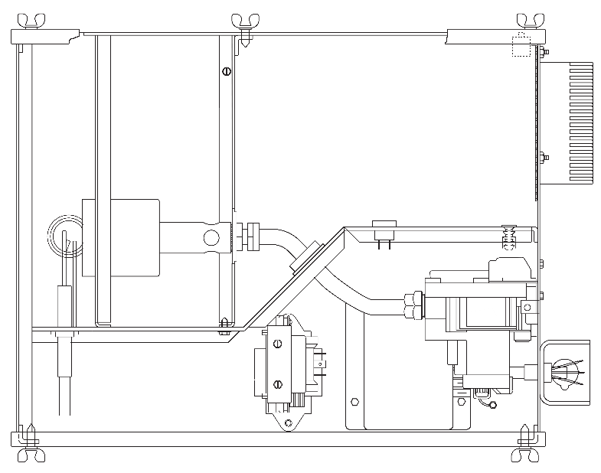
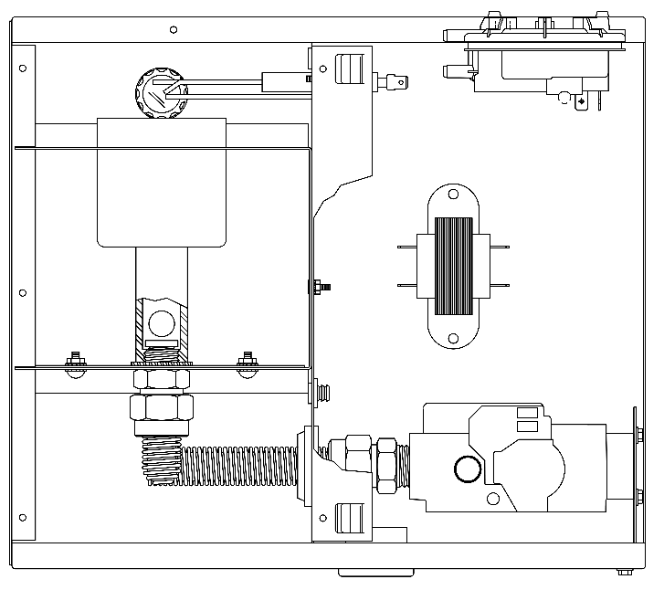
Top View (Internal)
Models:
CTH2V
HEV
CTHN
CTH3
HEM
Models:
BH
DF
Notes:
There are many common features that are shared across our product offering.
One of which for our unitary heaters is an internal patrician that separates the combustion air from the electrical compartment. This key feature helps keep dust and other debris off of electrical components keeping them clean to increase the longevity of the heater.
Also, silicone gasketing is applied to all removable door panels to maintain a tight seal for added protection from the environment.

Slide 15
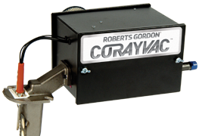
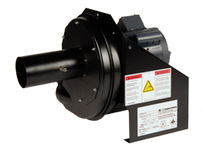


Black Powder Coat Finish
Notes:
All burners and vacuum pumps come with a baked-on black powder coat finish.
Powder coat provides an extremely durable level of protection for a long-lasting finish that is highly resistant to corrosion, chipping, scratching, or fading.

Slide 16
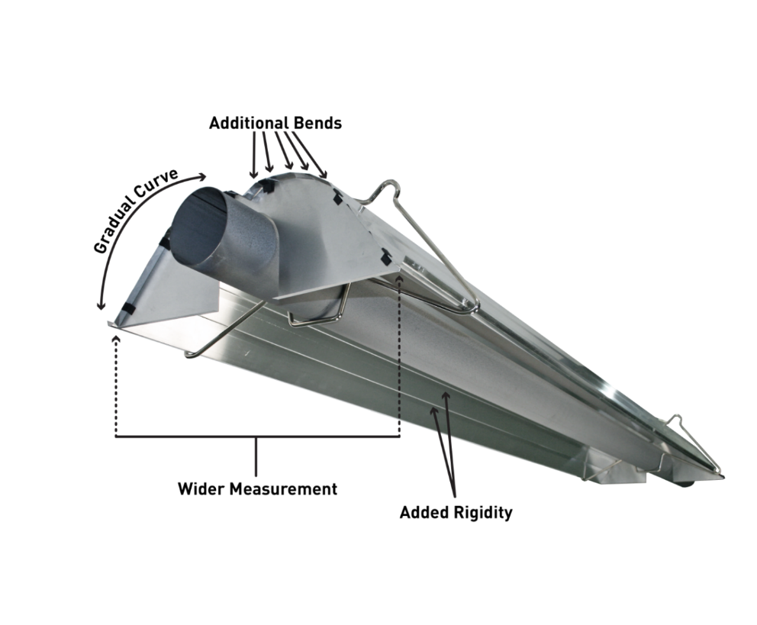
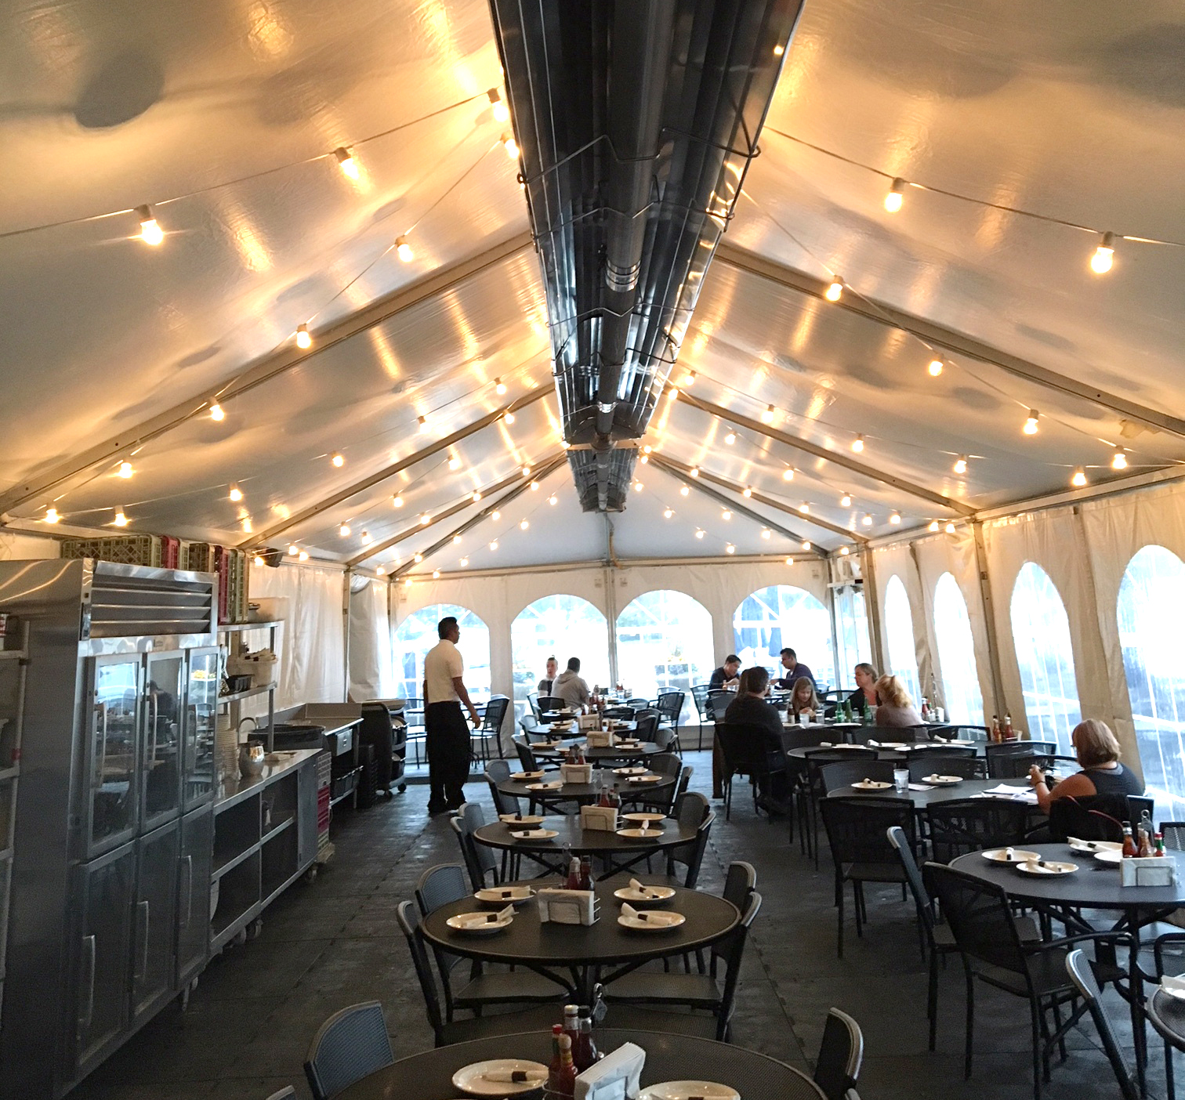
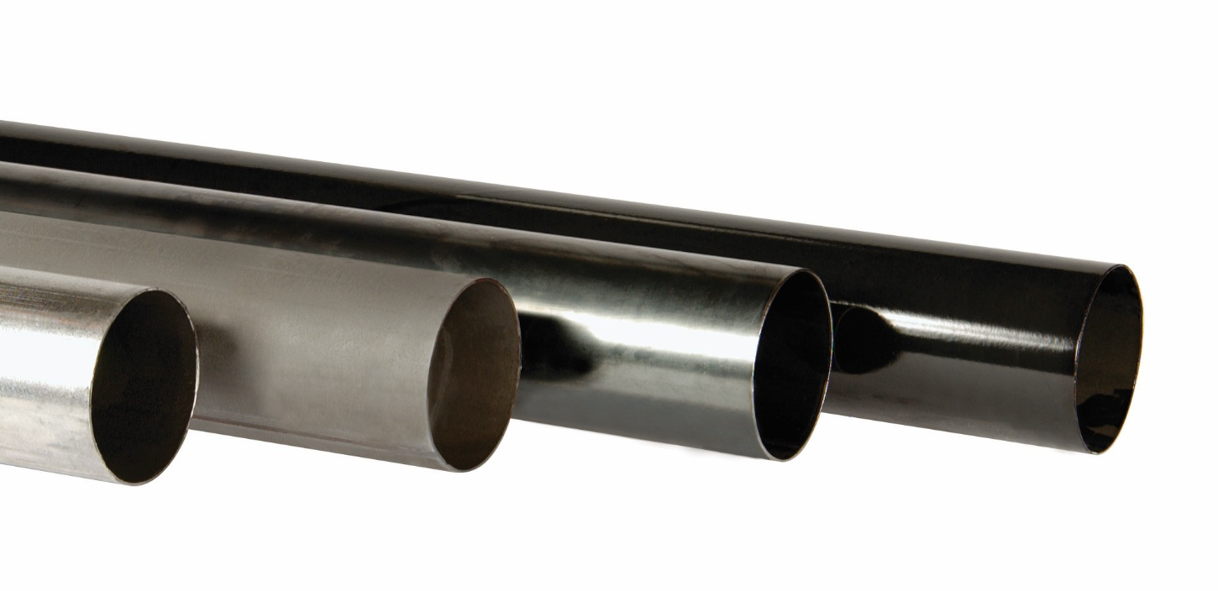
Reflector Material Reflectivity
Mill-Finished Aluminum 0.91 - 0.95
Stainless Steel 0.48 – 0.66
High Efficiency Reflector - Maximizes radiant output to deliver more radiant heat than any other reflector in the industry!
Tube Material Emissivity
Aluminized Steel (Heat Treated) 0.80
Hot Rolled Steel 0.80
Porcelainized Steel 0.92 to 0.96
Cast Iron 0.95
Stainless Steel (type 304) 0.44 to 0.62
Pyromark® Paint 0.80
Notes:
We offer different tube material options and 2 different reflector shapes throughout our product offering
Our 2 reflector types are referred to as our standard reflector and our high efficiency reflector both available in mill-finished aluminum, while the standard reflector is also available in stainless steel. The performance of the 2 material types is measured in reflectivity, which is a rating given for materials ability to reflect radiant energy. Mill-finished aluminum has a high reflectivity rating that ranges from .91 to .95. While the reflectivity rating for stainless steel is much lower with a range of .48 to .66.
For years the standard reflector was considered the best in the industry. However, the innovative design of the high efficiency reflector introduced to the marketing in 2016 has more gradual bends and a wider reflective space to maximize the amount of radiant energy emitted from the heat exchanger and direct it to the space below. When compared to the competition, the high efficiency reflector reflects more radiant energy than any other reflector in the industry.
Our heat exchanger tubes are 4” diameter 16-gauge steel tubing. Highlighted in red are the 3 basics types of tube material we offer along with their emissivity ratings. Emissivity is the measurement of material’s ability to product useable radiant heat.
The 2 most common types of tubing use are hot rolled steel, and heat treated aluminized which both have a high emissivity rating of .80. HRS is the economical choice as heat treated aluminized is a more durable option when comparing the 2.
Porcelain coated tubing is ideal for condensing CORAYVAC systems or for added durability. The tubes are coated porcelain both inside and out for increased emissivity which ranges from .92 to .96 and for corrosion resistance.
Although the same materials are available for all products, it is important to note that for all unitary heaters, the first section of radiant tubing that bolts to the burner head is made up of alumi-therm steel. Alumi-therm is a combination of aluminized steel with a small percentage of titanium alloy mixed in to provide a durable long lasting heat exchanger.
Emissivity Ratings: HT Alum and Hot Rolled Steel = .80 / Double coated porcelain = .95 / Schedule 40 black steel pipe for CORAYVAC Classic Systems (provided by others) = .95 / Cast iron combustion chambers for CORAYVAC Classic Systems = .95.

Slide 17

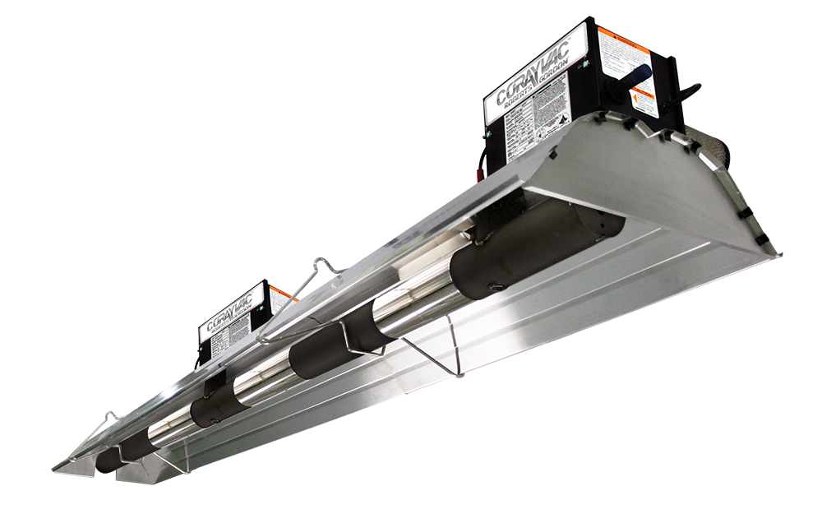
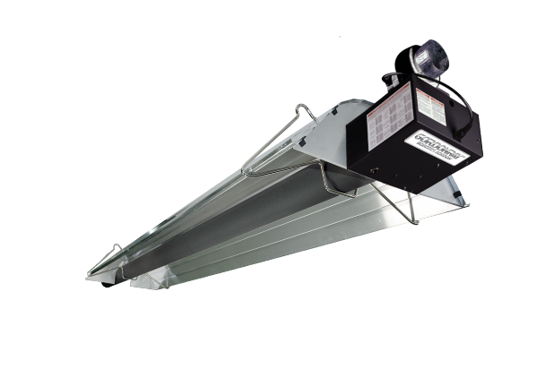
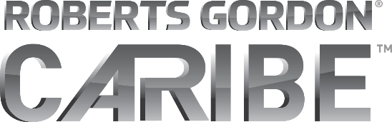
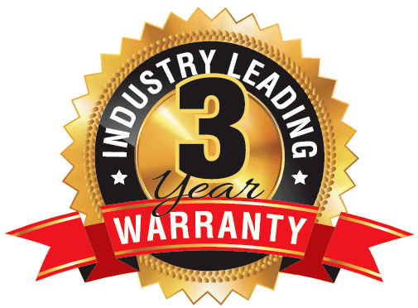
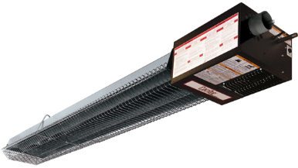

Notes:
Roberts Gordon heating equipment is offered under 4 different brand names. CORAYVAC, VANTAGE, GORDONRAY, and CARIBE.
Coravyac was originally introduced in the early 1960’s as the first low-intensity gas-fired infrared heating system on the market. It was then and remains today the premier product in the industry and as the most energy efficient, high-comfort heating method in the entire HVAC industry.
The VANTAGE family consists of 6 different premium unitary heaters.
GORDONRAY consists of 2 heaters that offer fantastic value.
The CARIBE is primarily designed and used for residential applications.
All Roberts-Gordon products are proudly made in Buffalo NY and qualify for all made in America or buy American requirements.
All Roberts-Gordon products are factory tested and are covered by an industry leading 3-year tip to tip warranty.

Slide 18
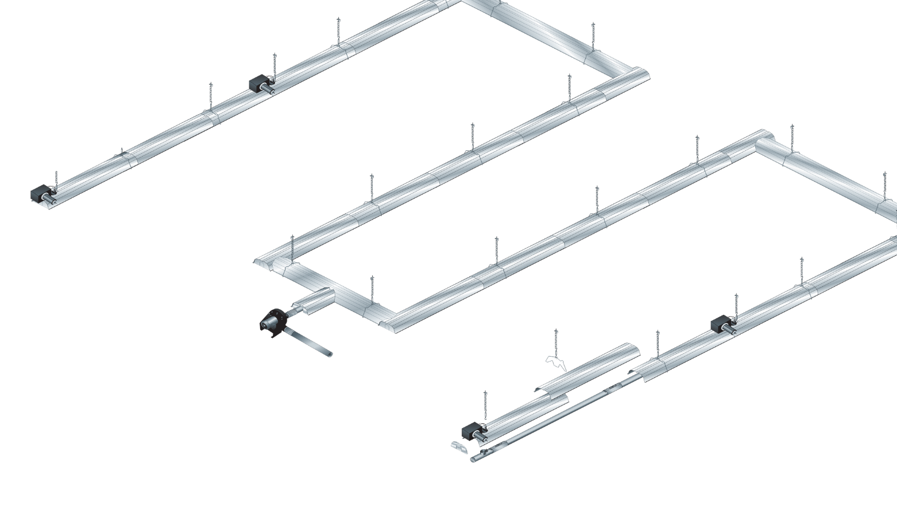
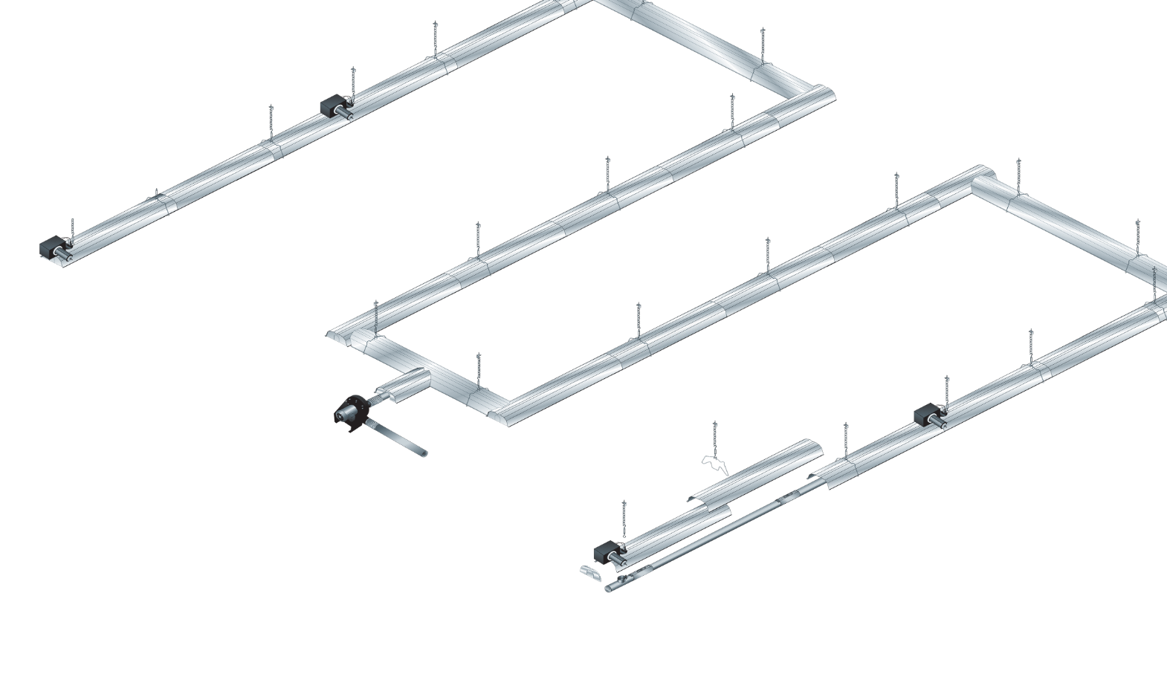
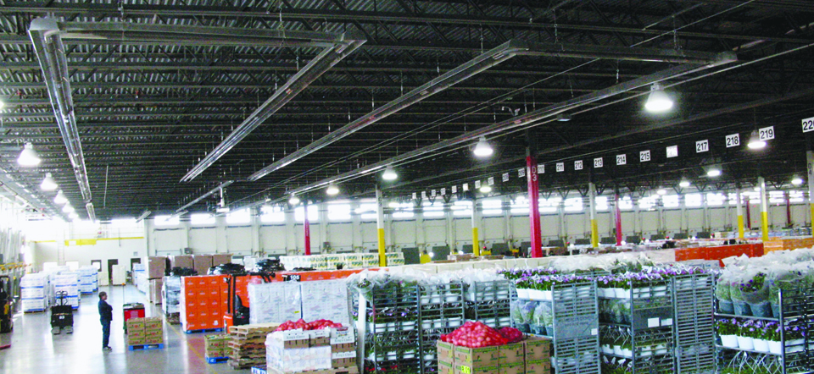
Premium Infrared Heating System
    Custom-engineered, burners-in-series system
    The most comfortable and efficient heating system in the HVAC industry!
    Ideal for medium to large commercial/industrial spaces
    Zero pressure regulator controls gas flow
Notes:
As mentioned, CORAYVAC is the premier product in the industry.
2. It is a vacuum system that incorporates burners in series of each other. The unique burners in series design provides a consistent temperature throughout the heating system to maximize comfort levels within the space. Corayvac can be designed as a condensing system and is known as the most energy efficient infrared heating system in the industry.
Ideal for large areas, CORAYVAC a fully engineered heating system that can be custom designed to fit almost any commercial/industrial application.
The total output of a single Corayvac system can be over 1 mBTU, thus drastically reducing the amount of flue penetrations compared to other heating methods. Only 1 flue penetration required per heating system.
Perhaps the most unique, and highly specifiable feature in a Corayvac burner is the zero pressure regulator. The zero pressure regulator controls the outlet pressure of gas by only allowing the flow of gas to occur when a negative pressure is produced by the vacuum pump.
CORAYVAC® is also the only in-series system in the industry with components to handle condensate when designed for maximum fuel efficiency
BTU’s: 20 (NG only), 40, 60, 80, 90, 100, 110 (NG only), 120 (LP only)
Direct spark ignition, fully automatic 3-try, 100% shut off in the event of a failure.

Slide 19
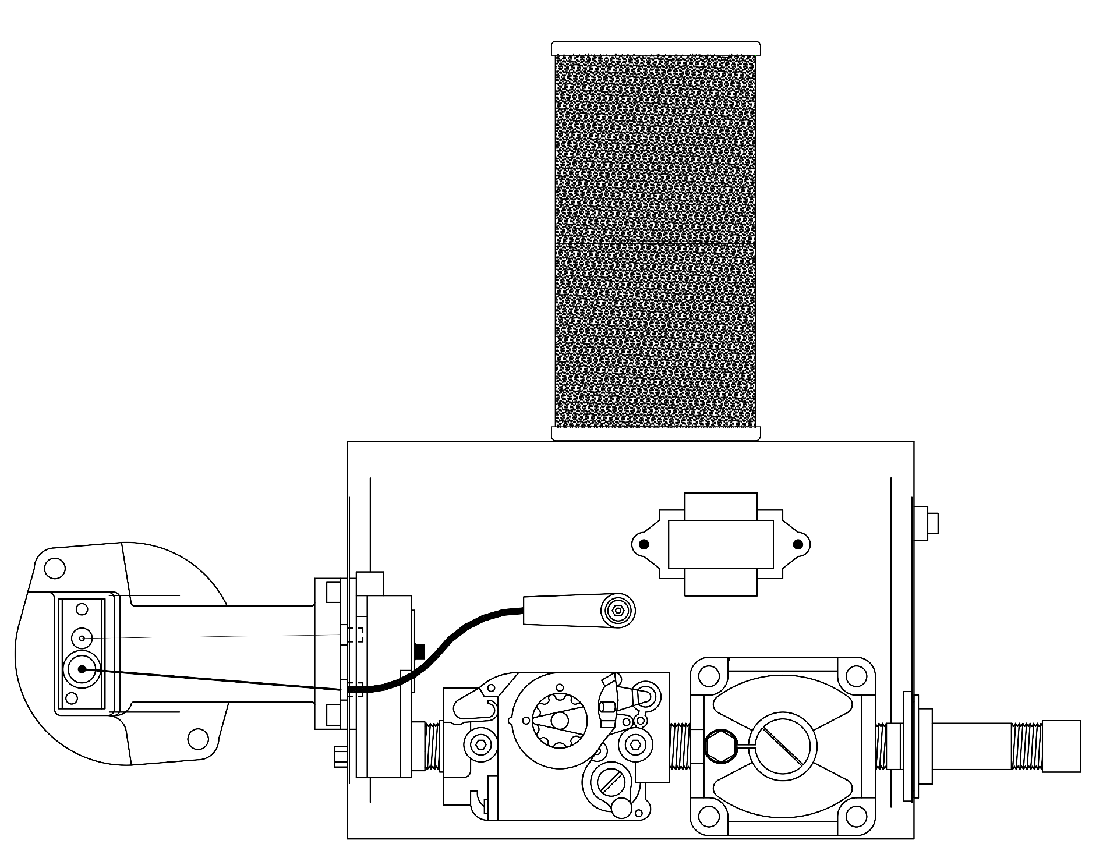






Burner Operation – Maximum Output
Notes:
Combustion air enters a CORAYVAC system through the end vent plate which is located on the very end of the heating system and through the CORAYVAC burner filter.
Because the gas pressure is regulated by the zero pressure regulator, the input of each Corayvac burner is dependent on system vacuum. Therefore over the normal range of operating vacuum, the air to gas ratio is always linear. With no vacuum, the zero regulator prevents gas flow.

Slide 20


Burner Operation – Minimum Output
Notes:
The zero pressure regulator is factory calibrated to maintain optimum combustion conditions at all times. Combustion conditions are unaffected by fluctuations in fuel pressure, vacuum loss, dirty air filters, changes in atmospheric pressure, wind velocity or other climate conditions.
It is the zero pressure regulator that also makes it possible to modulate a CORAYVAC system buy simply varying the speed of the vacuum pump via a variable frequency drive.

Slide 21
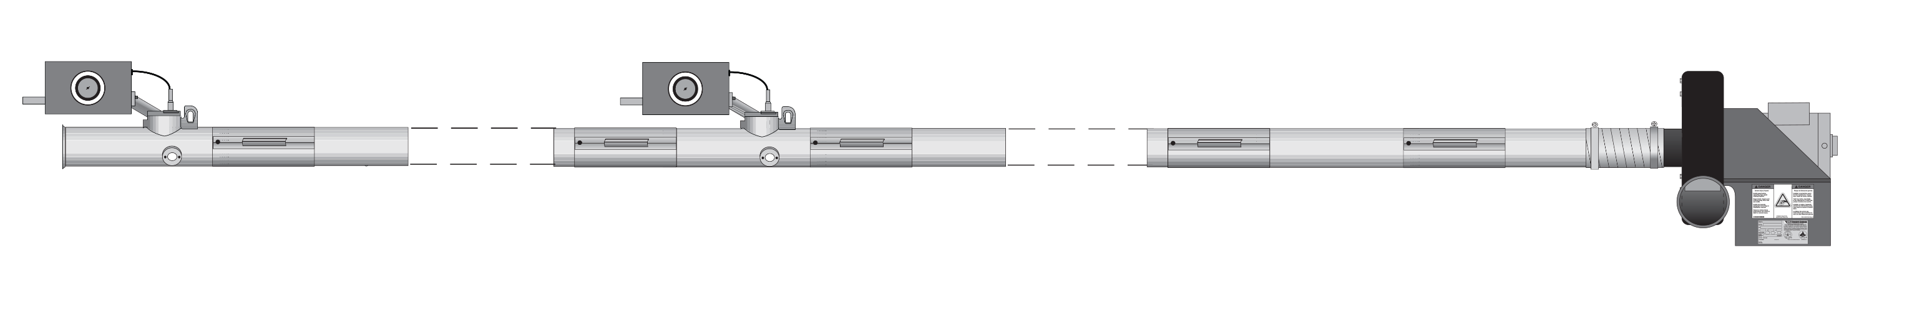

Operation
Notes:
Here we see a visual of an operating CORAYVAC system with 2 burners in series of each other. A vacuum pump is installed at the beginning of the system and pulls the products of combustion through the heat exchanger.
The burners in-series design of a CORAYVAC system allows for lower tube temperatures and even, comfortable heat patterns. And lower clearances to combustibles, compared to unitary heater which will free up valuable work space located directly underneath the radiant tubes.

Slide 22


Slide 23
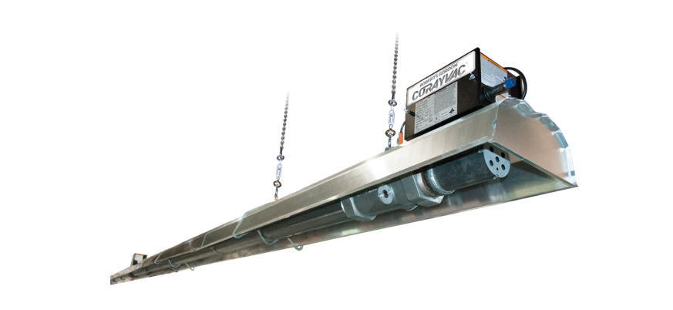
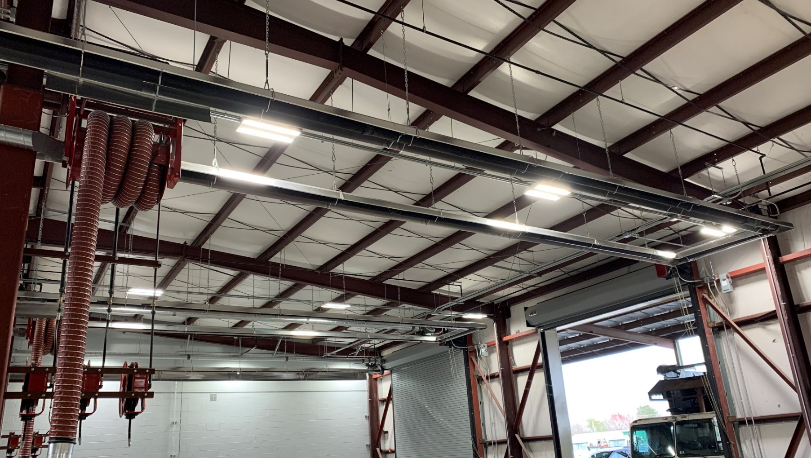
Heavy duty custom infrared heating system – CNG/LNG
Classic SF (Specialty Fuel)
    Designed for facilities where CNG/LNG fueled vehicles are repaired
    Certified by CSA to meet maximum tube temperature of 750°F (399°C) in accordance with NFPA30A 7.6.6
Notes:
According to NFPA 30A 7.6.6, surfaces of heating equipment can not exceed temperatures of 750° F in CNG/LNG vehicle maintenance repair facilities where major repairs are performed.
The CORAYVAC Classic SF infrared heating system is very similar to a normal CORAYVAC system, but with different design requirements, can efficiently and effectively heat CNG vehicle maintenance repair facilities while maintaining a surface temperature under 750° F.
The CORAYVAC Classic SF system has been approved by CSA to be in compliance with the 750° surface temperature requirement.
Like the original CORAYVAC system, CORAYVAC Classic SF is made up of cast iron combustion chambers and schedule 40 steel pipe that provides durability and longevity while maintaining system integrity.
All of the schedule 40 pipe is screwed or welded together for a tight fit to help eliminate leakage and to sustain tube temperatures.
The schedule 40 pipe is not offered by Roberts Gordon.

Slide 24

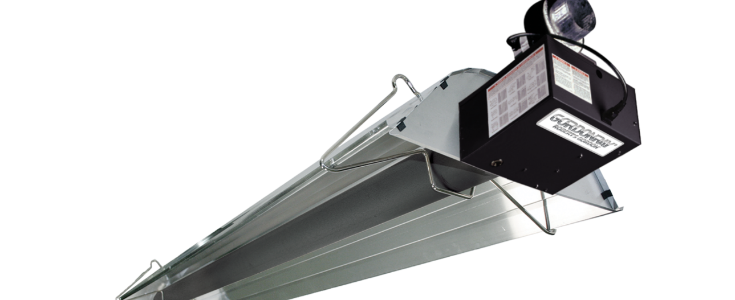
Unitary Heaters
Notes:
Our 2 levels of unitary heaters consists of 8 different models with a broad range of dynamic features that are available in a number of different outputs, lengths, and configurations.
Understanding the features of each model will help you determine the best solution for your customer.
As mentioned earlier, Vantage is our premium unitary heater series that are built to provide long-lasting energy efficient comfort.
The Gordonray series will also offer energy efficient comfort at a fantastic value.

Slide 25
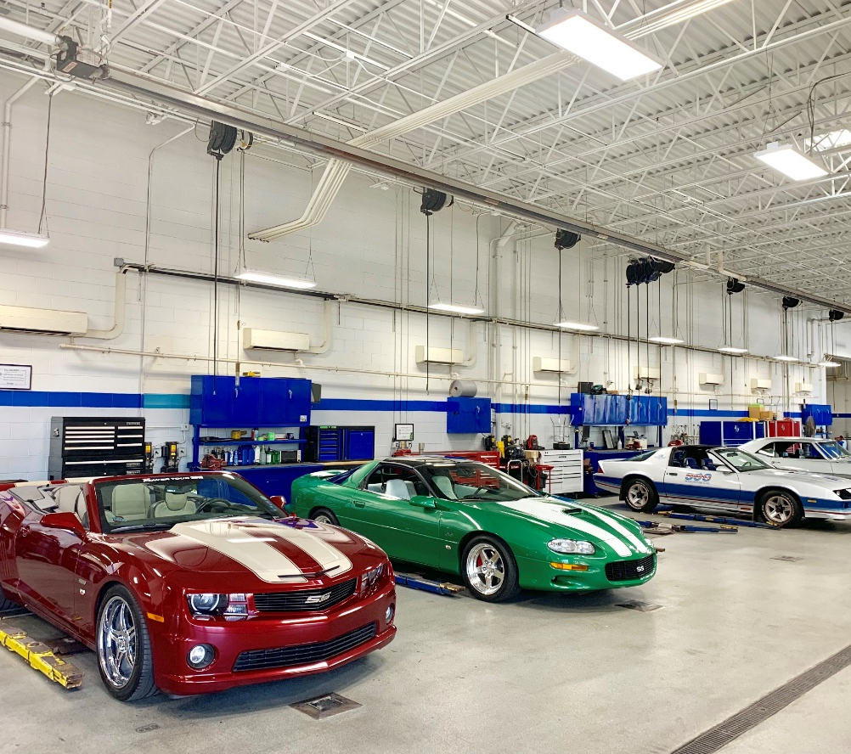

CTH2V
Premium Unitary Heater
Robust burner design with for increased longevity
External t-stat connection that can power a low voltage t-stat
Notes:
The Vantage CTH2V series is a robust single-stage positive pressure burner that is built for long-lasting trouble-free operation with a number of features that include an external LED burner operation light, an external thermostat connection with a 3rd terminal that provides power to energize a low voltage thermostat, a flame viewer window, and direct spark ignition.
Used successfully for years in demanding environment such as poultry and swine barns, automotive repair shops, and manufacturing plants just to name a few.

Slide 26
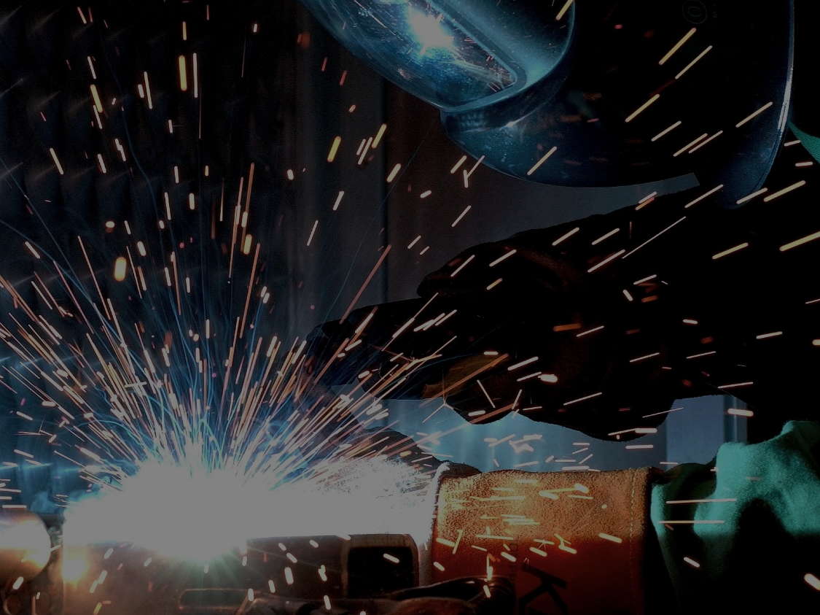
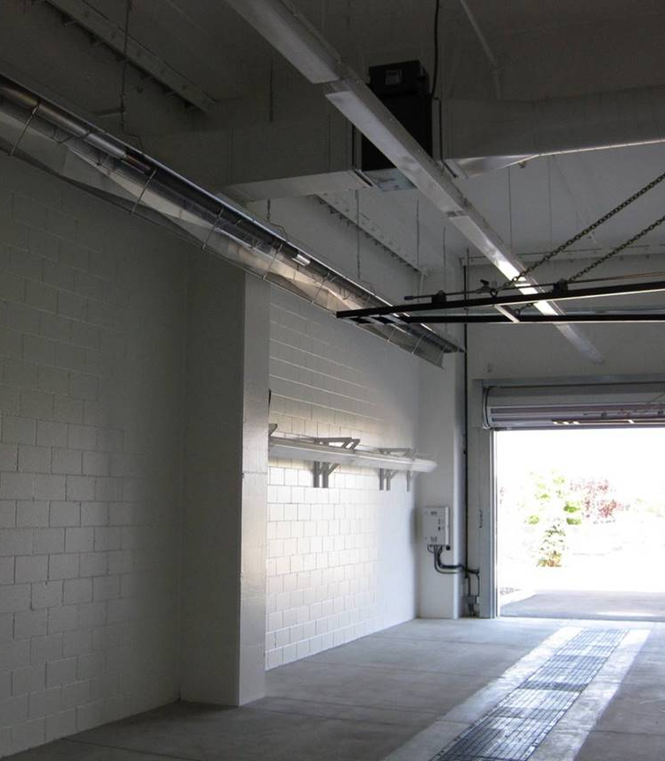

HEV
Heavy Duty, Industrial-Grade unitary heater for harsh environment applications.
Effective in high moisture environments with
durable components
Approved for indoor or outdoor installations ideal for patio heating or car wash)
Stainless steel gasketed fasteners for enhanced sealed burner box design
Notes:
The Vantage HEV is one of 2 heaters we manufacture that are approved for outdoor use. A step up from the CTH2V burner, this industrial grade heater features a spot welded enclosure with additional seals to keep out even more of the surrounding elements and stainless steel fasteners.
Capable of withstanding up to a 40 MPH wind, the HEV is ideal for heating harsh or corrosive environments such as car washes, outdoor patios, parking ramps, or heavy industrial applications.

Slide 27
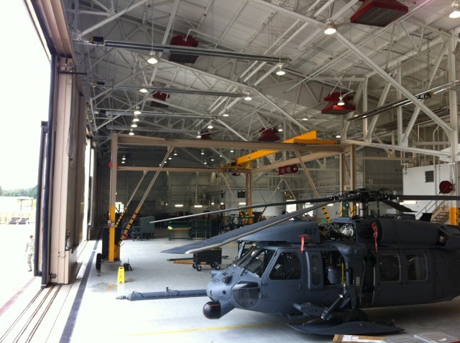

Modulating
Modulating unitary heater (Model: CTH3)
Fuel/air linkage technology modulates fuel and combustion air for increased fuel efficiency
Pre-programmed control is custom tailored for each
heater’s input and fuel type
Notes:
The Vantage Modulating heater offers energy efficiency and durability in a single package.
Equipped with a modulating gas valve and variable speed blower to operate at any input between 60% and 100% of the maximum firing rate.
An advanced control board controls modulation by adjusting both fuel and combustion air to increase efficiency and optimize combustion through the full range of inputs and provide the right amount of heat and consistent comfort throughout the entire heating season, moaking the Vantage modulating heater an ideal choice for users who want the most energy efficient, high comfort unitary heater.
System information and ease of service provided by comprehensive on-board diagnostics for fault and system status.
BTU’s: 80 (52 -80), 115 (75-115), 150 (100-150), 200 (130-200)
Lengths: min 20’-50’

Slide 28
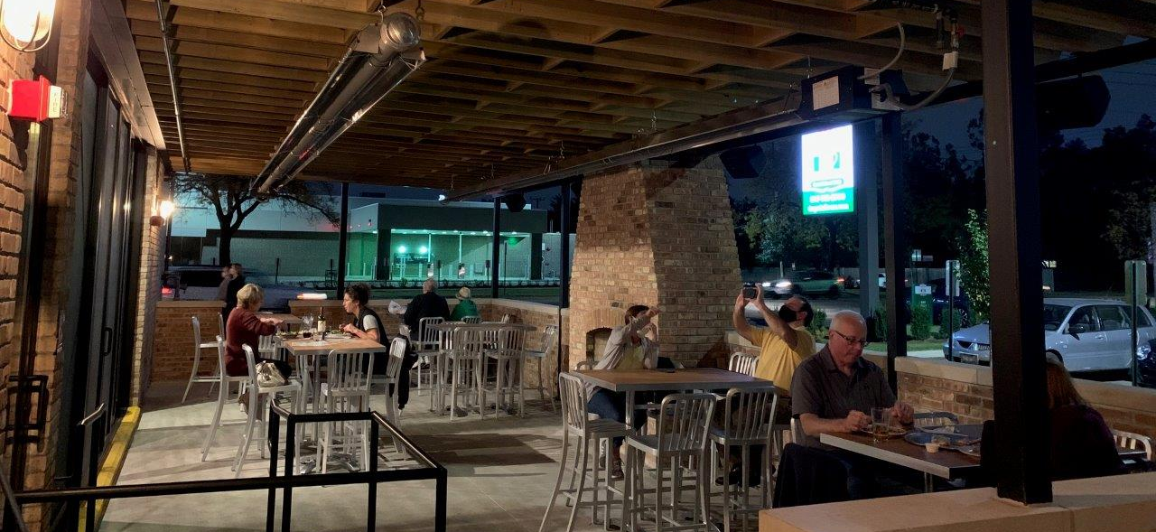
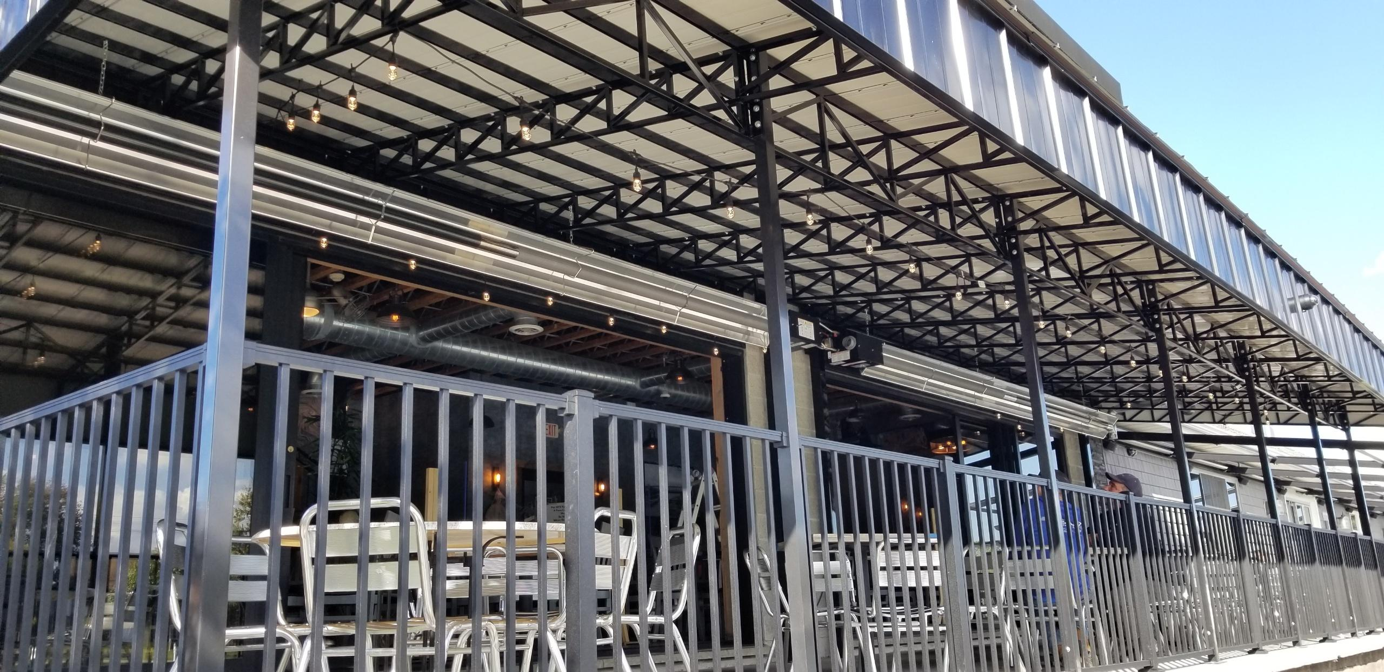

Harsh Environment Modulating (Model: HEM)
Industrial-grade enclosure combines fuel efficiency with durability
Maximize comfort levels and extend patio season
Approved for indoor or outdoor applications
Notes:
The Vantage HEM incorporates the same modulating operating characteristics as the Vantage CTH3 heater. However, the Vantage HEM features an industrial-grade weather resistant enclosure making it ideal for harsh environment applications or for an outdoor patio.
Like the Vantage CTH3, the HEM can be controlled via a zone sensor or modulating thermostat that would automatically adjust the output according to the heat demand. Or users can control the output manually via a potentiometer.
Although it is not ideal to use a zone sensor or thermostat on a restaurant patio that is not enclosed because it is not possible to maintain space temperature if there is nothing to hold the heat in the space. However, using a potentiometer for such an application is an ideal solution. Controlling the output via a potentiometer dial allows users to manually adjust the heat output thus maintaining high comfort levels for patrons to extend your outdoor patio season!
The potentiometer control can be purchased directly from Roberts-Gordon or supplied by others.
BTU’s: 80 (52 -80), 115 (75-115), 150 (100-150), 200 (130-200)
Lengths: min 20’-50’

Slide 29
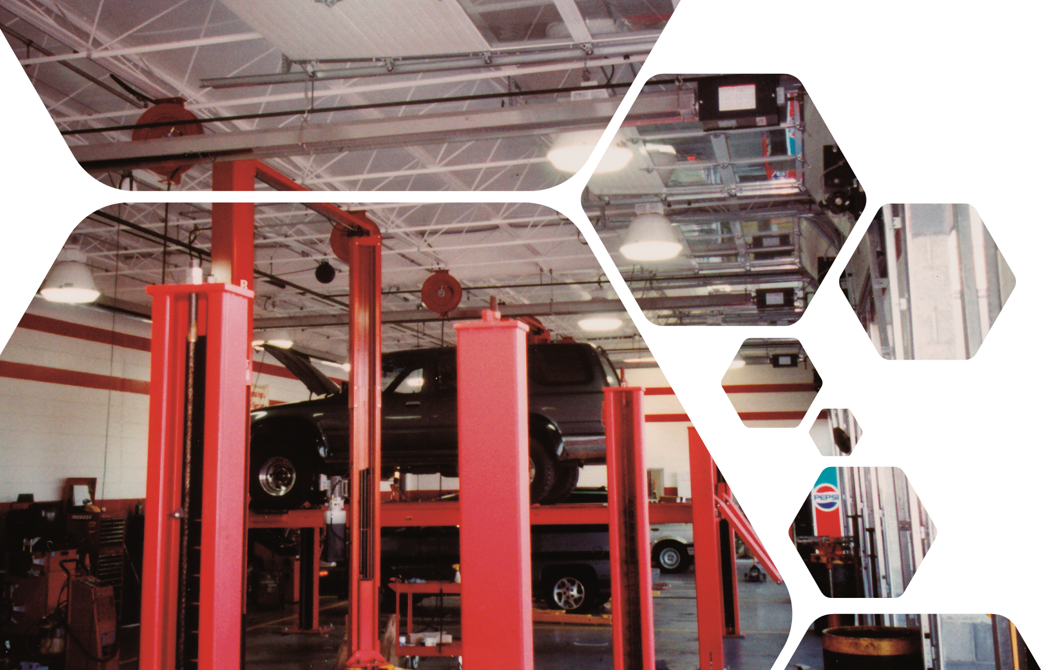
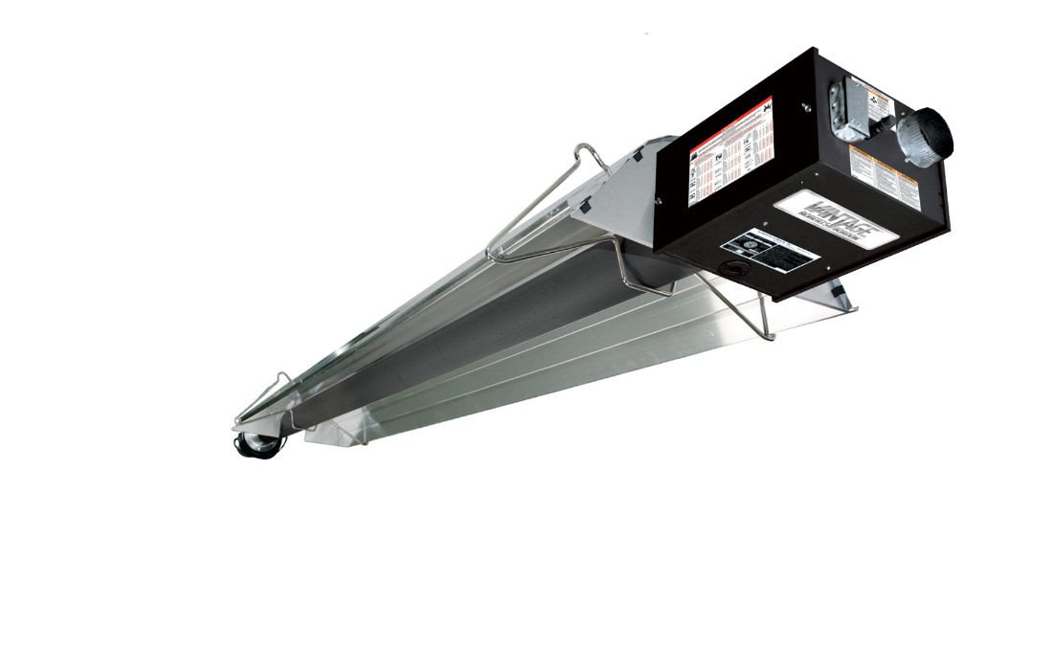
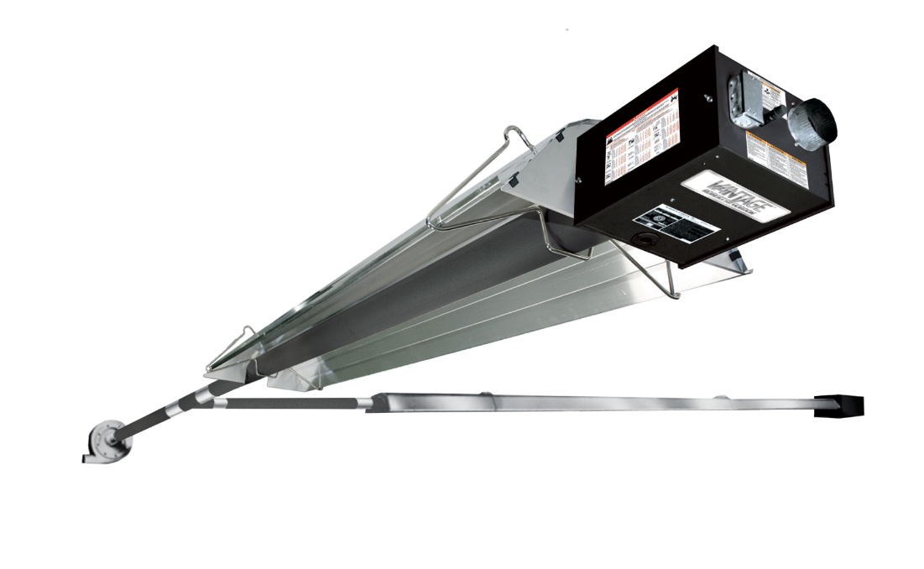
CTHN
Negative Pressure Unitary Heater or Multiburner System
Unitary
Multiburner
Notes:
The final product under the Vantage series of heaters I the Vantage CTHN or negative pressure heater.
The combustion blower for Vantage CTHN heater is located on the end of the heat exchanger and pulls the flame down the tube.
Our only negative pressure unitary heater, the Vantage CTHN offers better flame performance and better heat distribution throughout the length of the heat exchanger.
This unique design allows the Vantage CTHN heater to be a stand-alone heater, or connect multiple CTHN heaters to a common manifold tube and operate all heaters simultaneously via a single vacuum pump. We call this the Vantage CTHN multiburner heating system.
The Vantage multiburner system can be custom designed and can combine up to 16 burners or up to 1.6 million BTU’s on a single vacuum pump, which of course would be only a single exhaust penetration.

Slide 30
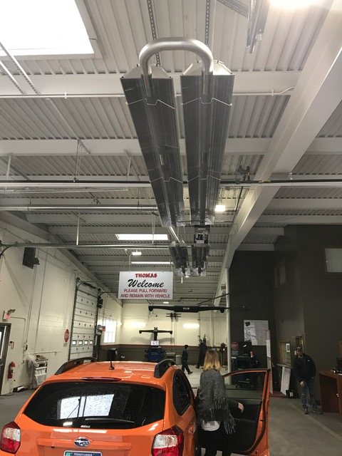

Two-Stage Unitary Heater
DF
Two-stage operation uses an algorithm output that will vary based on load conditions
LED burner status lights that indicate high or low operation
External t-stat connections for easy installation
Notes:
Our Gordonray series features 2 models that offer great value for your budget consensus customers.
The Gordonray DF, or “Dual-Fire” features a two-stage burner. The two-stage gas valve is controlled by a two-stage thermostat that will force the flame into high or low fire. An external LED burner status light easily indicates which firing stage the heater is in.
The DF series also features an external thermostat connection located on the rear of the burner for easier installation
Direct spark ignition.
BTU’s: 80, 100, 125, 150, 175, 200 - all NG only
Lengths: min 20’ (9m), max 80’ (24m)

Slide 31
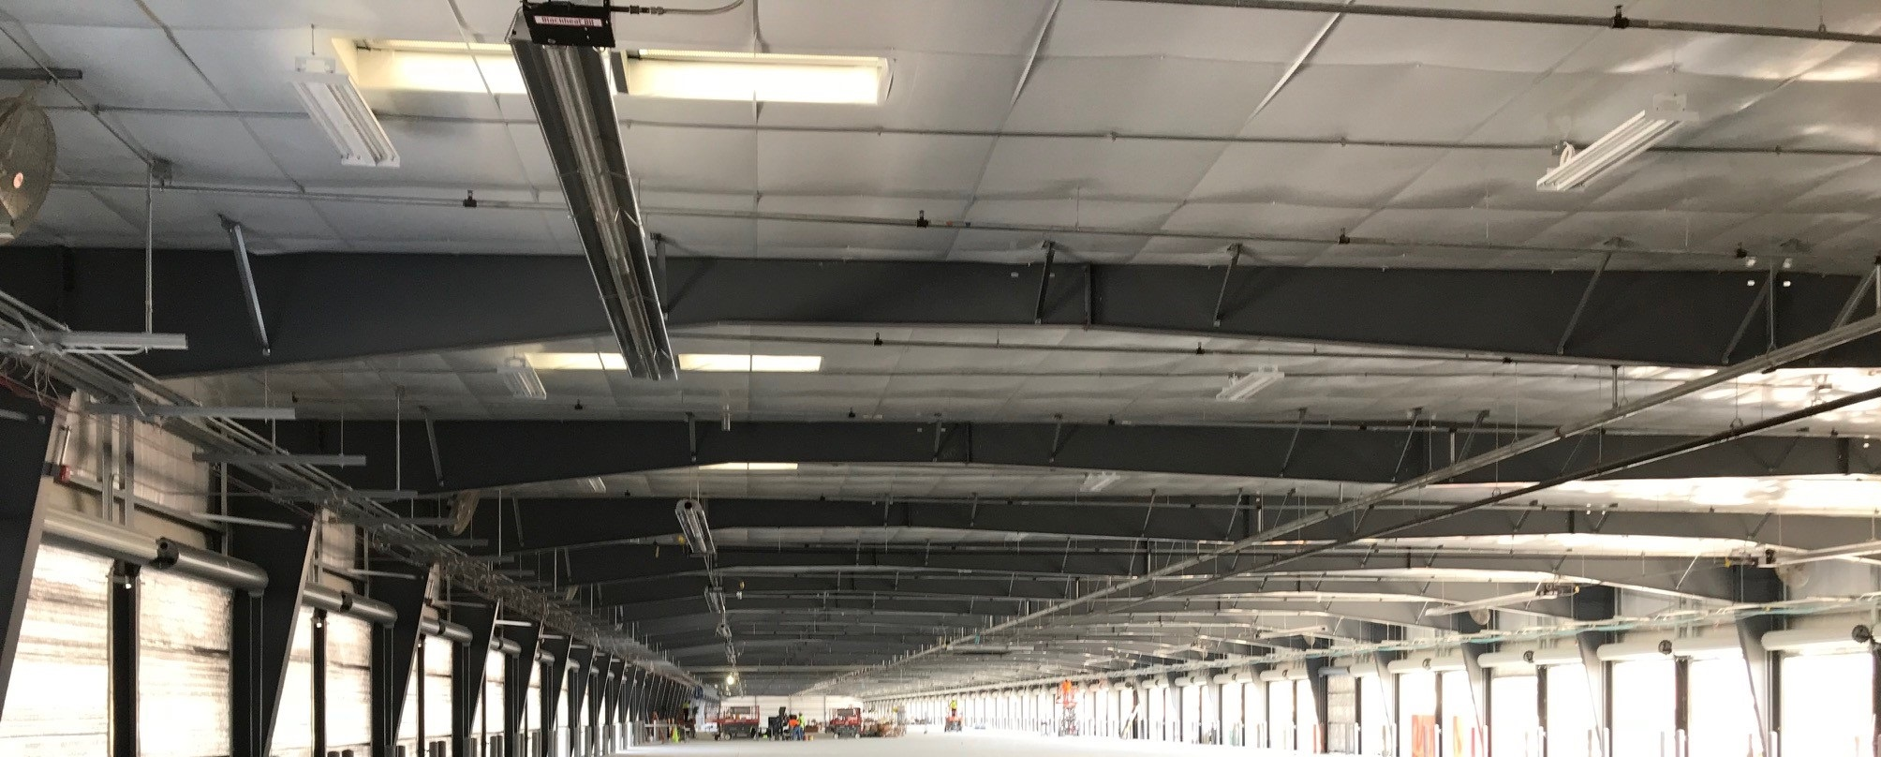

®
BH
Economical Unitary Heater
Easy serviceability through hinged door design
Priced for budget-conscious customer
Clean, quiet, draft free comfort
Notes:
The Gordayray BH has long been known as an economical heater that offers long-lasting energy efficient performance.
A single-stage and positive pressure heater, the BH is built and designed with the same heat exchanger, reflector, burner enclosure material and powder coat finish as the rest of our product offering
Offering much more than your typical economical heater. The Goronday BH is Designed for the less demanding environment such as auto-repair shops, commercial retail, or warehouses just to name a few.

Slide 32

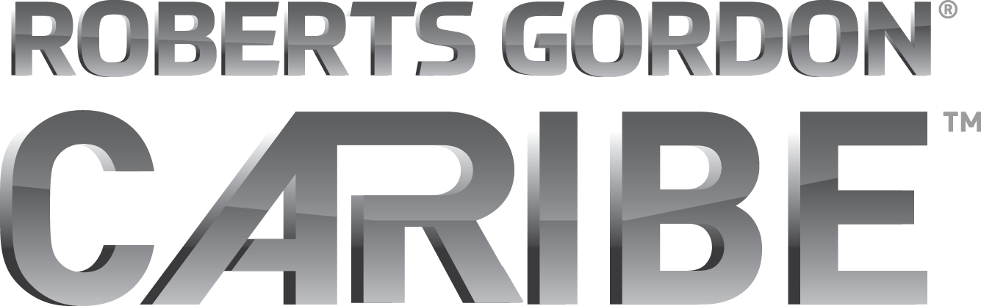
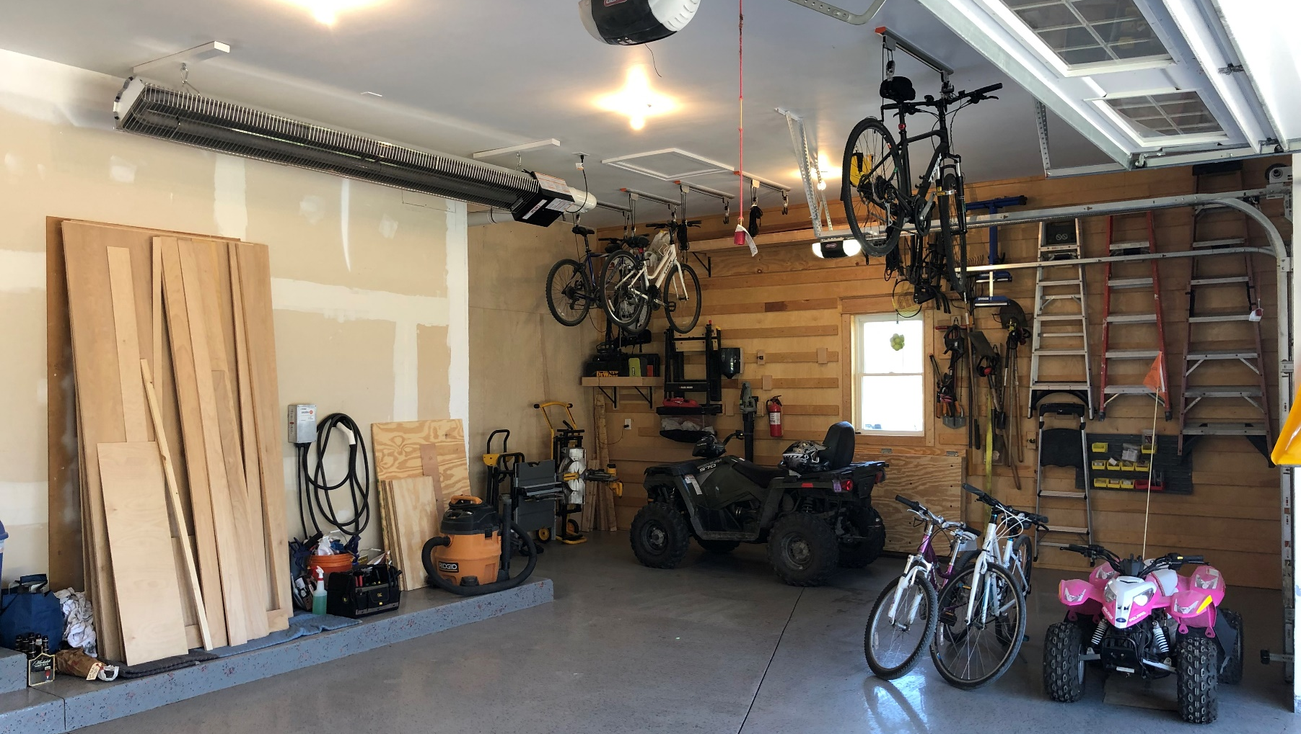
®
Light Commercial/Residential Applications
Compact U-tube design
Easy to install and transport - Heater is factory assembled and shipped in one box.
One building penetration - Balanced flue design for both exhaust and intake air.
Protective grille included on select models.
Notes:
Approved for residential applications, The Carbie heater is available in 30, 40, or 50,000 BTU’s.. – Ships completely assembled from the factory, the Compact U-tube design provides even heat distribution throughout the overall length of the heater. The Caribe is also available with a concentric vent kit and includes a 24v thermostat.
The Caribe is ideal for residential garages, barns, or small work shops.
BTU’s: 30, 40, 50
Lengths: min 8’ , max 11’ 6”

Slide 33
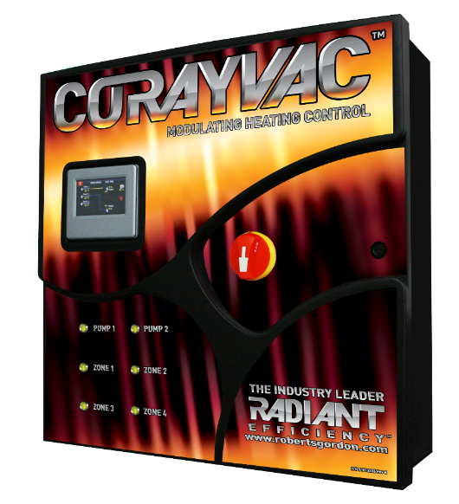
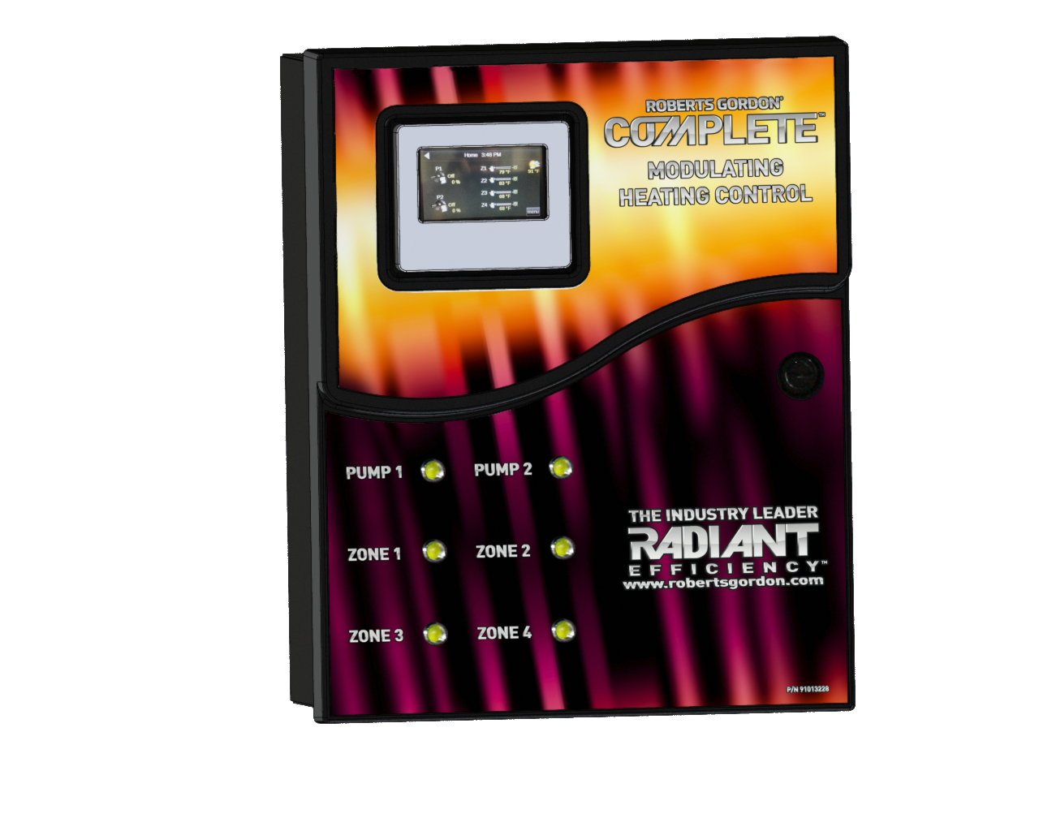
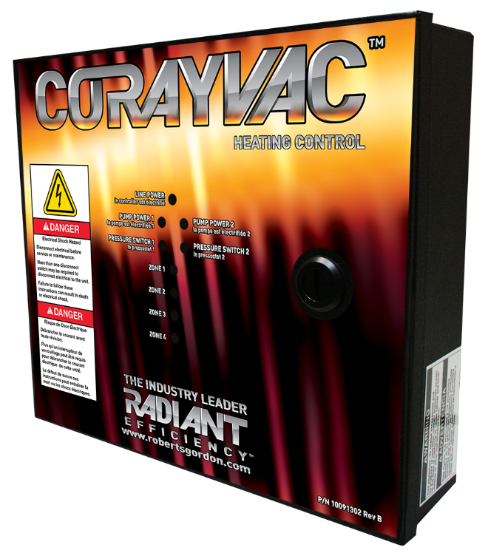
Control Panels
CORAYVAC® Modulating
Heating Control
COMPLETE® Modulating
Heating Control
CORAYVAC® Heating
Control
Notes:
33
We offer 3 types of control panels, each with their own unique features.
CORAYVAC® Modulating Heating Control is capable of controlling up to two CORAYVAC systems with four zones or any combination of unitary heaters. The central control panel will incorporate the touch screen which is used to program all of the satellite panels networked together. The VFD is located inside the panel, for easy programing, troubleshooting and servicing.
Please note that if the vacuum pump wiring is longer than 100’, load reactor must be provided.
- COMPLETE™ Modulating Heating Control is used to control the COMPLETE Modulating heater, COMPLETE CTHN Multiburner systems, including a non modulating CORAYVAC system and any unitary heater. It incorporate all of the features of CORAYVAC® Modulating Heating Control less the VFD.
- CORAYVAC® Heating Control is capable of providing on and off control of up to two CORAYVAC or COMPLETE CTHN Multiburner systems with four zones. This control functions based off of thermostats for each heating zone.

Slide 34


Modulating Heating Control Setup
BMS Operator’s Workstation
(Optional)
Zone 1 Sensor
S
CRV
Burner
CRV
Burner
Vacuum
Pump
CRV
Burner
S
Zone 2 Sensor
CRV
Burner
Central controller w/VFD (located inside controller)
Notes:
- The CORAYVAC® Modulating Heating Control is capable of controlling up to two CORAYVAC systems and up to four heating zones or any combination of unitary heaters. The central control panel has a touch screen which is used to program all of the satellite panels networked together. The VFD used to vary the speed of the vacuum pump is located inside the panel, for easy programing, troubleshooting and servicing.
This layout shows a single central controller operating a single vacuum pump and 2 heating zones.
The COMPLETE™ Modulating Heating Control, not shown here, is smaller in size and does not come with a VFD. The Complete controller is used to control unitary heaters, a non-modulating CORAYVAC system, or the Vantage CTHN multiburner system. Like the CRV modulating control, the complete control can control up to 2 vacuum pumps and 4 heating zones.
Both the Corayvac and Complete controllers are capable of operating as a stand-along control, or can be tied to an existing building management system.

Slide 35




Modulating Heating Control
Available Built-In Communication Ports:
BACnet over ARC156
BACnet MS/TP
BACnet PTP
BACnet over IP
BACnet over Ethernet
*LonWorks requires card sold separately
Notes:
The CORAYVAC and Complete Modulating Heating Controls feature built-in communication ports to connect to a Building Management System (BMS) using any of today’s four leading protocols: BACnet®, Modbus®, N2, and LonWorks®. The point mapping to all of these protocols can be pre-set, so that the protocol and baud rates desired are easily field-selected without the need for any additional downloads or technician assistance.

Slide 36

Heating Control Setup
Zone 1 Thermostat
T
CRV
Burner
CRV
Burner
Vacuum
Pump
CRV
Burner
T
Zone 2 Thermostat
CRV
Burner
On/Off Operation ONLY
Notes:
Another control option is the CRV Heating Control.
Used for non-modulating CRV systems or Vantage CTHN multi burner systems, the CRV heating control can control up to 2 vacuum pumps and 4 heating zones.
This stand-alone only controller requires no programming and minimal setup.

Slide 37





Accessories
Side reflectors
Protective grilles
Lower Clearance Shield
U-tubes and elbows
Vent caps
Thermostats
And More!
Notes:
37
- Lastly, Roberts-Gordon offers a number of accessories for a variety of reasons such as a low-clearance shield that will reduce the clearances of combustibles directly below the heater, a reflector side shield that directs the radiant heat downwards and inwards for heaters that might be installed along a side wall, protective grilles, thermostats, u-tube or 90 degree bends, and more!

Slide 38
Thank you!
Dan Schindler
Market Development Manager
Dan.Schindler@rg-inc.com
716.551.7910
Notes:
This concludes this lesson on the Roberts-Gordon product offering. If you or your team requires additional training on our products, please do not hesitate to give us a call!

