Slide 1
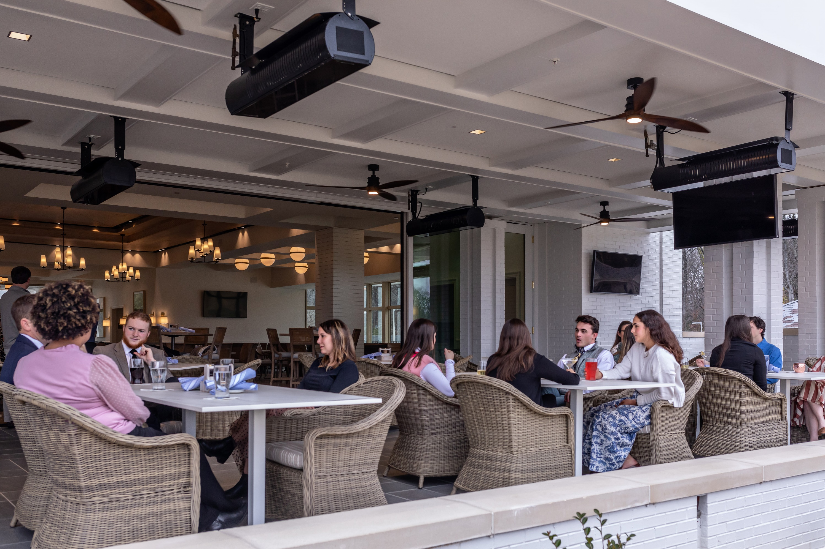

Gas High Intensity Infrared Patio Heaters

Slide 2
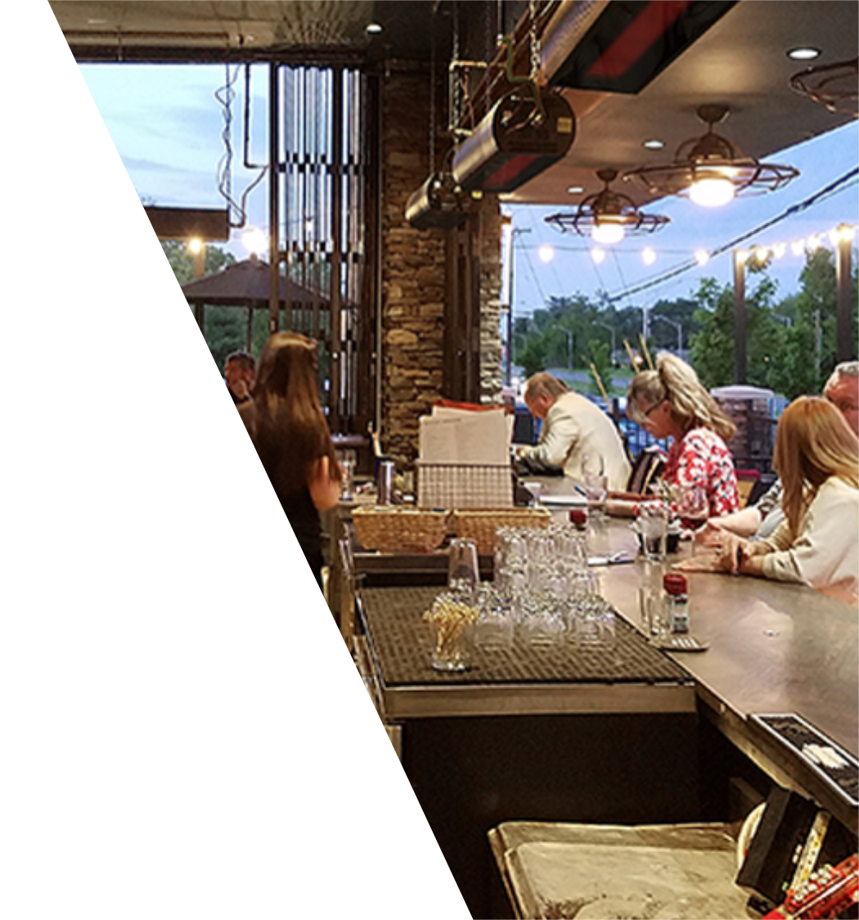

GGE Benefits
Long-lasting performance – withstands extreme rain, snow, even winds up to 40 mph
Gentle uniform comfort – spreads heat evenly and provides a soft red glow of infrared energy
Lower energy costs – saves energy by heating people, floors and objects, not the air
Expanded outdoor seating capacity – more patrons means more revenue
Saves valuable floor space – ceiling or wall mounted under awnings, patios, and covered areas
Quiet operation – no running fan to interfere with guest experience
Environmentally-conscious – NOx emission levels as low as 15 parts per million adjusted for 3% O2

Slide 3

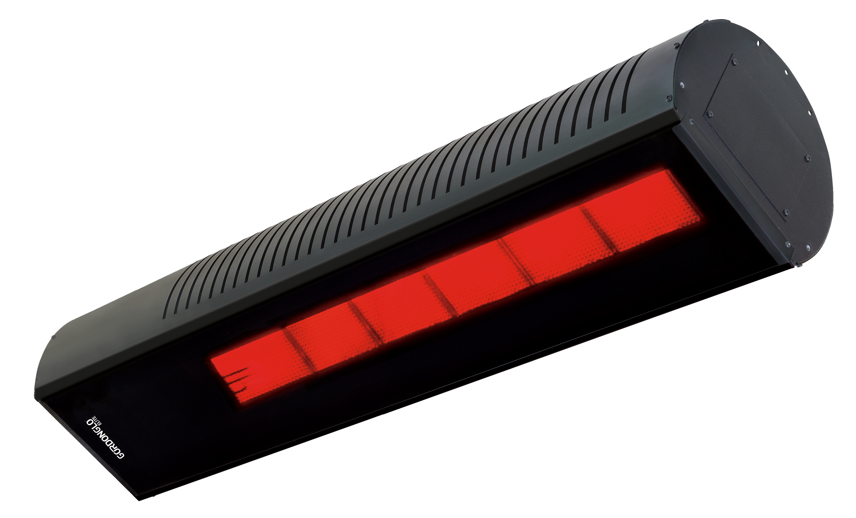

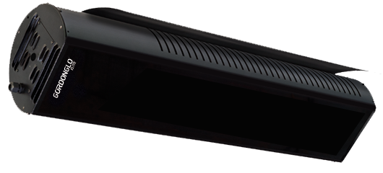
GGE Features
Attractive, sleek design complements outdoor or indoor decor
Btu/h inputs (High/Low)
35,000 (24,000) or 50,000 (34,000) Available in NG or LP
Indoor/outdoor rated
Durable, weather resistant construction
Zinc plated materials with 3 mil black high temperature powder coat finish
High efficiency, black tinted ceramic glass protects burner and helps improve performance

Slide 4
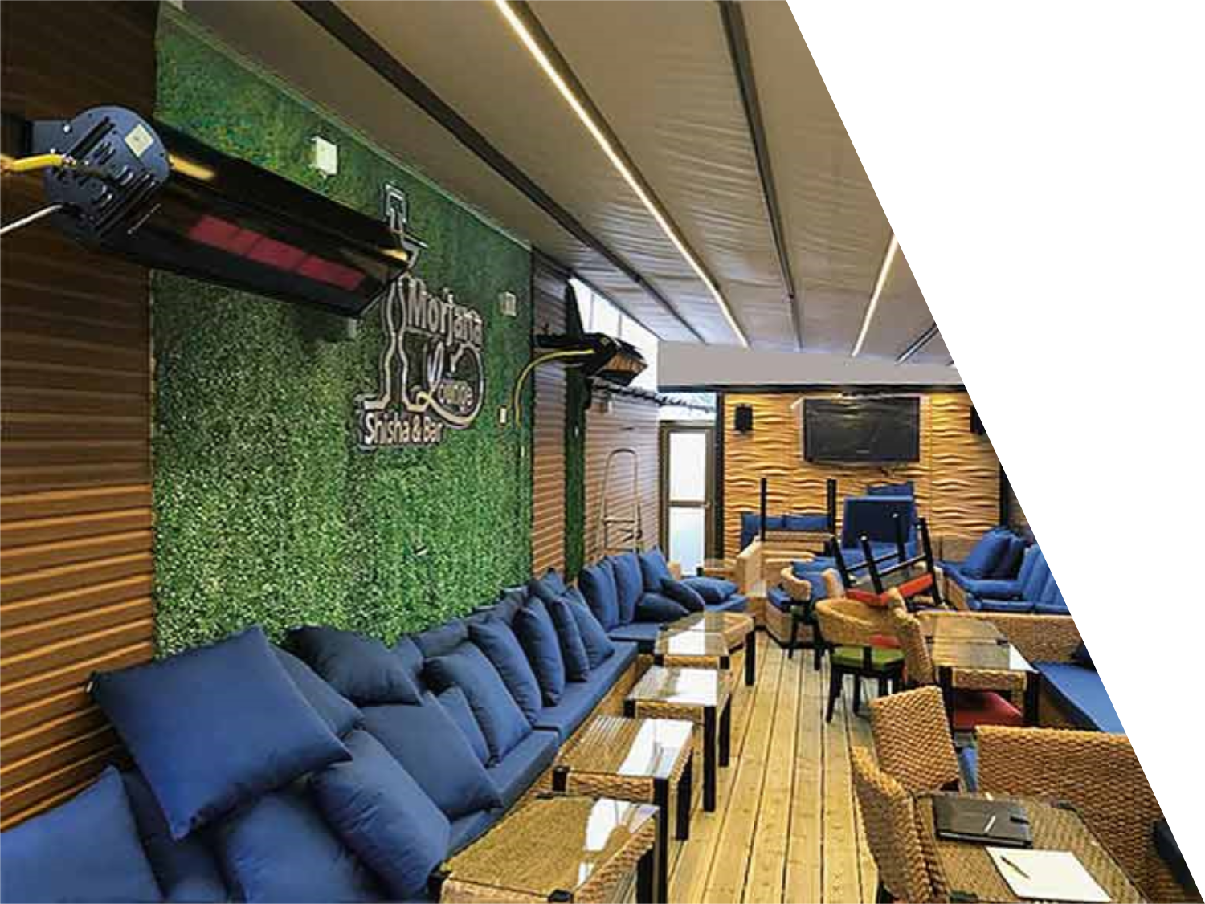
More Features
Single (with factory-supplied jumper wire) or two-stage operation
Potted (water resistant) direct spark ignition module
3-year warranty on burner assembly/1-year on controls
Horizontal or angle mounting up to 60°
CSA design certified

Slide 5
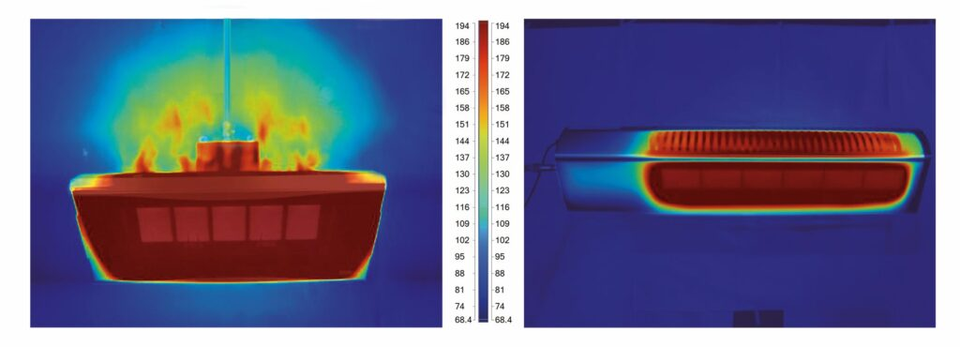
Competitive Edge
Competitor
Installation at 58° angle limits flexibility
Flames not totally enclosed
Flame outside heater is potential safety issue if heater mounted too close to combustibles
GORDONGLO™ Elite
Burner design helps prevents heat rollout during harsh wind conditions, helping eliminate exposed flames outside heater
Even when mounted at a 60° angle, burner flame is enclosed

Slide 6
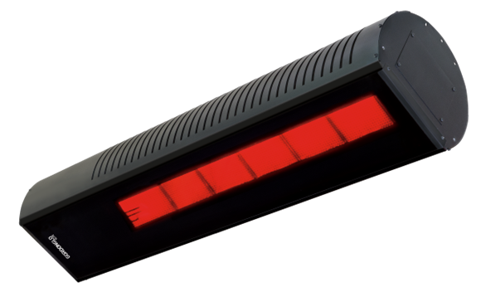
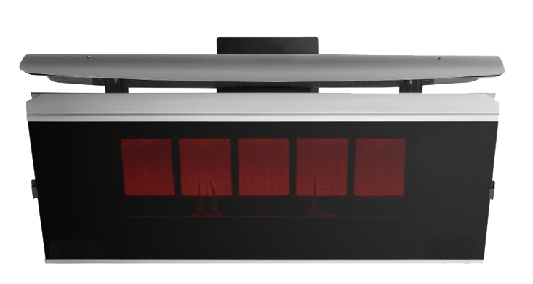
GGE vs. Competitor
GORDONGLO™ Elite
Withstands winds up to 40 MPH
Can be installed outside without protection and completely exposed to the elements
Can be installed at 0°, 15°, 30°, 45°, 60° allowing maximum flexibility
Two-stage operation standard
Competitor
8 MPH wind resistance
Must be protected from rain when installed outdoors
45° angle mounting only
Single-stage operation only

Slide 7
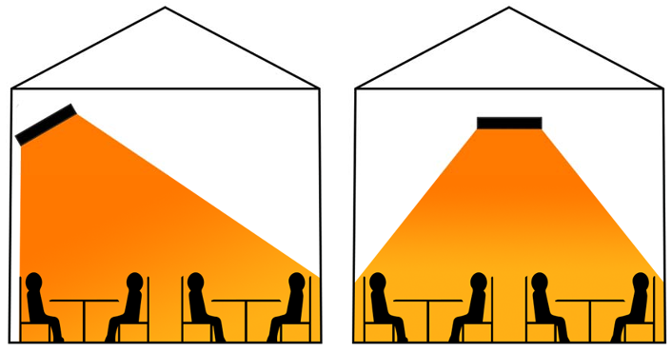
Layout Considerations (Approx. Heat Coverage)
Notes:
As you increase the angle, the radiant output to the occupied level decreases.
Recommended to follow these basic guidelines to ensure proper heat coverage

Slide 8
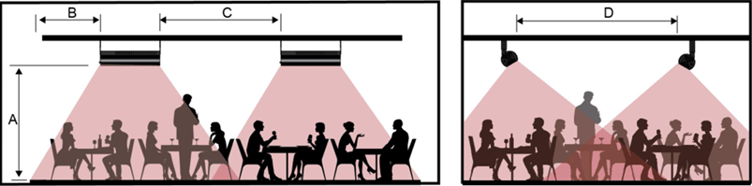
Layout Considerations (Heater Spacing)

Slide 9
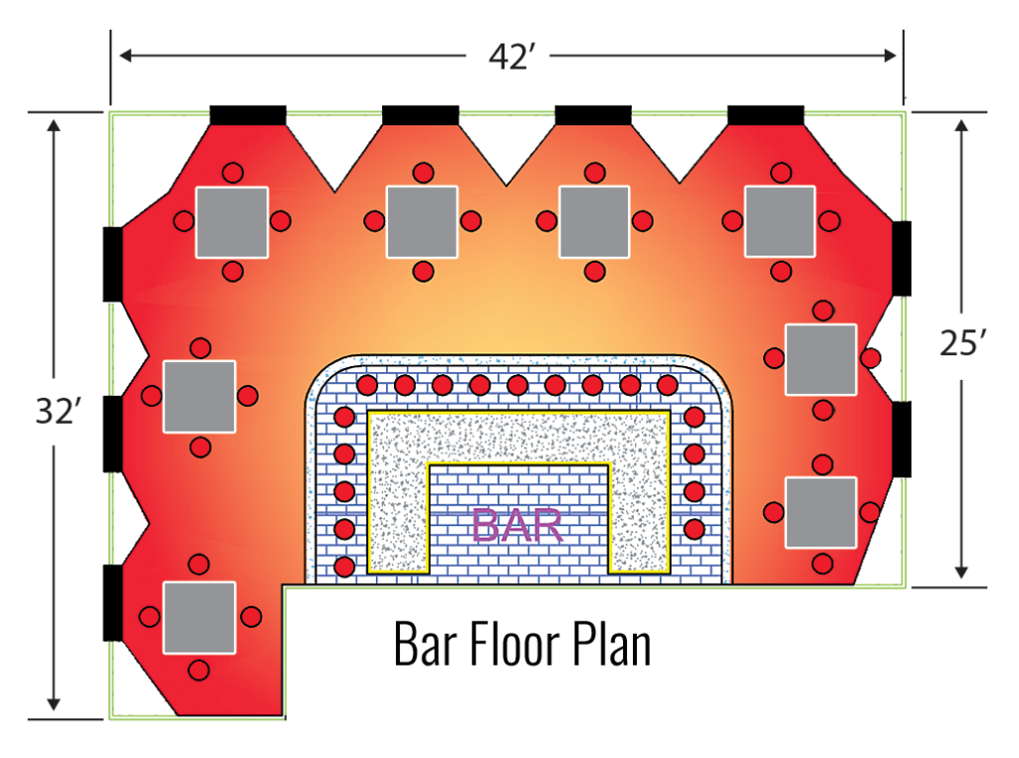
Layout Example
GORDONGLO™ Elite
This layout shows how nine heaters (the black rectangles) can heat an entire outdoor patio.

Slide 10
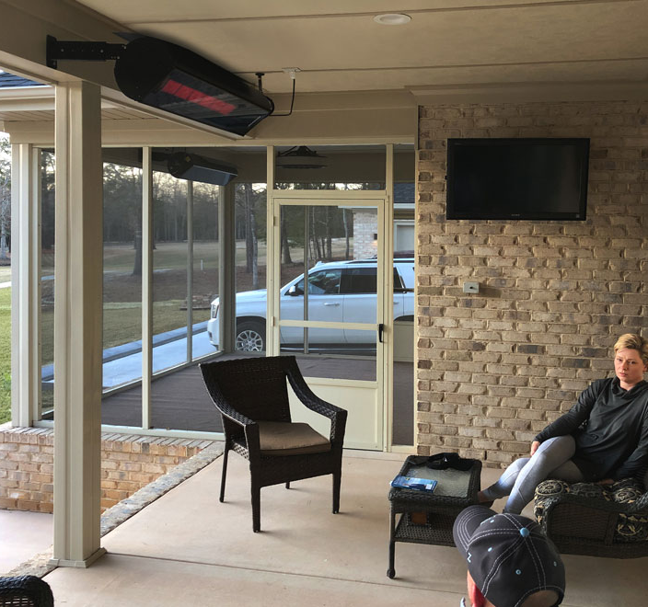
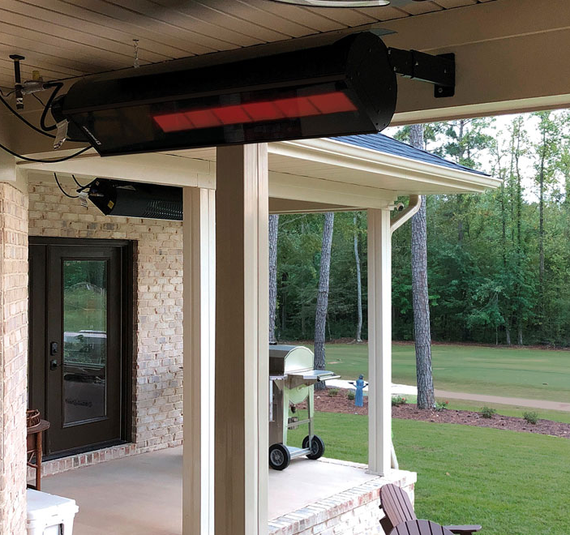
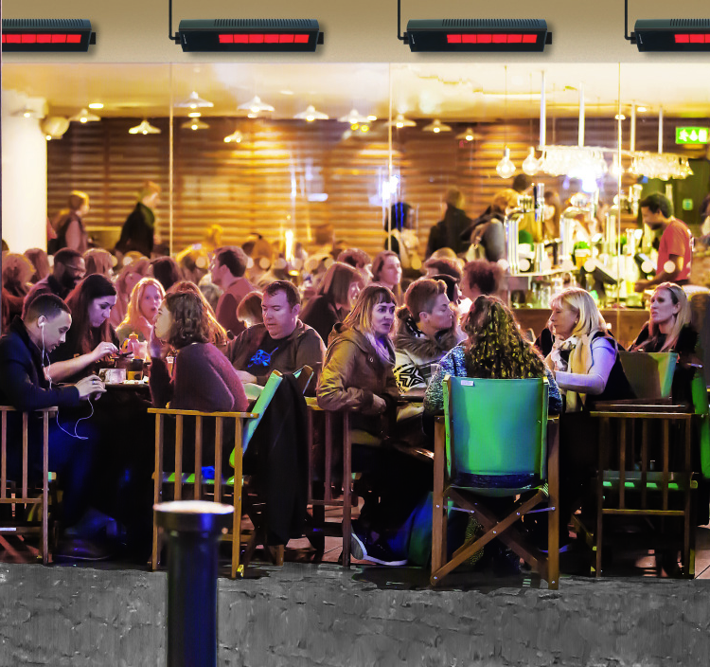
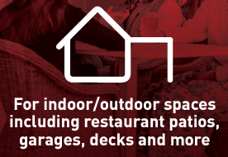
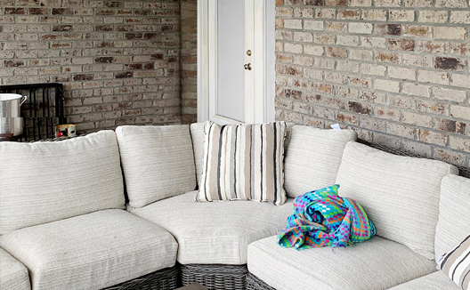
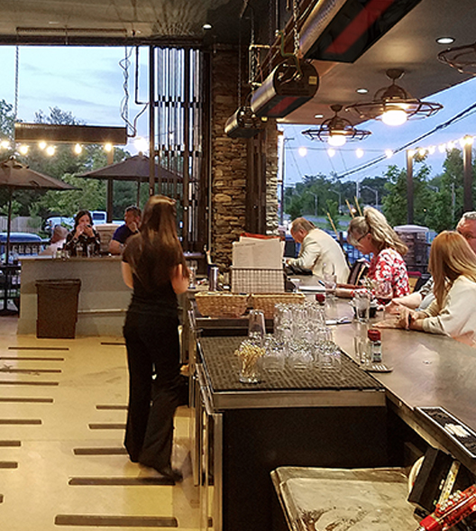
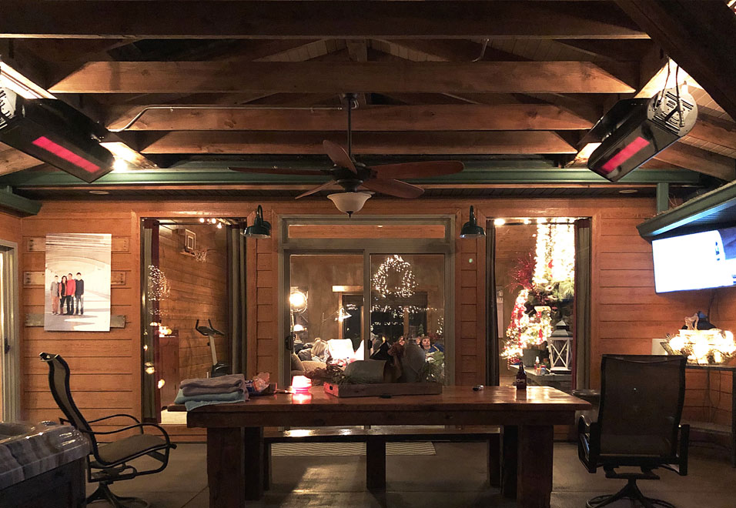
Applications
Hospitality
Patios/Decks
Residential
Driving Ranges
Garages
Workshops
Restaurants

Slide 11
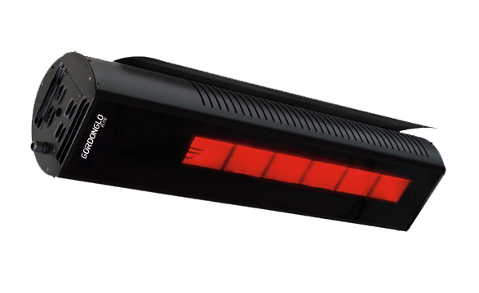
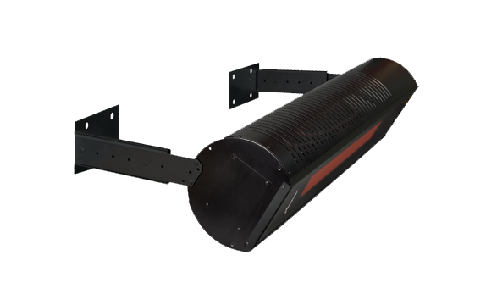
Accessories
Heat Shield
Mounting Bracket
Reduces clearances as low as 10” above heater for applications with limited overhead space
For wall or ceiling mounting at varying angles

Slide 12
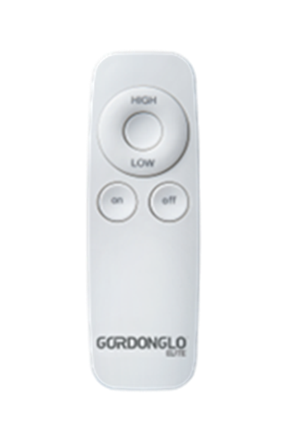
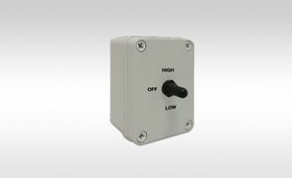
Controls
Two-Stage Remote Control
Control Switch
One per heater controls multiple heaters
(Wireless included on select models)
For individual or zone control using three-position switch or thermostat

Slide 13

Thank you!
Dan Schindler
Market Development Manager
Dan.Schindler@rg-inc.com
716.551.7910
Notes:
This concludes this lesson on the Roberts-Gordon product offering. If you or your team requires additional training on our products, please do not hesitate to give us a call!

