Slide 1
New Electric Products Review
Docked Trailer Heater (DTH)
Electric Infrared Heater (GGEL)
Compact Electric Unit Heater (EUHC)
Air Curtains
Notes:
100% efficient---no loss of energy in conversion process

Slide 2

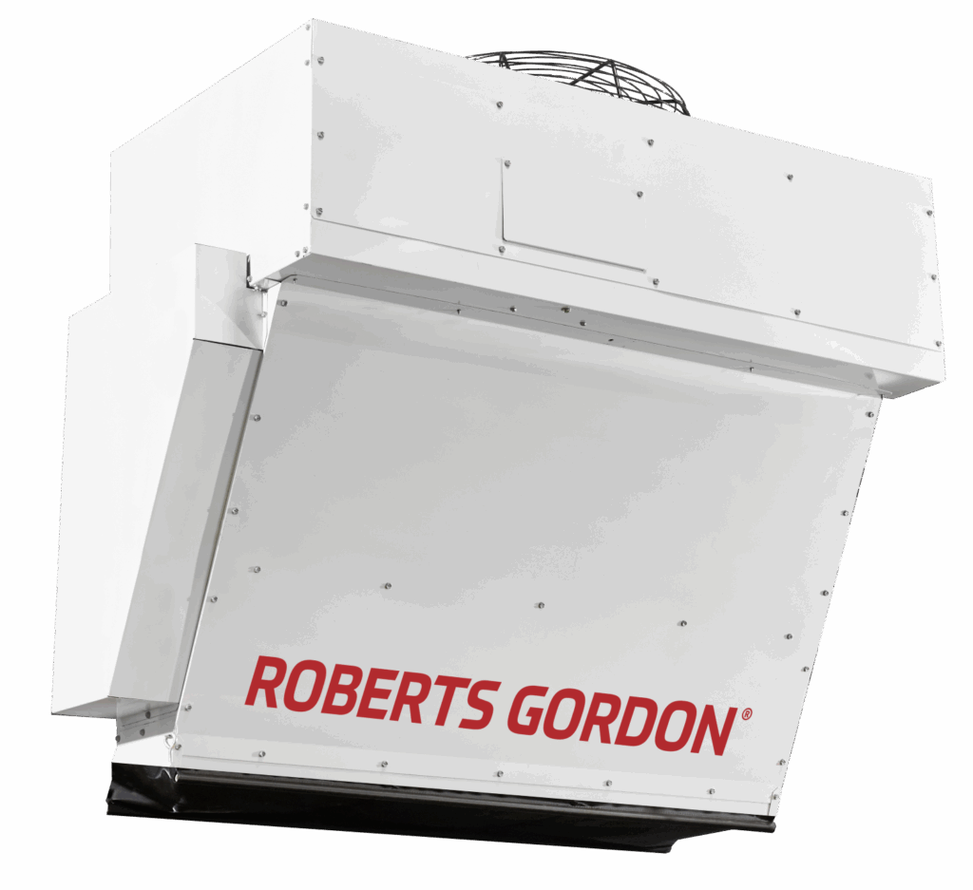
Model DTH
Docked Trailer Heater
Launched November 2025

Slide 3

When People are Cold…
Fatigue & Pace Slowdown
More breaks & fewer tasks
Turnover Risk
Uncomfortable thermal conditions top driver of dissatisfaction in dock roles
Physical Performance Loss
Reduced dexterity, reaction time, & focus

Slide 4

…Productivity Suffers
Slow Trailer Turns
Longer load/unload cycles
Equipment Slowdowns
Extreme temps can degrade dock equipment and loading areas
Worker Productivity Loss
Slower pace & interrupted workflows

Slide 5
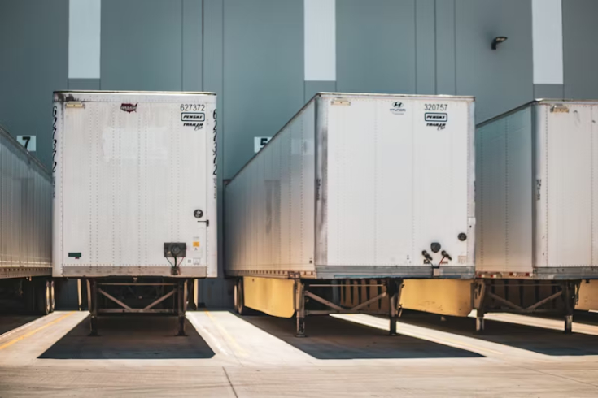
…and Safety is at Risk
OSHA‑Recognized Hazard
Cold, icy dock surfaces require protective controls
Increased Slip Risk
Freeze–thaw cycles create icy thresholds
Reduced Worker Function
More errors from slower reaction speed
Source: BLS Employer-Reported Workplace Injuries and Illnesses 2023-2024
Notes:
Some union regulations prevent workers from going into cold trailers

Slide 6
introducing
The docked trailer heater
Notes:
Designed specifically for the dock environment and the realities within a warehouse

Slide 7
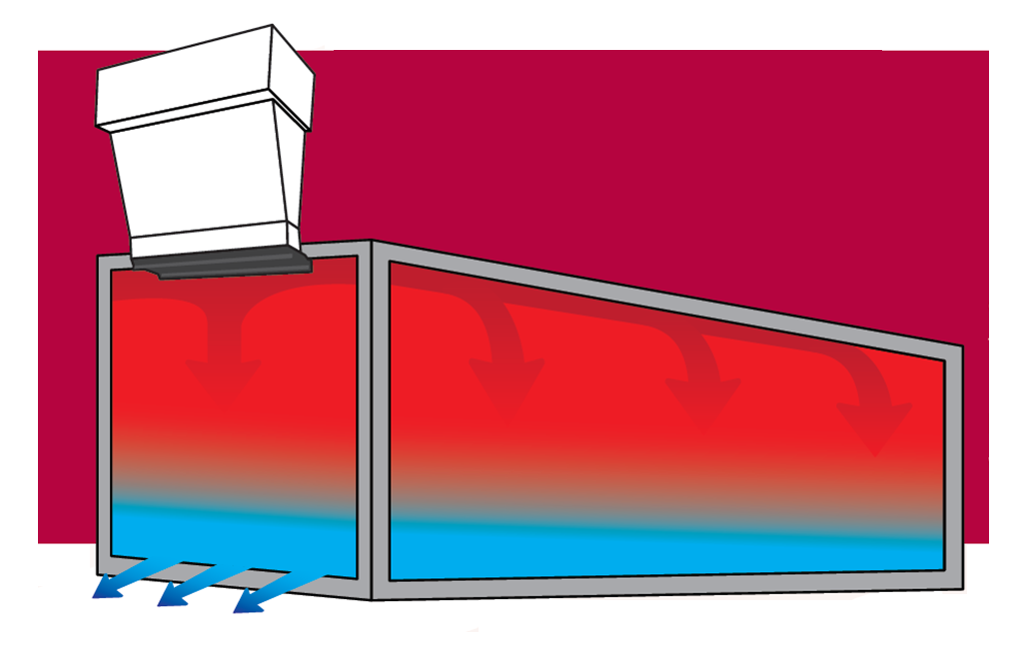
A high‑velocity, mount-at-dock heating system to rapidly warm docked trailers
Notes:
Comfort
Productivity
safety

Slide 8
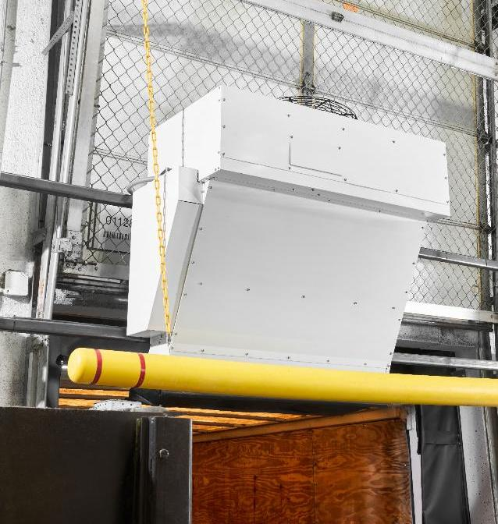
Advantages You’ll Feel Immediately
Feature​ | Benefit​
Fast Heating​ | Reduces trailer warm-up time significantly​
Dock Door Integration​ | Streamlines installation and operation​
Heat + Fan-Only Mode | Year-round versatility
Multiple Wattages | Fits various dock & location needs
User-Friendly Controls​ | Simplifies operation and reduces errors​

Slide 9

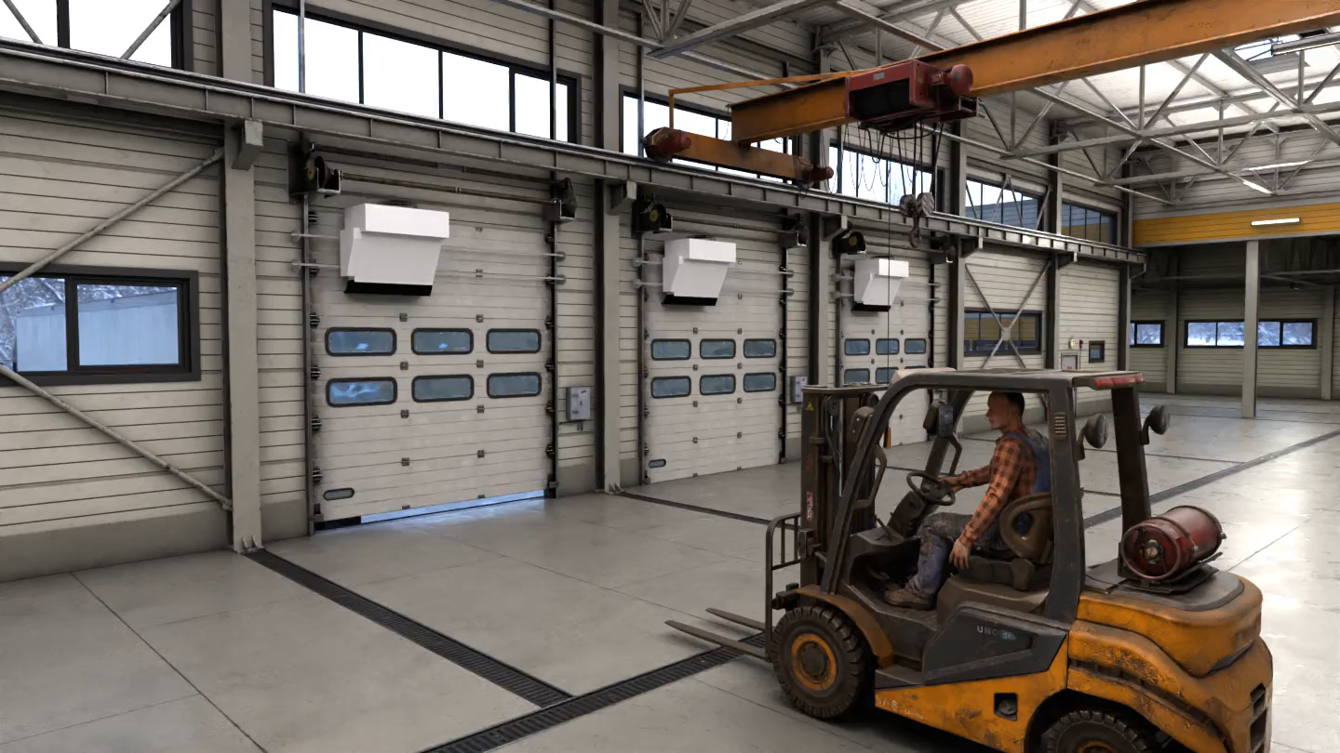
Notes:
Here you can see exactly how the system sits at the dock: mounted up and out of the way of equipment….

Slide 10
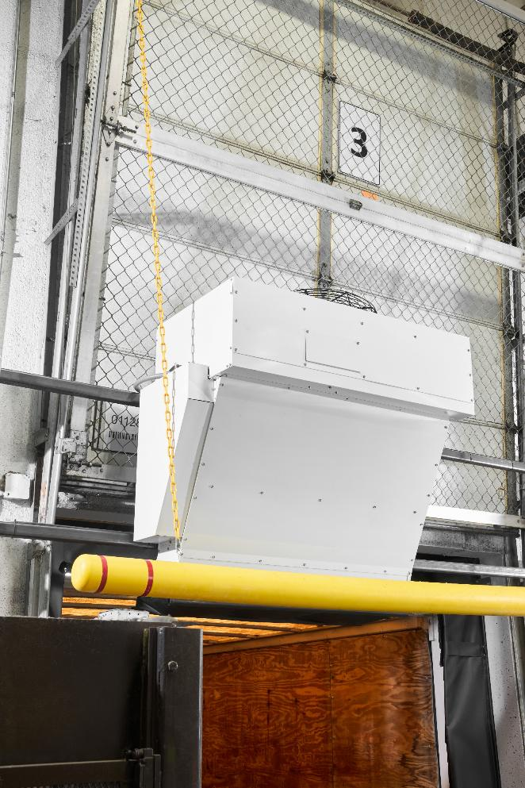
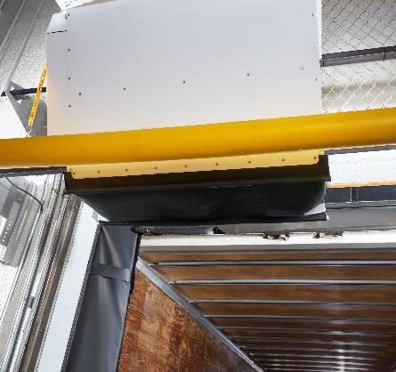
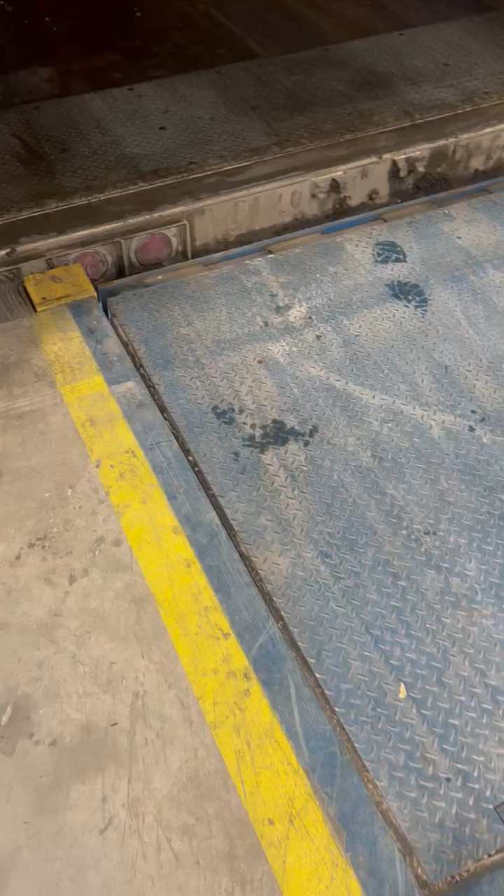
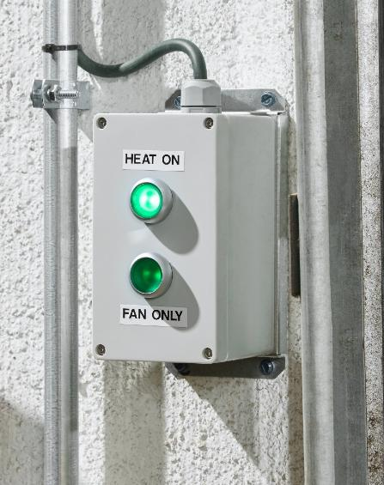
Video of Actual Install In Canada
(you can actually see the side of trailer where the ice is melting)
Notes:
Here are some pictures of the unit mounted in action

Slide 11



Impact on Temperature & Conditions
Rapid Boost of Warmth Within Minutes
Uniform Heat From End-to-End
Faster & More Efficient Loading
Study based on pilot located in Upstate New York; completed March 2025.

Slide 12
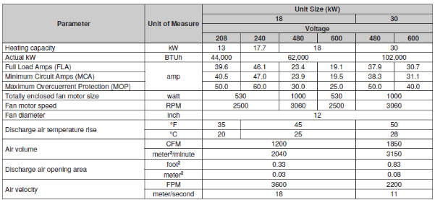
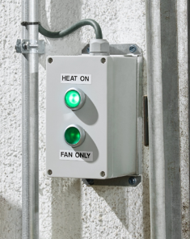
DTH Technical Info
Electric heating elements:
  4 voltage option: 208V/3, 240V/3, 480V/3, 600V/3
    208V/240V available on 18kW only
  3 heating capacities: 13kW (208V/3) , 18kW, 30kW
1 cabinet size
  Main parts changed between sizes are the heating element, fan, and flexible discharge
Mounted above dock doors and provide clearance for loading and unloading trailers
  Incorporates a flexible discharge to absorb incidental contact with freight, fork trucks or pallet jacks
Fan only
  To speed up warm weather trailer cooling
  Or maintain trailer temperature at indoor after heating
Manual Heat/Fan control for simple operation
Notes:
Clearances to Combustibles Unit Surface Top (from fan guard) 36 (915)
Sides Back (non-discharge side) 21 (533)
Front (discharge side) (Inches (mm)) 1 (26)
Bottom Unit Location 0 (0
All units are equipped with a normally-open automatic-reset air proving pressure switch (see Figure 8 or Figure 9) that senses air pressure provided by fan operation . The switch is factory-set and is non-adjustable . When the setpoint is satisfied, the switch allows electric supply to the heating elements . This safety device provides protection in the case of fan motor failure or lack of airflow due to a restriction at the inlet or outlet . High Temperature Limit Switch ⚠ WARNING ⚠ The automatic-reset high temperature limit switch will continue to shut down the unit until the cause is corrected. Never bypass this switch as hazardous conditions could result. All units are equipped with a normally-closed temperature-activated, automatic-reset high temperature limit switch (see Figure 8 or Figure 9) . The switch is factory-set and is non-adjustable . If the setpoint is reached, the switch interrupts the electric supply to the heating elements . This safety device provides protection in the case of fan motor failure or lack of airflow due to a restriction at the inlet or outlet . Fan Motor The fan motor is equipped with automatic-reset thermal overload protection . If the motor does not run, the cause may be due to improper voltage . Ensure that the correct voltage is available at the motor

Slide 13
Preliminary Field Data: Productivity & Comfort Improvements
Metric​ | Value​
Estimated Productivity Gain​ | $2,000+ per worker per year
Improvement in Worker Comfort​ | 72%​
Key Benefits​ | Higher throughput, reduced errors, & improved morale​
Results from pilot location; actual results may vary by location.

Slide 14
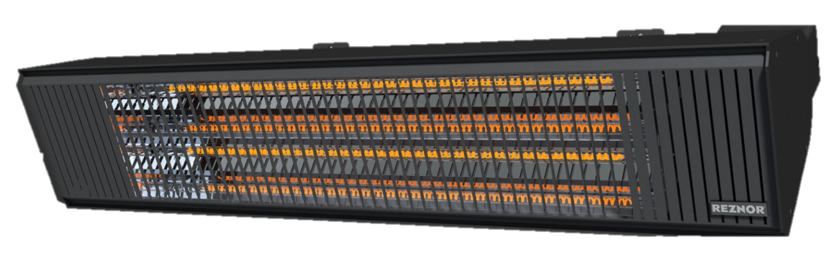
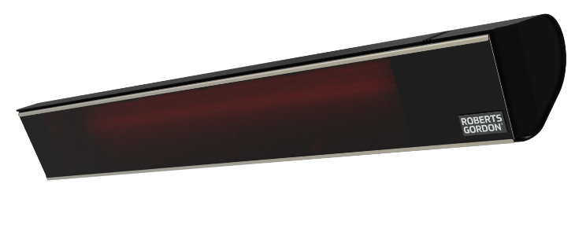
Infrared Electric Heater (GGEL)

Slide 15


Key Features
These key features are what enable GGEL to deliver fast, reliable performance in demanding environments for both commercial and residential outdoor spaces.
Features
Carbon fiber element delivers faster heat, Low light output, lasts longer, and operates more efficiently—giving customers better performance with lower total cost.
Durable construction, IP65 Weather‑resistant build with aircraft‑grade 6063 powder coated aluminum housing
  On board controls:
    1500W & 3000W: onboard switch + 6‑stage IR remote
    6000W 240V/208V: 2-stage remote
    6000W-277V: No controls
  1500W and 3000W Supplied with power cord
    1500W -12.5’ cord length Nema 5-15 plug
    3000W- 7’ cord length with Nema 6-15 plug
Applications
Warehouses
Manufacturing areas
Vehicle service centers
Residential patios, decks, and cabanas
Commercial outdoor dining areas

Slide 16
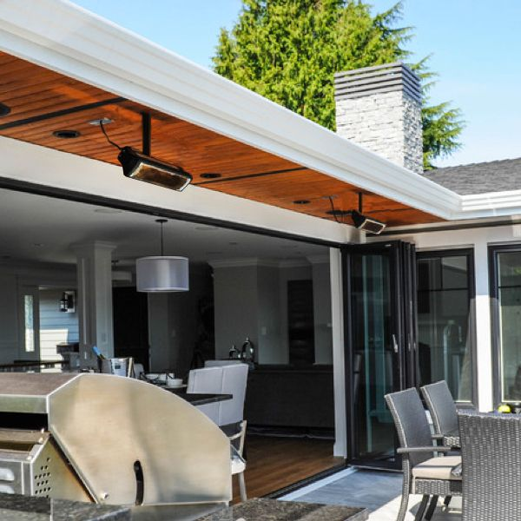
Key Benefits
GGEL delivers fast, reliable comfort with the durability and simplicity customers expect in demanding environments.
Auto off after 8 hours, emission‑free and silent
Built in controls with IR Remote
Wall Mounting brackets included with all units
  Ceiling mounts with 3000w/6000w units
Low maintenance carbon‑fiber elements for long life
  More durable than traditional metal or quartz elements
Instant comfort with rapid heat‑up
Safe & certified (cETLus / UL2021 / CSA22.2):

Slide 17
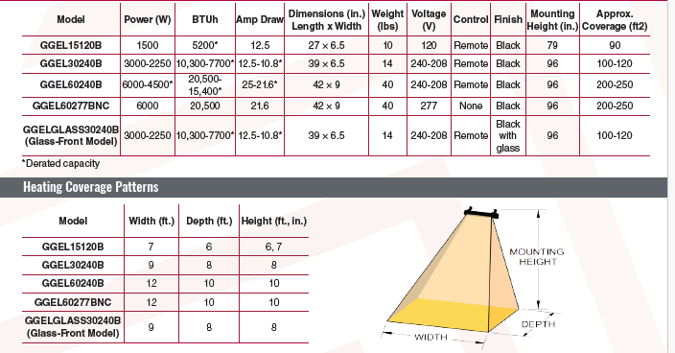
Key Technical Specs

Slide 18
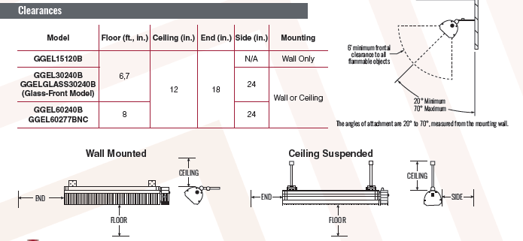
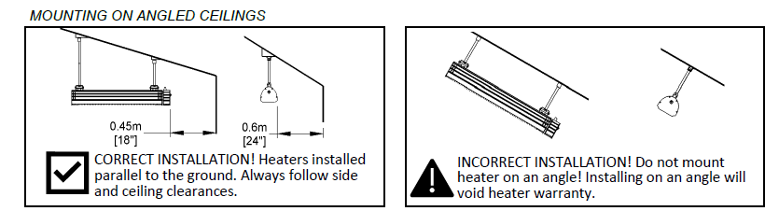
Mounting Options & Clearances
The minimum clearances indicated on the nameplate and in the manual must be observed at the time of installation. Clearances are based on a surface temperature of 194F (90°C). Building materials with low heat tolerance may be subject to degradation at lower temperatures. It is the installer’s responsibility to assure adjacent materials have sufficient heat tolerance. Mount heaters at least 36” apart.

Slide 19
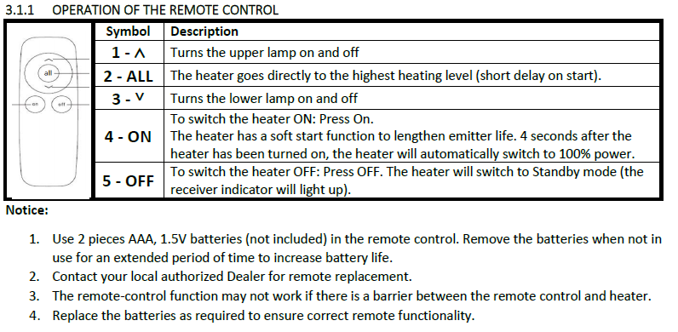
Remote functions

Slide 20
Competitive Comparison
Why GGEL Wins
5x faster heat-up
Works in harsher conditions
Longer life= lower replacement cost
Key Buying Factor | Roberts-Gordon GGEL |  | [competitor A] | [competitor B]
Weatherproofing | IP65 |  | IPX4 | IPX4
Full temp | 20-30 sec |  | 3-5 min | 3-5 min
On board controls | On/off switch on unit- Remote included |  | N/A | N/A
Bulb Life | Up to 8000hrs |  | Up to 5000hrs | UP to 5000hrs
IP65 offers better protection than IPX4, as it is fully dust-tight and can withstand low-pressure water jets, while IPX4 is only splash-proof with no dust protection.
Quick heat means heaters
Turned on when needed and turned off sooner
Less wasted runtime= lower energy cost

Slide 21
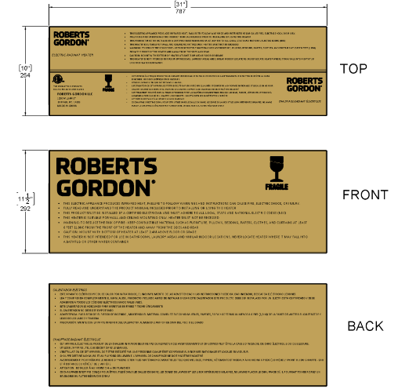
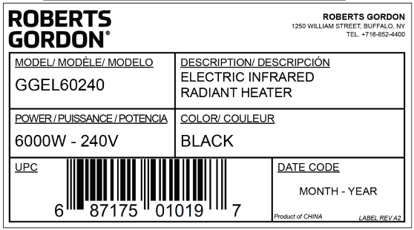
Heater Packaging

Slide 22
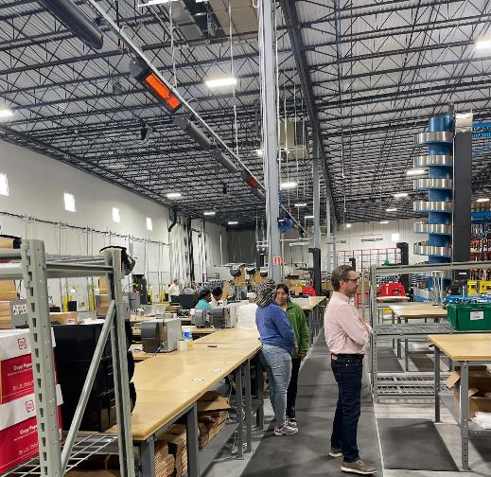

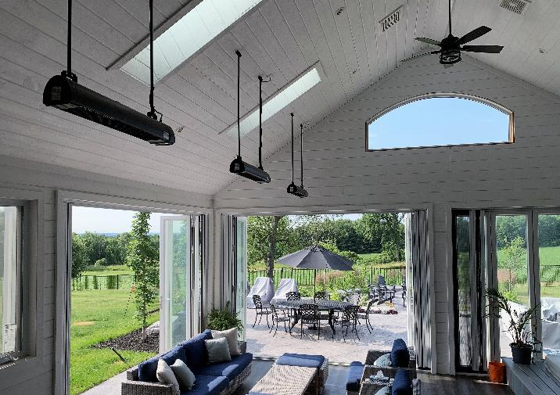
Applications
Commercial
Retail spaces
Vehicle service centers
Hospitals/Campuses
Transportation
Warehouses
Shipping areas
Production workstations
Hospitality
Hotels
Restaurants
Cafes/Clubs
Valet areas
Concierge
Residential
Backyard patios
Outdoor kitchens
Solariums/outdoor rooms
Pergolas/Gazebos

Slide 23
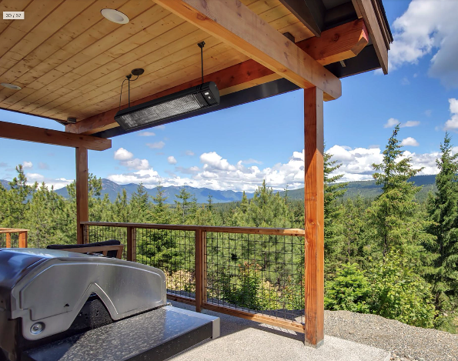
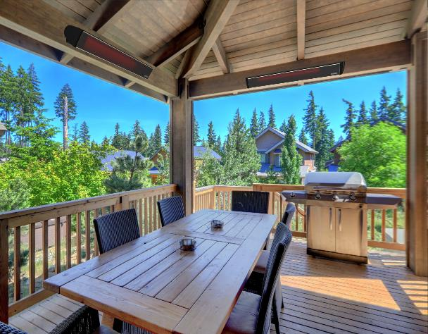
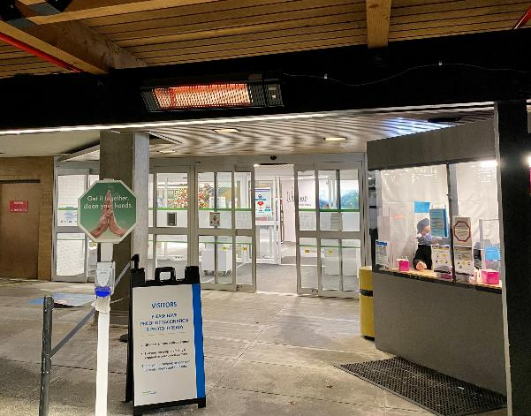
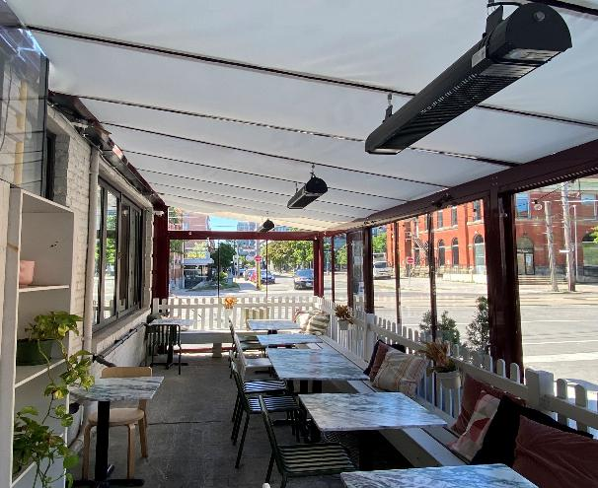

More installations…

Slide 24
FAQ questions
1. Is the IR remote compatible with all heaters or are they specific to each heater?
The 1500w and 3000w use the same remote, and 1 remote can control multiple 1500w & 3000w heaters as they are IR line of sight. The 6000W has a different remote which will not work with the 1500w or 3000w, but 1 remote can still control multiple 6000w heaters.
2. Can the heaters be used indoors?
In a residential install, only the 1500w models can be used indoors. All models can be used outdoors residentially. UL and CSA Standard 22.2 NO. 46 do not allow glowing type radiant heaters greater than 1500w to be used indoor in a residential application. All can be used indoors or outdoors commercially. All installations and clearances must be met as per the manual.
3. Can I recess/flush mount the GGEL heaters?
No, the GGEL is not able to be recessed mounted
4. Will these heaters integrate with BUILDING management systems?
No, heaters come with on board control that communicated via line of sight to the included remote. These heaters cannot integrate with building management systems.

Slide 25
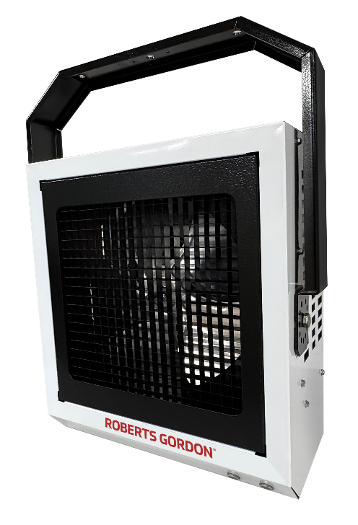
Model EUHC
Compact Electric Unit Heater
Launched September 2025

Slide 26
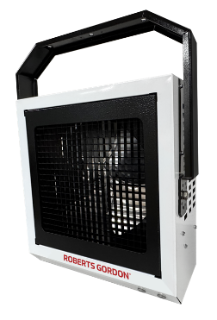
Compact Electric Unit Heater (EUHC)
Delivers maximum flexibility & efficient performance in a compact, low-clearance heater
Reduces & simplifies ordering & stocking with multiple sizes and common voltages
Provides precision airflow where needed:
  Multi-position hanger mounted that can be wall or ceiling mounted enables vertical and horizontal mounting, or every 15° in between with swiveling capability
Optimizes fit in small spaces with industry-leading clearances for space optimization
Delivers year-round comfort with fan-only mode for warm-weather airflow
Applications
Factories
Warehouses
Garages
Stairwells
Shipping Docks
Power Stations
Mechanical & Maintenance Rooms
Retail
Public Buildings
Notes:
7 minutes to heat to indoor ambient (60°F)

Slide 27
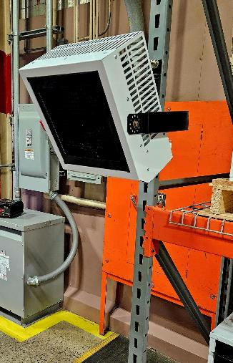
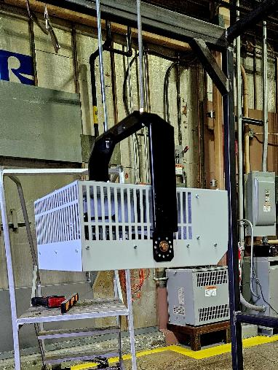
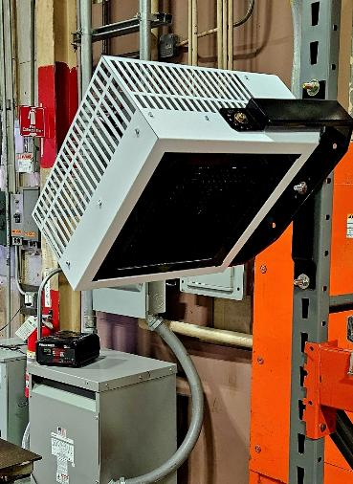
EUHC Features
Sizes 3-20kW
208 & 240V/1-3p in sizes 3,5,7,10 kW→field adjustable to 3 phase
24V control power (external terminal strip)
3D air direction control
Fan-only mode​ for all-season comfort
Residential certification for 3 & 5 models→non-living spaces
Notes:
7800 to 68000 BTU equivalent

Slide 28

Versatile & Application-Ready
Heating Capacity (kW)
  2.3
  3
  3.8
  5
  7.5
  10
  11.3
  15
  20
Seven (7) Voltage/Phase Combinations
208/1
208/3
240/1
240/3
277/1
480/3
600/3
208V & 240V units sizes (except 15 & 20) are field-adjustable to 3-phase electrical power to reduce amperage demand & operating expense
Simplifies ordering and installation across a wide range of applications

Slide 29
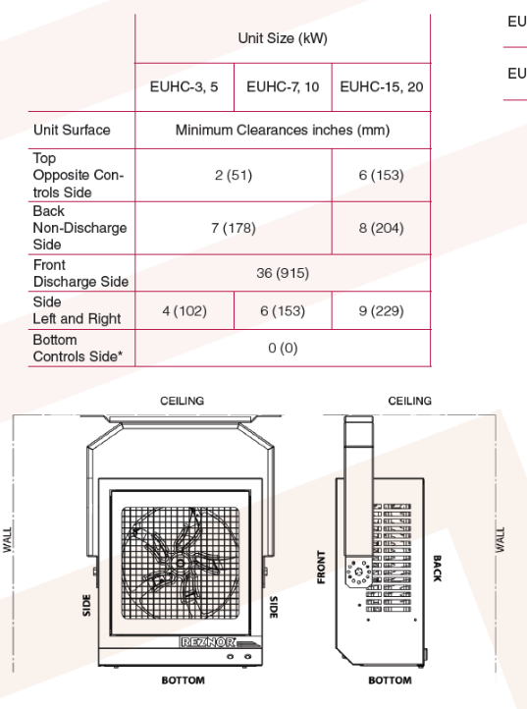
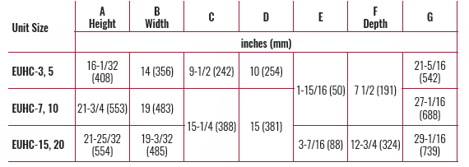
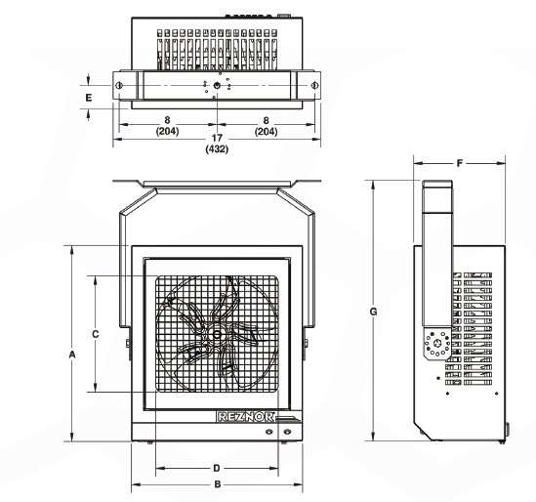
EUHC Technical Info—3 sizes of cabinets
Minimum Clearances to Combustibles
Dimensions
Model | 3/5 | 7/10 | 15/20
Unit Weight lbs. (kg) | 28 (13) | 40 (19) | 58 (27)
Shipping Weight lbs. (kg) | 37 (17) | 53 (24) | 71 (32)
Notes:
6 feet from bottom of unit to the floor
Standard Controls Fan Motor The fan motor is equipped with automatic-reset thermal overload protection .
If the motor does not run, the cause may be due to improper voltage . Ensure that the correct voltage is available at the motor . FAN ON Limit Switch ⚠ WARNING ⚠ The automatic-reset FAN ON limit switch cools the heating elements after the heating demand is satisfied..
High Temperature Limit Switch ⚠ WARNING ⚠ The automatic-reset high temperature limit switch will continue to shut down the unit until the cause is corrected. Never bypass this switch as hazardous conditions could result

Slide 30
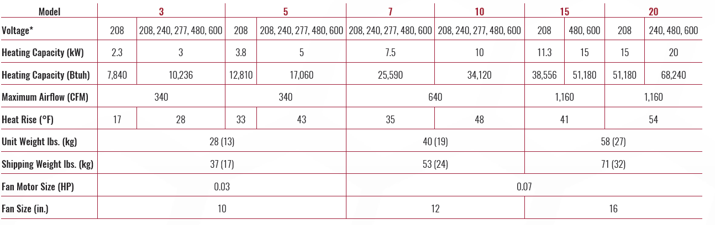
EUHC Specifications

Slide 31

Sustainable & Supported
Factory Supported
  Many components are shared with gas-fired units for easy service & availability
Market-Leading
Lead Times
~15 days
Market-Leading Warranty
5-year electrical & mechanical parts

Slide 32

Built for Comfort, Safety, and Durability
Modern design, appliance-grade finish, and robust construction for tough environments
  Painted galvanized-steel cabinet with two-tone black and white glossy, scratch-resistant paint scheme
  Corrosion-resistant, stainless-steel sheathed, finned heating elements resist wear, shock, and vibration
Standard safeties
  Automatic reset thermal overload protection on the fan motor and automatic reset high temperature limit switch
  Vibration- and noise-isolated fan motor designed for low-noise operation
  Fan guard for added safety

Slide 33

Multiple Control Options
Basic ON/OFF to multi-unit thermostat control
Compatible with destratification fans and BMS systems
Single-stage (standard), two-stage, unit-mounted, and BACnet-capable thermostats
Fan-only mode for warm-weather airflow

Slide 34
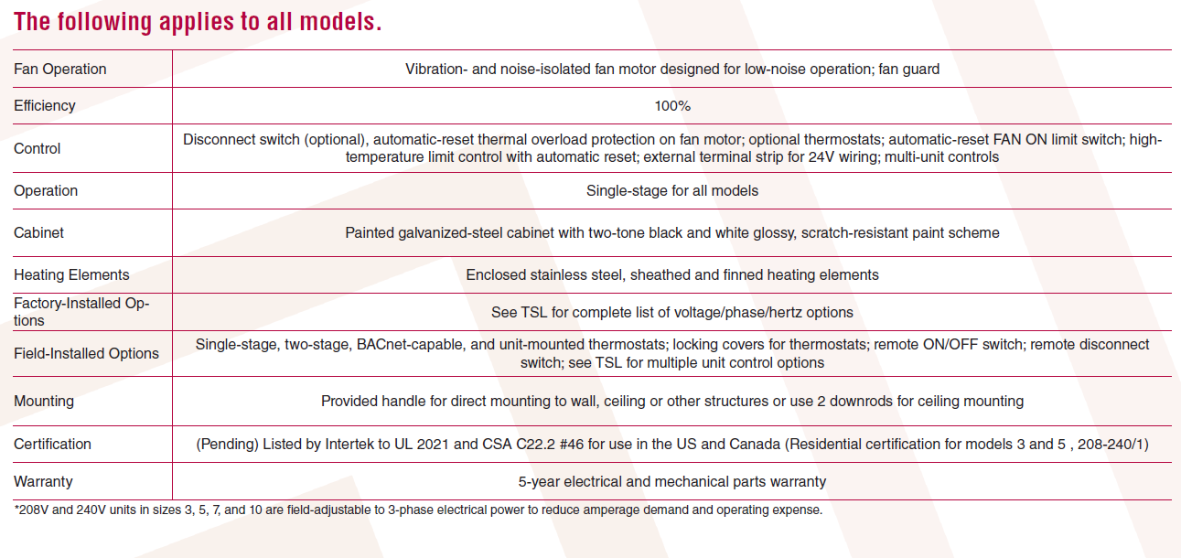
EUHC Specifications

Slide 35
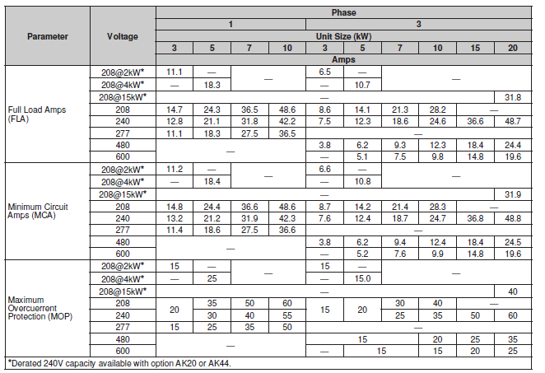
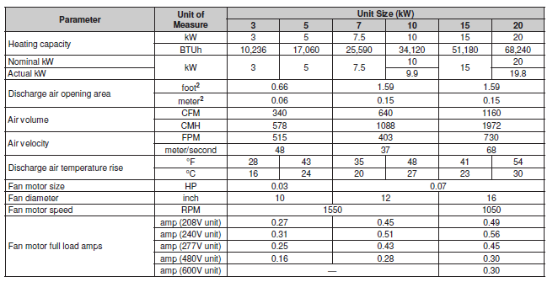
Technical Data
Full electrical information
  FLA, MCA, MOP
  Disconnect/circuit breaker size

Slide 36
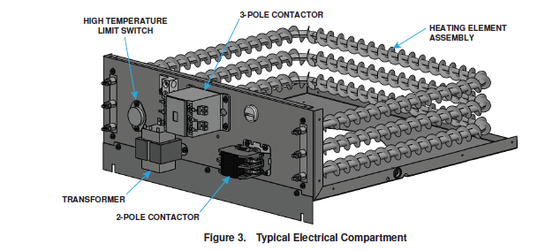
Electrical Connections

Slide 37
EUHC Options
Factory-Installed
277/1/60 voltage (models 3, 5, 7, & 10)
480/3/60 voltage (all sizes)
600/3/60 voltage (all sizes)
208/1/60 voltage (models 15 & 20, field-convertible from 1- to 3-phase)
208-240/1/60 voltage (models 3 & 5 approved for residential use)
208-240/3/60 voltage (models 15 & 20)
Field-Installed
Single-stage low-voltage thermostat
Multiple unit control includes components for:
  one controller unit & one additional unit
  each additional non-control unit
Two-stage programmable thermostat
Two-stage smart thermostat
BACnet-capable thermostat
Locking covers
Remote OCCUPIED/UNOCCUPIED
Remote disconnect switch
Unit-mounted thermostat with mounting kit
Unit wiring kit, includes thermostat with wire & disconnect switch with wiring harness
BACnet® is a trademark of ASHRAE.

Slide 38
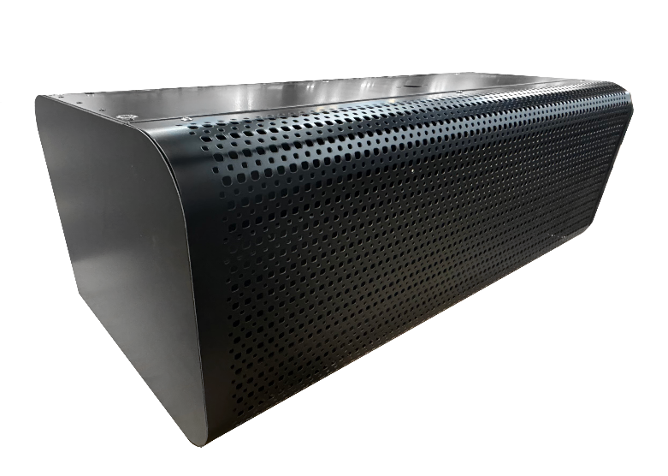
Air Curtains

Slide 39
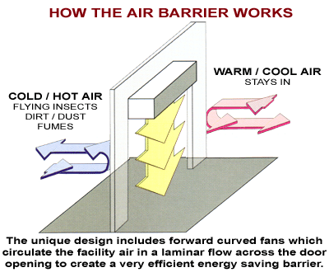
What is an Air Curtain?
An air curtain creates a high-velocity stream of air across an opening, acting as an invisible barrier that separates indoor and outdoor environments—without blocking access.
What It Does for Customers
Prevents outside air from entering
Reduces heating and cooling loss, therefore the costs associated
Keeps out dust, insects
Maintains comfort at open doors

Slide 40
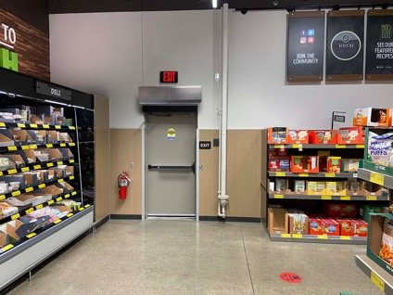
Why Air Curtains Matter
Air curtains provide energy savings, comfort, and protection—without changing how a space operates.
Benefits
Reduces energy loss by creating a consistent air barrier that helps maintain indoor temperatures
Enhances comfort by eliminating drafts at open doorways and stabilizing indoor conditions
Maintains operational flow with no physical doors to open or close
Improves safety with full visibility and no obstructive strip curtains
Flexible options available in unheated and electric heat models
Applications
Restaurants
Retail Stores
Offices
Healthcare Facilities
Vestibule Exceptions
Cold Storage
Manufacturing
Grow Farms

Slide 41
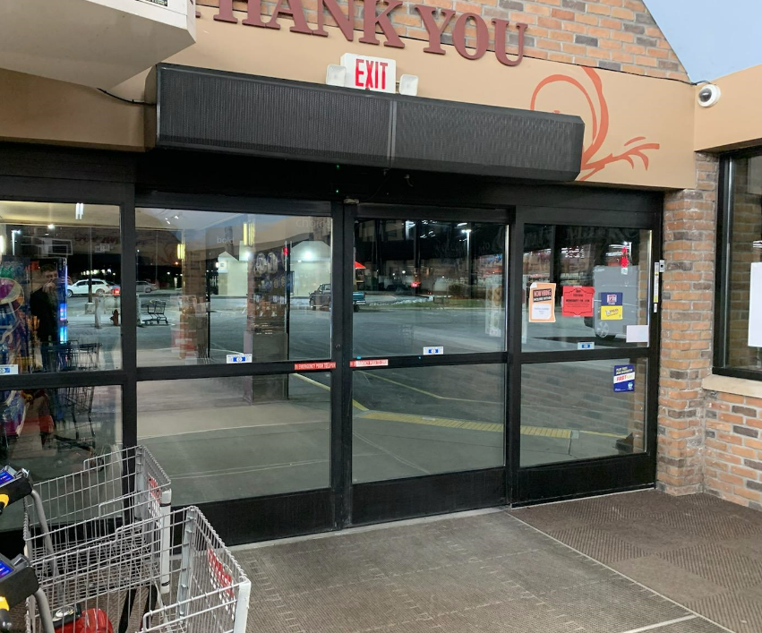
Where Air Curtains Win
Best Applications
  Warehouses and loading docks
  Retail storefront entrances
  Food service areas and commercial kitchens
Ideal Use Cases
  Frequently opened doors
  Noticeable drafts or temperature fluctuations
  Rising or high energy costs
  Concerns with dust, insects, or airborne contaminants

Slide 42
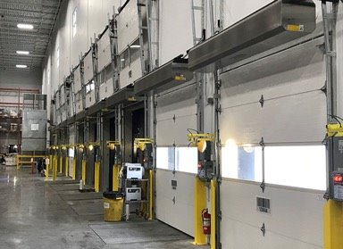
Are Air Curtains Effective?
Tested to AMCA 220 and IECC Vestibule exception (ASHRAE 90.1)
Properly installed and AMCA-certified air curtains can be used in place of a vestibule
Independent studies demonstrate that air curtains can outperform vestibules in energy savings
Units meet the performance requirements (e.g., tested to ANSI/AMCA 220 and minimum airflow velocity at the floor)
Proven Effectiveness
Up to 90% effectiveness in reducing air infiltration
Compared to strip doors: less than 65% effectiveness
Fast Return on Investment
When professionally installed and properly operated, air curtains can deliver payback in under two years
Annual energy savings can exceed $4,000

Slide 43

The RG Air Curtain
Performance & Design
  High-efficiency plenum for optimized airflow
  Quieter air discharge for a better working environment
  Improved airflow uniformity for a stronger, more consistent air barrier
  Low sound – 63 dBA @ 10 ft
Ease of Installation
  Single-point power connection
  Simplified installation process
Quality & Service
  Shipped fully assembled and prewired
  Secure packaging in durable wooden crates
  Factory tested prior to shipment for reliable performance

Slide 44
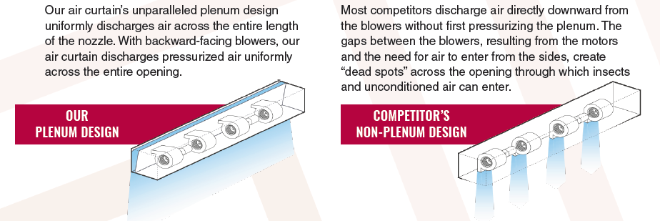
Industry-Leading Plenum

Slide 45
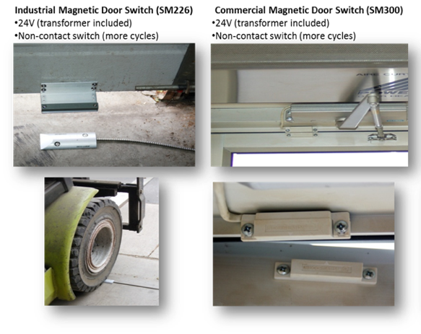
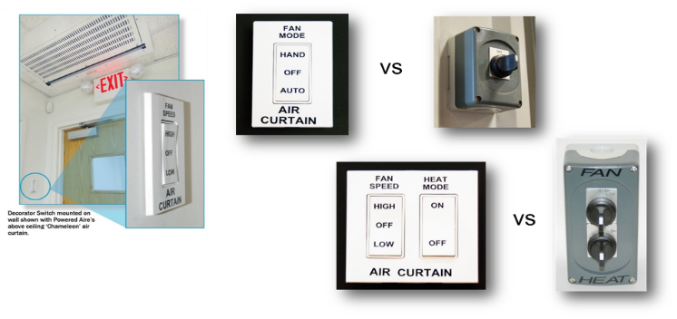
Controls
Simple & Flexible Operation
  Door-activated control via 24V magnetic door switch
  Optional manual toggle disconnect switch for local control
Advanced Control Options
  SmartTouch controller for intuitive operation and adjustments
  Compatible with building management systems (BMS) for centralized control
User Convenience
  Automatic on/off operation tied to door activity
  Easy adjustment of fan speed and settings
  Designed for plug-and-play simplicity

Slide 46
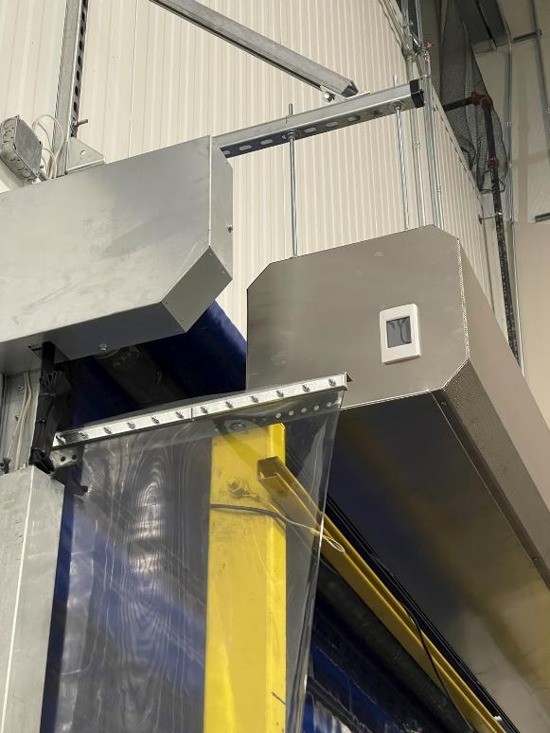
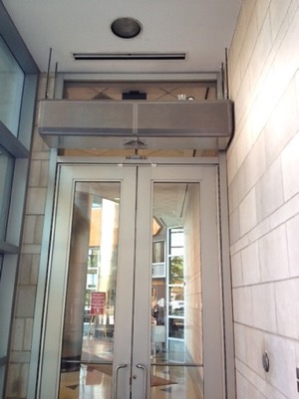
Installations: We Keep It Simple!
Sectional Doors: 0-12” Projection Standoff Brackets + Unistrut extensions to clear the door tracks (12” in each direction).
High Speed or Rolling Steel Doors: 20” Standoff Brackets to Sit in Front of Door Canister
  May mount below if headroom is not an issue.
  Consider PVC Side Baffles for large projections off the wall
Tell Us the Type of Door and We Will Include the Brackets and Struts Necessary

Slide 47
Technical Specifications
Roberts-Gordon Industrial Air Curtains
Model | # of Motors | Heating | Heating Capacity (kW) | Maximum Door Height (ft) | Door width (in) | Door width (ft)
RGAC-1-36 | 1 | Unheated | NA | 12 | 36 | 3
RGAC-1-42 | 1 | Unheated | NA | 12 | 42 | 3.5
RGAC-1-48 | 1 | Unheated | NA | 12 | 48 | 4
RGAC-1-60 | 1 | Unheated | NA | 12 | 60 | 5
RGAC-2-72 | 2 | Unheated | NA | 12 | 72 | 6
RGAC-2-84 | 2 | Unheated | NA | 12 | 84 | 7
RGAC-2-96 | 2 | Unheated | NA | 12 | 96 | 8
RGAC-3-108 | 3 | Unheated | NA | 12 | 108 | 9
RGAC-3-120 | 3 | Unheated | NA | 12 | 120 | 10
RGAC-3-132 | 3 | Unheated | NA | 12 | 132 | 11
RGAC-4-144 | 4 | Unheated | NA | 12 | 144 | 12
RGAC-4-156 | 4 | Unheated | NA | 12 | 156 | 13
RGAC-4-168 | 4 | Unheated | NA | 12 | 168 | 14
Designed for door heights up to 12 feet
Available for openings from 3 to 14 feet wide across 13 model options
Offered in unheated and electric heat configurations
  Heated curtain can be run in fan mode only.
AMCA 220 certified for verified performance
Qualifies for vestibule exception applications
Features a modern, streamlined design for enhanced appearance
Model | # of Motors | Heating | Heating Capacity (kW) | Maximum Door Height (ft) | Door width (in) | Door width (ft)
RGACE-1-36 | 1 | Electric | 10 | 12 | 36 | 3
RGACE-1-42 | 1 | Electric | 10 | 12 | 42 | 3.5
RGACE-1-48 | 1 | Electric | 10 | 12 | 48 | 4
RGACE-1-60 | 1 | Electric | 10 | 12 | 60 | 5
RGACE-2-72 | 2 | Electric | 20 | 12 | 72 | 6
RGACE-2-84 | 2 | Electric | 20 | 12 | 84 | 7
RGACE-2-96 | 2 | Electric | 20 | 12 | 96 | 8
RGACE-3-108 | 3 | Electric | 30 | 12 | 108 | 9
RGACE-3-120 | 3 | Electric | 30 | 12 | 120 | 10
RGACE-3-132 | 3 | Electric | 30 | 12 | 132 | 11
RGACE-4-144 | 4 | Electric | 40 | 12 | 144 | 12
RGACE-4-156 | 4 | Electric | 40 | 12 | 156 | 13
RGACE-4-168 | 4 | Electric | 40 | 12 | 168 | 14

Slide 48
Technical Data
Model | Nozzle Width (in) | Max FPM @ nozzle | Avg Outlet Velocity (FPM) | Airflow rate (CFM) | Heater kW | Temp Rise (°F) | Weight (lbs)
RGACE-1-36 | 36 | 5654 | 1845 | 1310 | 10 | 24 | 95
RGACE-1-42 | 42 | 5321 | 1903 | 1503 | 10 | 21 | 102
RGACE-1-48 | 48 | 5296 | 1514 | 1438 | 10 | 22 | 109
RGACE-1-60 | 60 | 5288 | 1343 | 1665 | 10 | 19 | 121
RGACE-2-72 | 72 | 5654 | 1845 | 2620 | 20 | 24 | 177
RGACE-2-84 | 84 | 5321 | 1903 | 3006 | 20 | 21 | 195
RGACE-2-96 | 96 | 5296 | 1514 | 2876 | 20 | 22 | 210
RGACE-3-108 | 108 | 5654 | 1845 | 3930 | 30 | 24 | 255
RGACE-3-120 | 118 | 5340 | 1886 | 4316 | 30 | 22 | 284
RGACE-3-132 | 133 | 5305 | 1617 | 4285 | 30 | 22 | 301
RGACE-4-144 | 145 | 5654 | 1845 | 5240 | 40 | 24 | 354
RGACE-4-156 | 157 | 5648 | 1876 | 5626 | 40 | 23 | 372
RGACE-4-168 | 169 | 5321 | 1903 | 6012 | 40 | 21 | 390

Slide 49
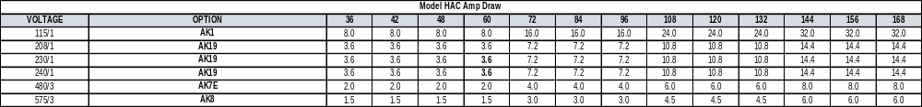
RGAC/RGACE Voltage Options
Model RGACE Amp Draw (Breaker Size)
VOLTAGE | OPTION | SEPARATE SUPPLY CIRCUIT | 36 | 42 | 48 | 60 | 72 | 84 | 96 | 108 | 120 | 132 | 144 | 156 | 168
208/1 | AK2 | 1 | 27.6 (35) |  |  |  | n |  |  | n |  |  | n
 |  | 2 | 24.0 (35) |  |  |  | n |  |  | n |  |  | n
240/1 | AK3E | 1 | 45.3 (60) |  |  |  | n |  |  | n |  |  | n
208/3 | AK5 | 1 | 31.4 (40) |  |  |  | 35.0 (45) |  |  | 38.6 (50) |  |  | n
 |  | 2 | - |  |  |  | 27.8 (35) |  |  | 27.8 (35) |  |  | n
 |  | 3 | - |  |  |  | - |  |  | 27.8 (35) |  |  | n
240/3 | AK6E | 1 | 27.7 (35) |  |  |  | 31.3 (40) |  |  | 46.9 (60) |  |  | n
 |  | 2 | - |  |  |  | 24.1 (35) |  |  | 36.1 (50) |  |  | n
480/3 | AK7E | 1 | 14.0 (20) |  |  |  | 28.1 (40) |  |  | 42.1 (60) |  |  | 32.1 (45)
 |  | 2 | - |  |  |  | - |  |  | - |  |  | 24.1 (35)
575/3 | AK8 | 1 | 11.5 (15) |  |  |  | 23.1 (30) |  |  | 34.6 (45) |  |  | 46.2 (60)
Voltages selected to reduce amperage, installation time/cost, and operational costs

Slide 50




Applications

Slide 51


Industrial Applications – Interior Separation
Consider air curtains in place of traffic doors or strip doors
  More Hygienic
  Promote 100% Visibility
  Promote Non-Contact Pass Through
  Inexpensive to Run
  Less Replacement Parts
  Fastest High-Speed Door
Typically, Less Velocity Required
  No wind load on the opening
  Do not want to create too much turbulence at the floor
Notes:
Fastest high speed door – High speed doors run at 108” per second
With a max velocity of 4218 at the nozzle, our ETD runs at over 800 inches per second

Slide 52


Interior Applications – High Speed Doors
Designed to run when the high-speed door is in the open position
Activation is by a dry contact in the high-speed door control panel
  We can supply a 24-volt transformer and control relay
  Time delay relay prevents the air curtain from turning on and off constantly
Can mount below or in front of canister

