Slide 1

CORAYVAC® and Unitary
Layout and Design

Slide 2
Heat Loss
Sizing up a CORAYVAC® System
Critical Considerations:
Heat-loss adjustment factor for CRV (.80 with old reflector)
Heat-loss adjustment factor for CRV (.75 with NEW High Efficiency reflector)
Height Adjustment (1% per for over 20’)
Notes:
The building heat loss must be calculated in accordance to accepted energy load calculation methods. The CRV-Series system input is determined in conjunction with the required radiant adjustment to heat loss and height adjustment factors. The practice of applying an adjustment factor to heat loss calculations for radiant heating systems is well known within the radiant heating industry, having been used by manufacturers for over 30 years. A number of
studies have been conducted to identify the values of the adjustment factor in the range of 0.8 to .85, (higher efficiency uses lower factor). For CORAYVAC use 0.8, and the height adjustment factor is 1% per foot over 20‘ or 1.10, to a total heat loss. This is recommended for the heights up to 60’. Above this height, additional correction overstates the BTU requirement as determined by the heat loss..

Slide 3
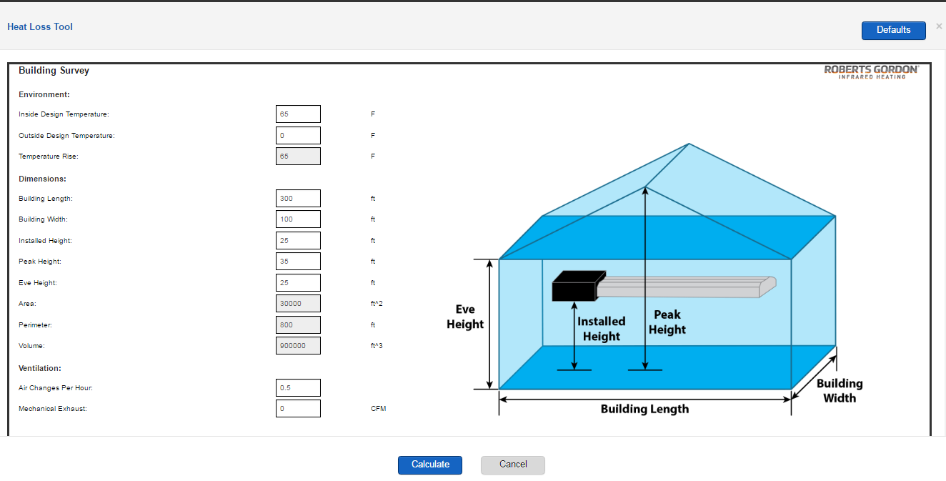
Heat Loss
Notes:
- Heat loss can be quickly accessed and calculated in the Roberts Gordon ACE Interface program

Slide 4
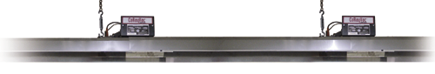
Factors in Burner Selection
    Heat gain and distribution
    Desired Radiant intensity
    Mounting Height
    Flow units
    Required Distance Between Burners
    Tail Pipe Lengths
Notes:
The number of burners and input for each must be specified in the design layout. The following factors should be considered when selecting burner
Heat gain and distribution required
Mounting height
Flow Units
Distance between the burners
Tail Pipe Lengths

Slide 5
Model Number Designation
CRV-B Series
Input (BTU/Hr.) | Model Number
20,000 (NG Only) | CRV-B-2
40,000 | CRV-B-4
60,000 | CRV-B-6
80,000 | CRV-B-8
90,000 | CRV-B-9
100,000 | CRV-B-10
110,000 (NG Only) | CRV-B-12A
120,000 (LP Only) | CRV-B-12
Notes:
Model number of the unit is associated with the BTU input of the burner, i.e CRV B-2=20,000 BTU, CRVB-10 =100,000 BTU.

Slide 6
Recommended Mounting Heights
CORAYVAC® System
Input (BTU/Hr.) | Min. Mounting Height
20,000 | 8’
40,000 | 8’
60,000 | 8’
80,000 | 10’
90,000 | 10’
100,000 | 15’
110,000 | 15’
120,000 | 15’
Notes:
Mounting height will largely be based on ceiling height.
However, these are the suggested minimum mounting heights for a CRV system.

Slide 7
CRV System Identification
Tailpipe
Shared
Tailpipe
EP-100
Pump
CRV-B4
CRV-B4
Branch #2
Radiant
Tubing
Branch #1
Radiant
Tubing
CRV-B4
CRV-B4
CRV-B4
CRV-B4
End Vent
End Vent
Notes:
Branch – Shown in red, each branch consists of 3 CRV-B4 burners. ’Branch’ refers to one length of radiant tube before an elbow or tailpipe.
Radiant Tubing – Their is a minimum, recommended, and maximum distance between the burners for the radiant section of the system.
Tailpipe – The run of tubing between the last section of radiant pipe and the vacuum pump. Can be heat treated aluminized steel or double coated porcelain.
End Vent – According to the Branch Configuration chart on pg 10, the end plate # to use for each branch shown in this layout is end vent plate # 4.
Flow Units – total flow units when adding both branches together is 64. An EP-100 pump has the capacity to handle this many flow units.

Slide 8
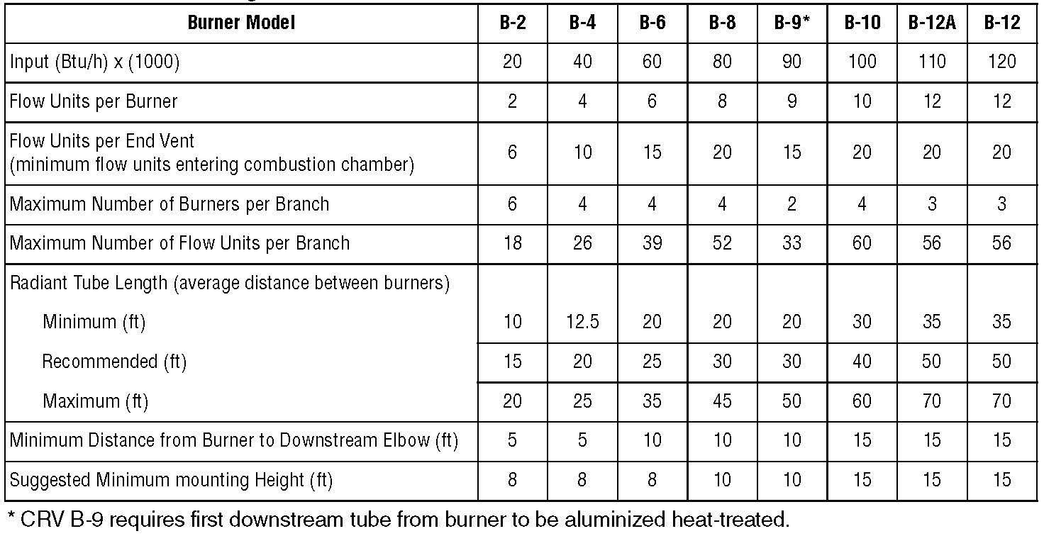
Firing Rates in Regards to Design Parameters
Notes:
This table will explain various terms associated with the CORYVAC system.
In the previous slide we explain the model number vs. the input of the unit
2. Flow units per burner. The flow unit is defined as the amount of fuel/air mixture for a heat input of 10,000 (Btu/h). This corresponds to a flow rate of 1.83 cfm. For the purpose of design, flow units enter the CRV Series
system in one of two ways:
• Through the burner.
• Through the end vent plate.
The purpose of the end vent air is to dilute the hot combustion gases at the burner, thereby promoting uniform heating of the tube while avoiding excessive heating of the combustion chamber. For the end burner, the burner inlet flow consists of the end vent air and combustion air.
3. Maximum number of burner per branch is the maxim allowed number of units in a single ran of the system, for specific input
4. The limiting factor for maximum flow in the radiant section has been determined experimentally in terms of the maximum burner inlet flow units that can be tolerated without degradation of combustion characteristics at the last downstream burner. This maximum flow in the radiant branch can be expressed for each burner firing rate by either a maximum number of burners per branch or the maximum number of flow units.
5. Radiant tube length is the minimum, recommended and maximum length for a CRV burner at specific input. Keep in in mind that tubes are 10’ in length for easier installation. Minimum Radiant Tube Provides for the highest level of intensity per length of radiant tube and good radiant heat uniformity between burners. More tailpipe length is required to maintain operating efficiency and pump capacity.
Maximum Radiant Tube Provides the lowest level of intensity per length of radiant tube, and consequently the largest span between burners.
6. Minimum distance form the burner to downstream elbow is the distance allowed for the elbow to be installed, after the burner
Suggested minimum height is recommended by Roberts Gordon and its based on the heater input, and the intensity

Slide 9
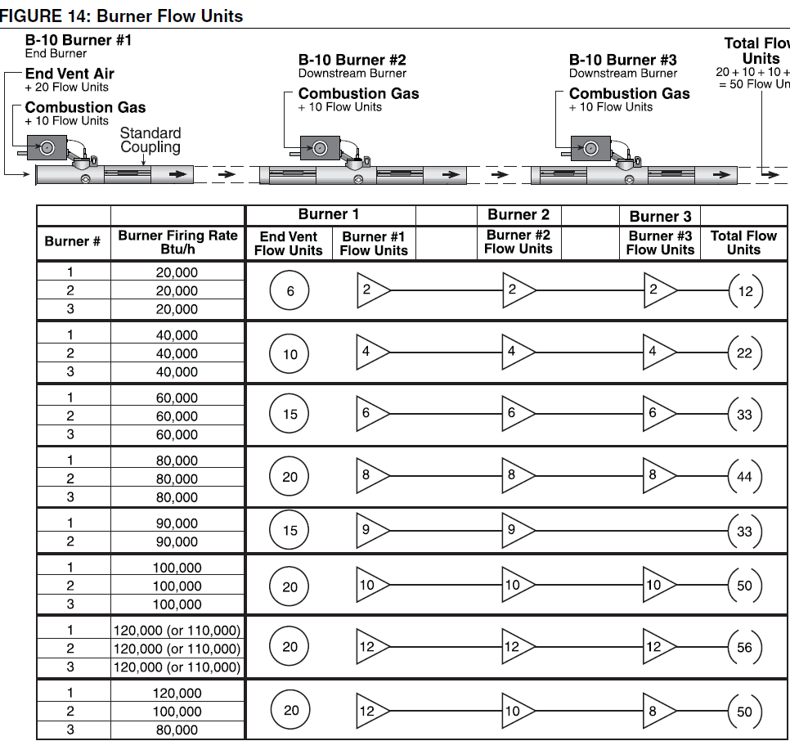
Burner Flow Unit: Amount of fuel/air mixture required to produce 10,000 BTU
Notes:
This slide is more of a pictorial presentation of the flow units by input, and by the flow units on a single branch of heaters. It helps visualize the system flow. Burners can be mixed with different inputs on a single branch. Highest input must be installed first.

Slide 10
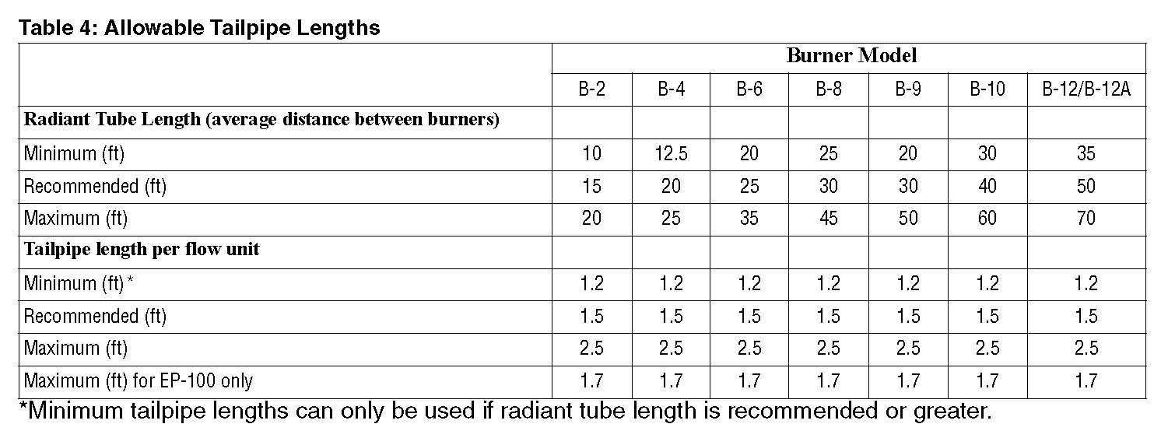
Allowable Tailpipe Lengths
Notes:
Tail pipe
The main purpose of the tailpipe and the radiant tube is to provide sufficient tube surface to transfer the heat from the flue gases to the tube wall where it radiates from the tube. Tailpipe is defined as all tubing between the radiant tube and the pump. The use of adequate tailpipe is the key to high combustion efficiency and proper operation of the pump. Tailpipe provides a low level of radiant intensity per length. The length of tailpipe for systems can be varied according to the flow units in the system and the designed radiant length. Longer lengths of tailpipe will achieve higher operating efficiencies and therefore condensation will occur.
From Table 4, we can use between 1.2' per flow unit and 2.5' per flow unit when the average radiant length per B-10 burner is 40'. By multiplying the number of flow units in the branch (3 burner system with 100MBH=50 flow units) by the minimum tailpipe length from the chart (1.2' per flow unit), we see that we will need a minimum of 60' of tailpipe for this branch. Likewise, by multiplying the number of flow units in the system (60 flow units) by the maximum tailpipe length from the chart (2.5' per flow unit), we see that maximum system, tailpipe length is 150'. To properly design the system and achieve higher efficiencies, at least recommended radiant and recommended tail pipe should be selected. Minimum radiant and recommended tail pipe will not allow system to condense, unless modulation controls are selected.

Slide 11
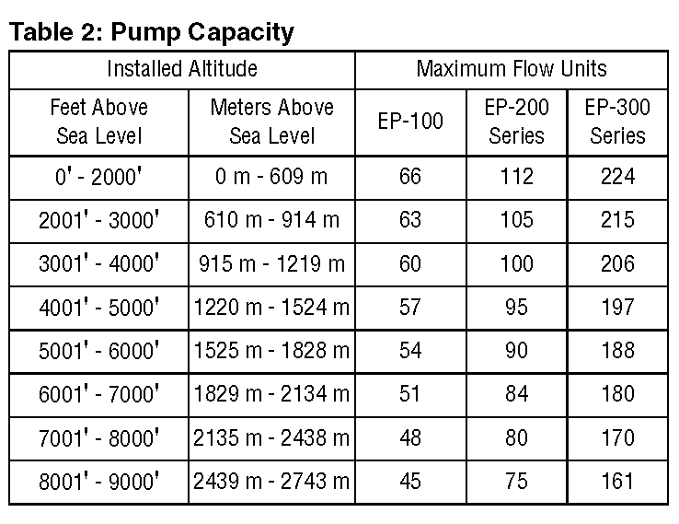
Pump Capacity at Altitude
Notes:
Pump capacity
When the CRV-Series system is designed in accordance with this set of instructions and is in proper operating condition, a vacuum from 2-3" w.c. will be obtainable at each end vent (i.e. at all burners). Vacuum pump capacity is effected by altitude.
Minimum Length of Tailpipe - If less than the minimum length of tailpipe is provided per radiant branch, there will be insufficient cooling of the combustion gases and improper operation of the pump.
More than maximum number of burners or flow units per radiant branch.
Excessive number of elbow or tee fittings which increases vacuum loss.
Excessive back pressure on discharge line of pump can be caused by partial blockage or too much flow for length.
Line Loss Check for Tailpipe (AKA Shared tail pipe) is applicable to sections of tailpipe which are common to two or more radiant branches used by partial blockage or too much flow for length.

Slide 12
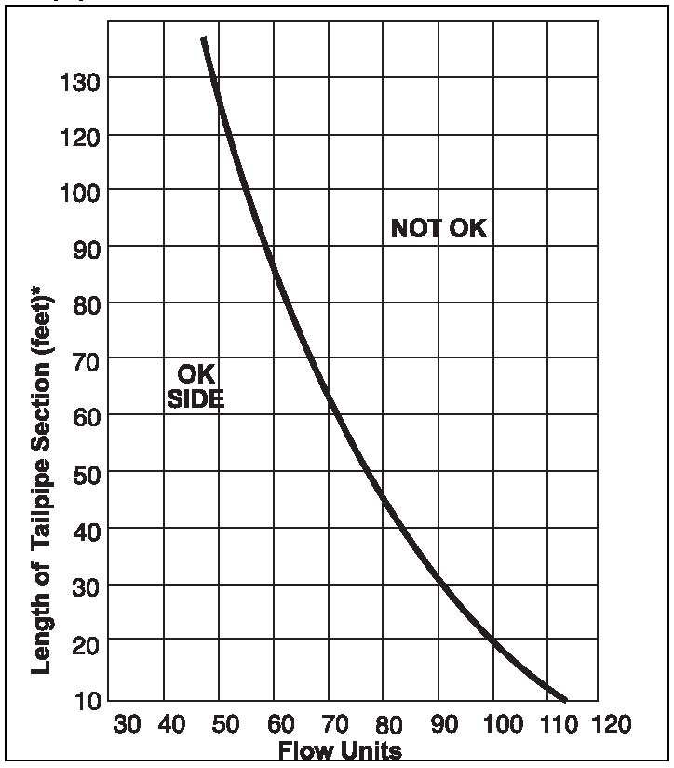
Vacuum Loss
For 4” Shared Tailpipe
Notes:
Figure 15 explains the shared tail pipe vs. the flow units on the system. Readings for length and flow when plotted on the graph must fall on OK side to avoid excessive vacuum losses. I.E. system with 100 flow units should have less than 20’ of the shared tail pipe. If longer the shared tail pipe must be increased to 6”, or a larger vacuum pump must be selected. 6" shared tailpipe limited to maximum of 4 combined branches and length limited to maximum of 100‘, and its recommended with an EP-300 vacuum pump.

Slide 13
Clearances to Combustibles
Have non-stationary items been considered when laying out heaters? See Installation, Operation and Service Manual.
  Garage Doors – Do not place heaters above areas occupied by open overhead doors
  Vehicle Lifts – Do not place heaters directly above lifts, since clearances diminish as the lift rises
  Movable Cranes – Shielding may be required above movable (or even stationary) cranes
Notes:
Clearances are the required distances that combustible objects must be away from the heater to prevent serious fire hazards. Combustibles are materials, which may catch on fire and include common items such as wood, paper, rubber, fabric, etc. The stated clearances to combustibles represents a surface temperature of 90° F above the room temperature.

Slide 14
Mixing Burners
CRV-B6
CRV-B6
CRV-B6
CRV-B8
CRV-B10
CRV-B10
End Vent
End Vent
Notes:
Burners with different inputs can be mixed in the same system, however. You can design the system so the largest BTU burner is first, and smaller BTU burners are downstream.
OR as long as the end vent plate used for the end burner is larger or equal to all other burners in the branch.
For example: The size of the end vent plates dictates these parameters. For example, CRV-B8’s, B-10’s, and B-12’s all have the same end vent plate size.
This means that you can have a CRV-B8 on the end, with a CRV-B10 and or a CRV-B12 or even a burner with a smaller input downstream of the CRV-B8. As long as you maintain the correct distances in between burners as specified in the design manual.

Slide 15
Uneven Branches
Damper
Coupling
CRV-B4
CRV-B4
CRV-B4
End Vent
CRV-B4
CRV-B4
End Vent
Notes:
In the case where uneven system branches are used, damper couplings must be used to obtain the system vacuum balance. If the system is within 10’ difference, you are not required to use a damper coupling. Unbalance system can degrade the system performance. One branch could have too much vacuum and one not enough

Slide 16
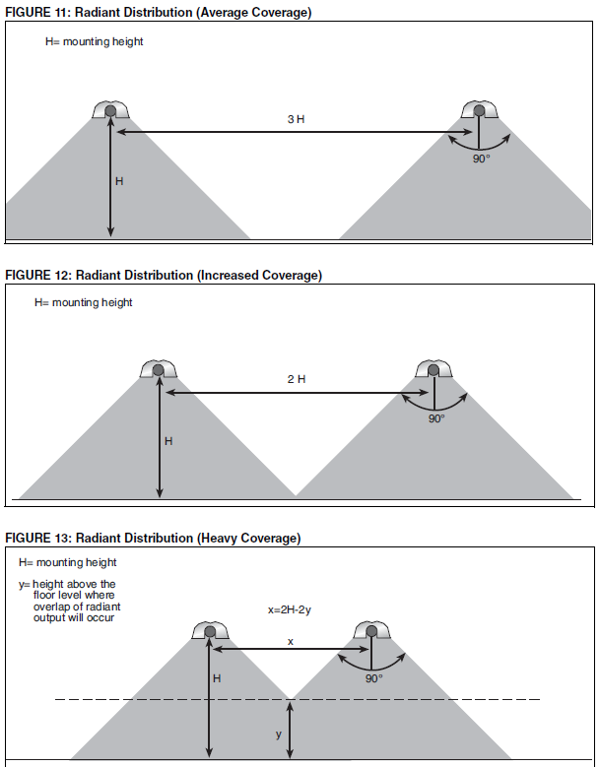
Infrared Distribution:
Notes:
Radiant heat distribution at occupant level must be considered in the burner and design selection process. Distribution of heat between radiant branches at floor level is more critical at the perimeter of buildings where the heat loss is the highest. Normal coverage of radiant heat is the height x 2
The aim of the Average Coverage is to provide average or lighter than average radiant intensity and works well for general building heating. The distance between radiant branches can vary between 2.5 to 4 (or more) times the mounting height. This distribution is commonly used in applications such as warehouses and lower heat loss areas of a building.
The aim of the Increased Coverage is to provide continuous radiant intensity through the whole space
And the Heavy Coverage, is aimed at spot heating the areas requiring the most heat (loading docks etc.) In loading bays, spot heating and areas of high heat loss, the horizontal distance (x) between branches can be as little as 0.5 times the mounting height.

Slide 17
Unitary Layout considerations

Slide 18

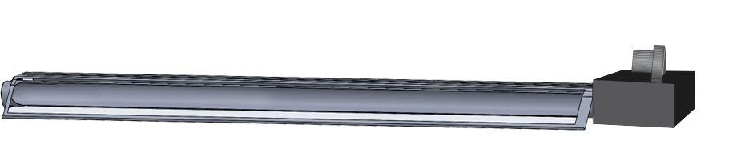
IRH - Operation
Combustion Air Inlet
Notes:
Here we see a visual of an operating twin fire heater

Slide 19
Degree Days
Buffalo | 6489
Norfolk | 3439
Dallas | 2137
Portland, OR | 4294
Louisville | 3917
Atlanta | 2451
Chicago | 6466
Green Bay | 7548
Degree Day Level (65 °F)
Application Type | 2000 | 4000 | 6000 | 8000
Comfort Space Heating | 5-25 | 10-35 | 25-50 | 30-60
Area Heating | 30-50 | 40-80 | 55-100 | 65-120
Station Heating | 45-65 | 80-150 | 100-175 | 120-200
Btu/h/ft-sq
Notes:
This slide is more of a pictorial presentation of the flow units by input, and by the flow units on a single branch of heaters. It helps visualize the system flow. Burners can be mixed with different inputs on a single branch. Highest input must be installed first.

Slide 20
Qualifying Questions
Building location?
  Climate plays a big role in determining total BTU required
Is there access to gas and electricity?
  IRH heaters run on 120vac and require NG or LP gas to operate
Are we heating the entire space, or focusing heat in a certain area (spot heating)?
Tell me about the building or space we are heating
Collect information about the space such as: dimensions (HxWxL), if loading docks – size of doors and how many, how often are the doors left open, etc..
What temperature are you looking to maintain?
Are there obstacles that would prevent the heaters from being installed in the preferred location?
Clearances, garage doors(open vs. close), car lifts, etc..

Slide 21
Clearances to Combustibles
Have non-stationary items been considered when laying out heaters?
Garage Doors – Do not place heaters above areas occupied by open overhead doors
Vehicle Lifts – Do not place heaters directly above lifts, since clearances diminish as the lift rises
Movable Cranes – Shielding may be required above movable (or even stationary) cranes
Notes:
Clearances are the required distances that combustible objects must be away from the heater to prevent serious fire hazards. Combustibles are materials, which may catch on fire and include common items such as wood, paper, rubber, fabric, etc. The stated clearances to combustibles represents a surface temperature of 90° F above the room temperature.

Slide 22
Infrared Distribution:
Notes:
Radiant heat distribution at occupant level must be considered in the burner and design selection process. Distribution of heat between radiant branches at floor level is more critical at the perimeter of buildings where the heat loss is the highest. Normal coverage of radiant heat is the height x 2
The aim of the Average Coverage is to provide average or lighter than average radiant intensity and works well for general building heating. The distance between radiant branches can vary between 2.5 to 4 (or more) times the mounting height. This distribution is commonly used in applications such as warehouses and lower heat loss areas of a building.
The aim of the Increased Coverage is to provide continuous radiant intensity through the whole space
And the Heavy Coverage, is aimed at spot heating the areas requiring the most heat (loading docks etc.) In loading bays, spot heating and areas of high heat loss, the horizontal distance (x) between branches can be as little as 0.5 times the mounting height.

Slide 23
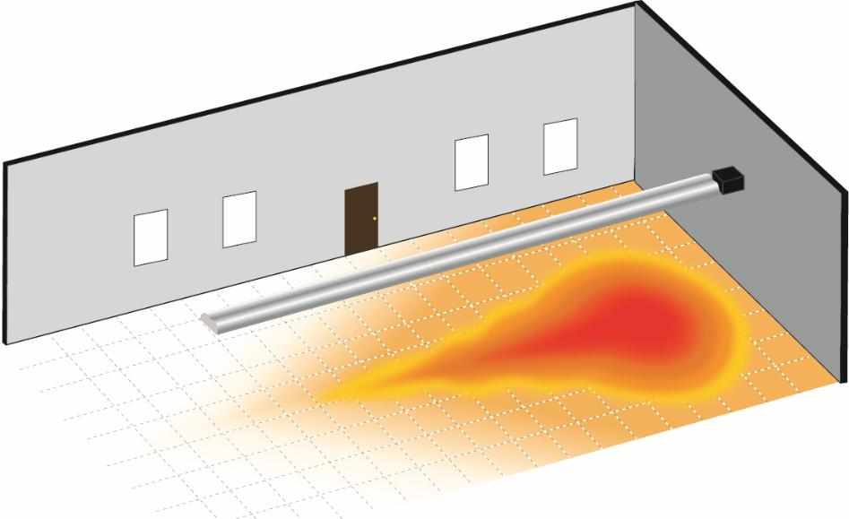
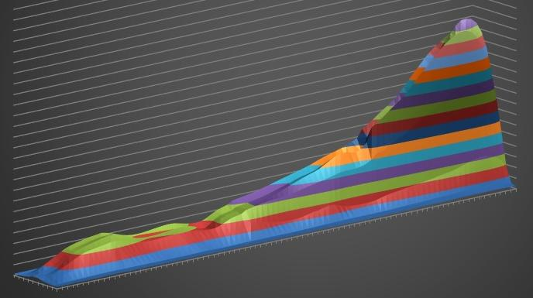
THE TEAR DROP
Burner end
Upside Down Tear Drop
Heat Pattern
100,000 BTU/h – 30’
Radiant Heat Output
Notes:
The image on the right shows the amount of radiant heat that a 100,000 BTU 30’ heater outputs. As you can see, there is a higher concentration of radiant output closer to the burner.
This creates an uneven heat distribution throughout the heat exchanger as you can see in the image on the left.
However, this can easily be resolved by a proper layout. If the room on the left required 200,000 BTU to satisfy the heat-loss, putting in a single 200,000 BTU heater could be a poor solution.

Slide 24
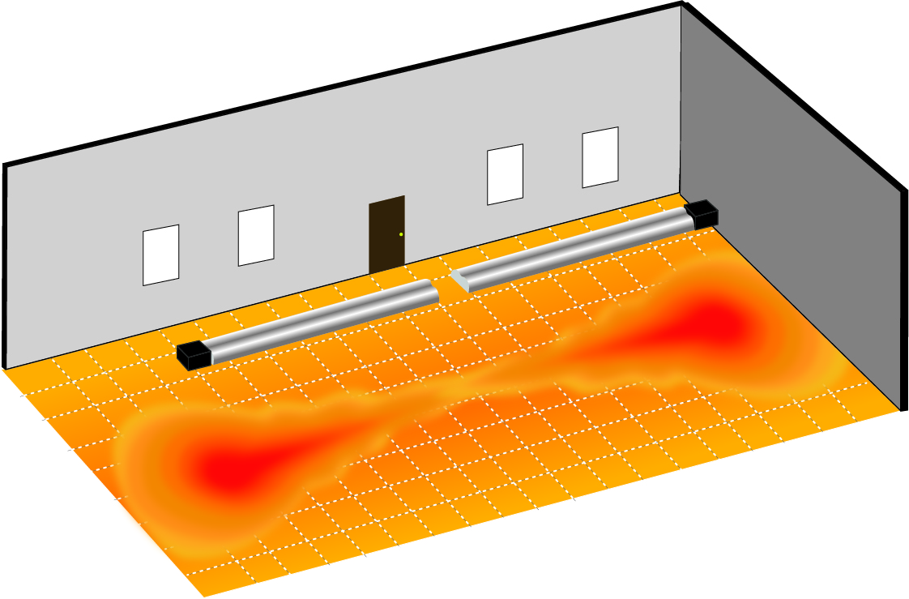
Proper layout and design
Notes:
A better solution would be to layout multiple heater with smaller inputs to even out the heat distribution.
If this was the same room that required 200,000 BTU to satisfy the heat-loss, laying out 2 – 100,000 BTU heaters opposite of each other would provide a better heat distribution throughout the space.

Slide 25
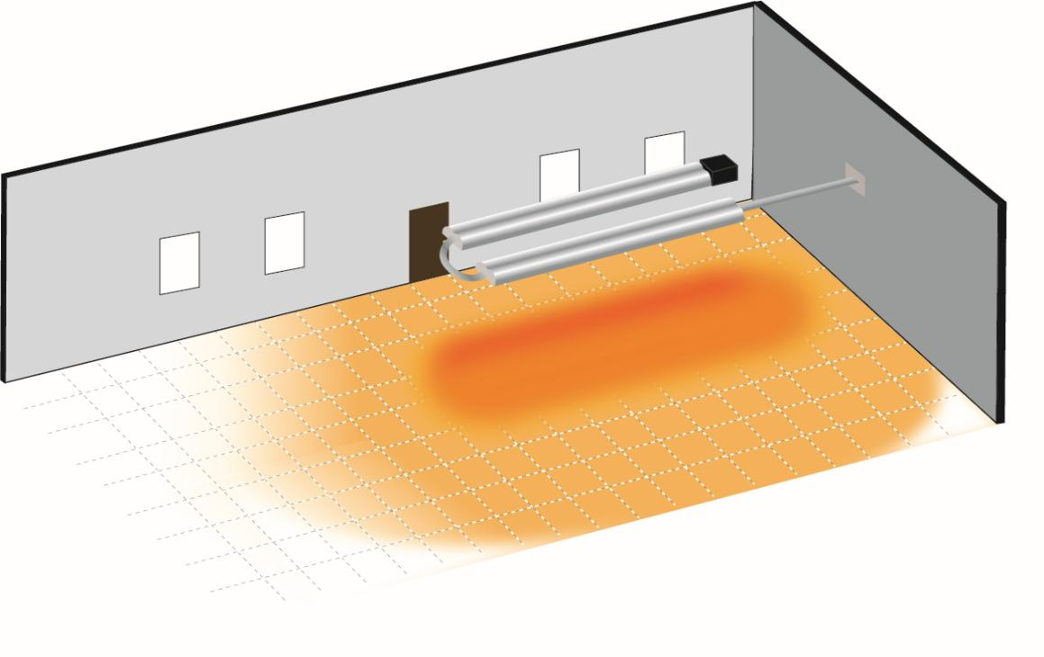
RADIANT DISTRIBUTION WITH A SINGLE UNIT (U-Tube)
Notes:
Unitary heaters can be used to your advantage by directing heat only where heat is needed.
Some applications only require specific areas to be heated, such as a work station. Other areas such as storage areas may not need heat.
This type of application is called spot heating.
Spot heating can be achieved with straight heaters. But to maximize heat distribution in a specified area, a U-tube design may be a better choice.

Slide 26
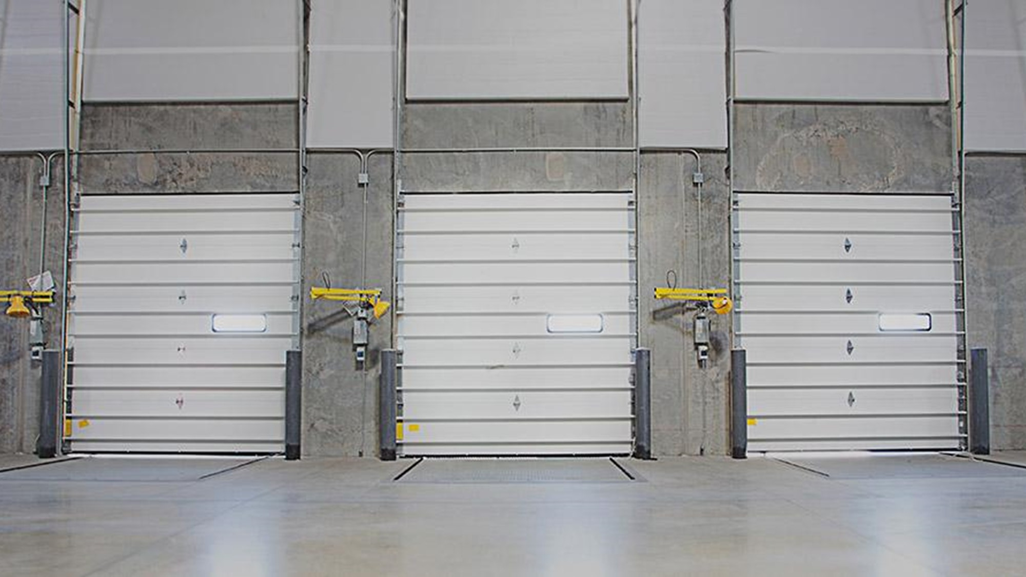
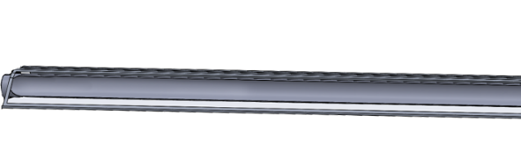

Slide 28
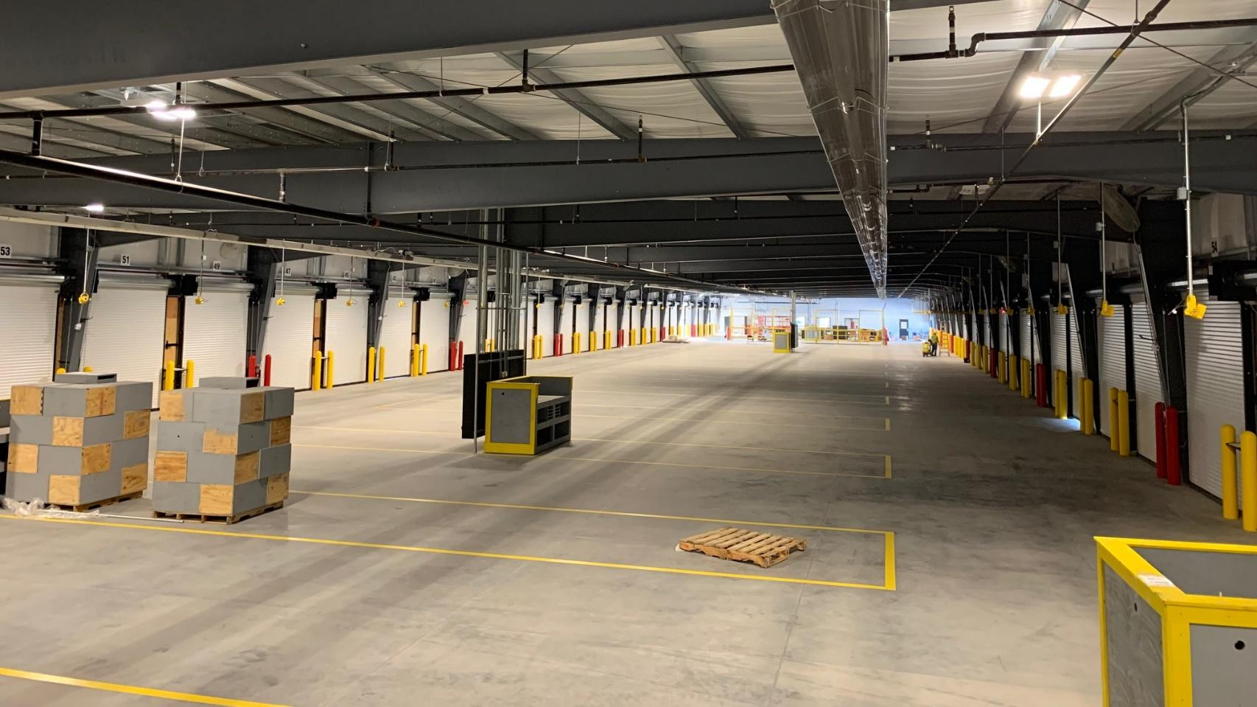
Notes:
The Vantage TF, or twin-fire heater, produces a flame from both sides of the burner giving you the advantage of having 2 separate heaters in a single enclosure. Saving contractors and end sures money by reducing equipment and installation costs with a single gas line and single electrical hook-up.
This is a highly specifiable product as no other manufacture in the industry offers anything like it.
With an output that ranges between 120,000 and an industry highest 380,000 BTU’s, the Vantage TF is fantastic for use in high heat-loss areas such as loading docks, or can be stretched to up to 120’ long for general space heating.
BTU’s range from: 120, 160, 200, 250, 300, 350, 380
Lengths: min 20’ (6m), max 60’ (18m) each side

Slide 29
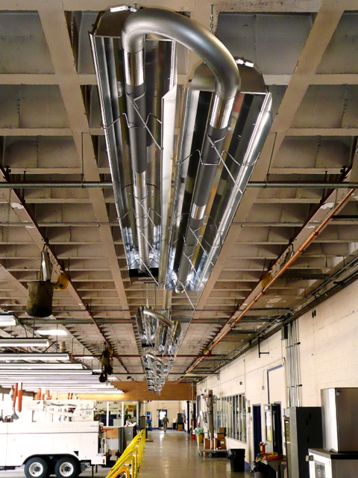

Slide 30
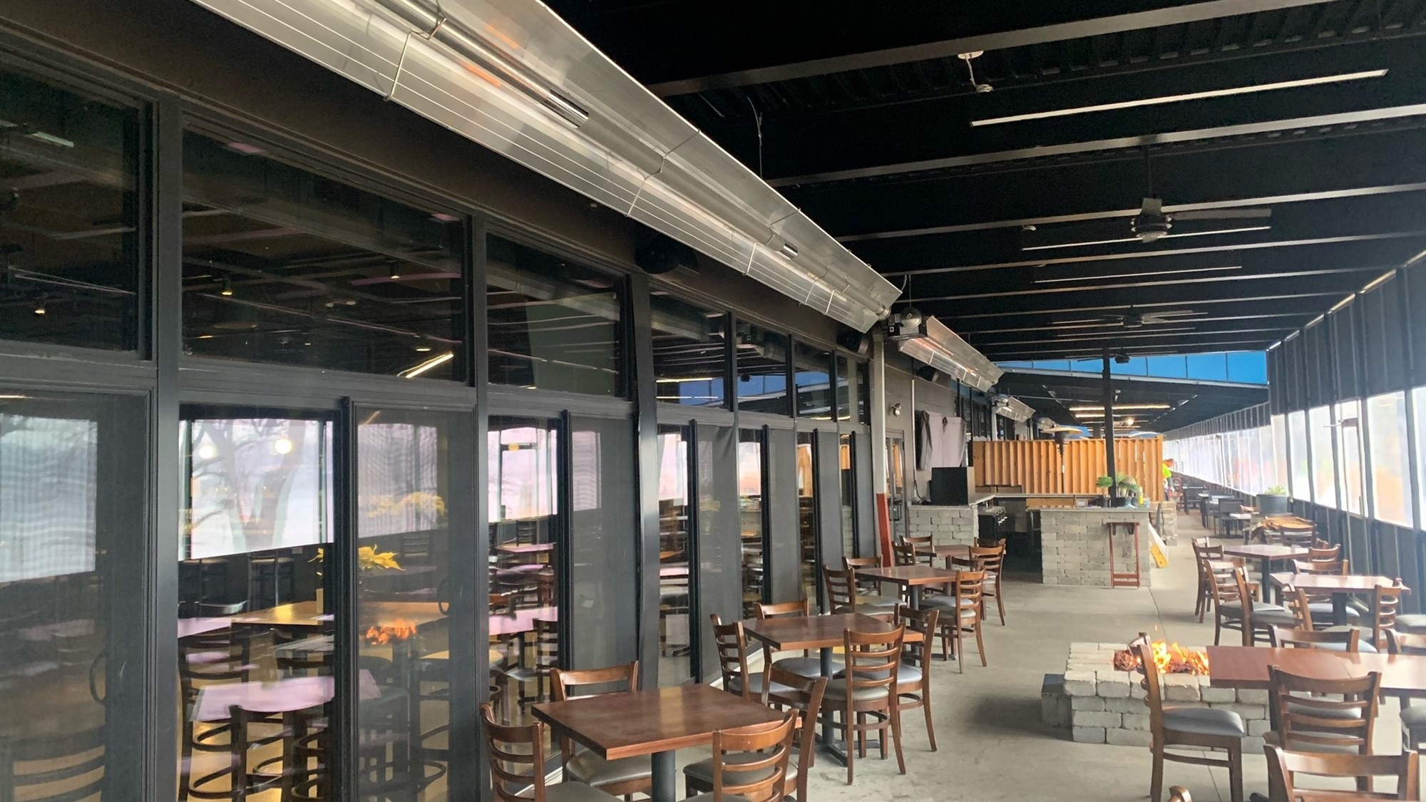

Slide 31
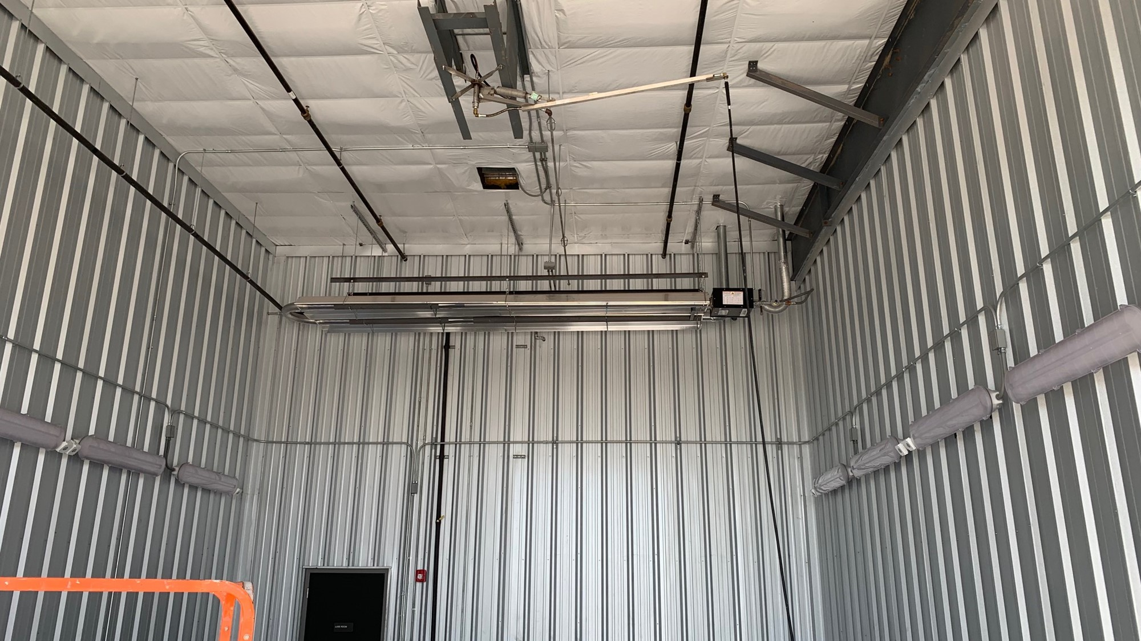

Slide 32
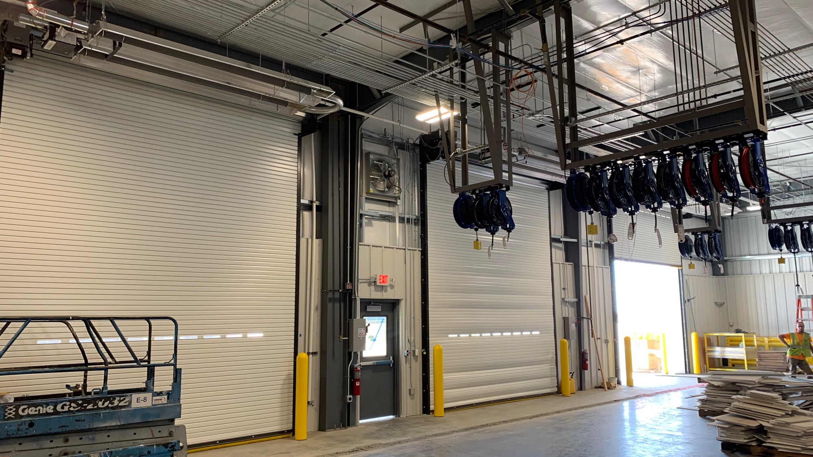

Slide 33
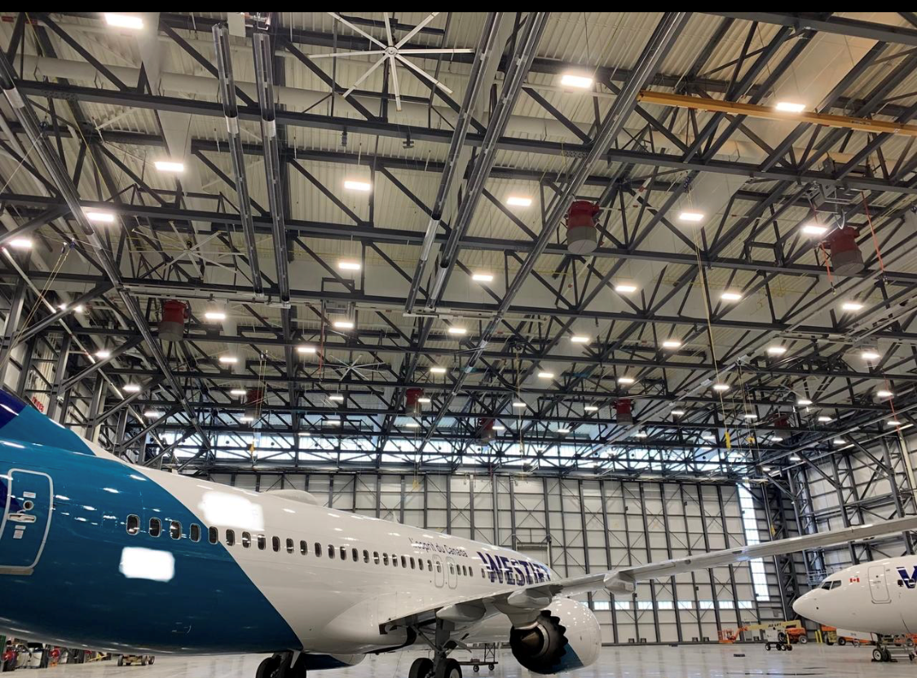

Slide 34
We can do it for you!

Slide 35
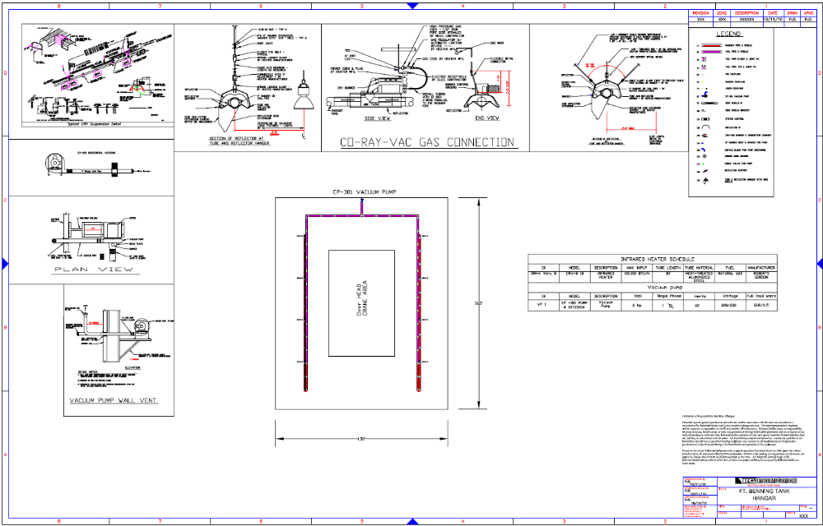
Sample Drawings
Notes:
This is a complete drawing with a legend, and a schedule.
This is an affective way of getting RG equipment specified.

Slide 36
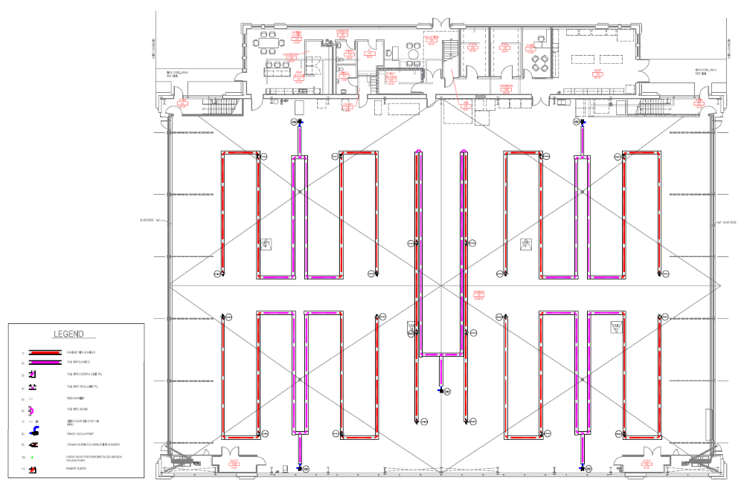
Sample Drawings
Notes:
This is a complete drawing with a legend, and a schedule.
This is an affective way of getting RG equipment specified.

Slide 37
Thank You!
Questions?

