Slide 1
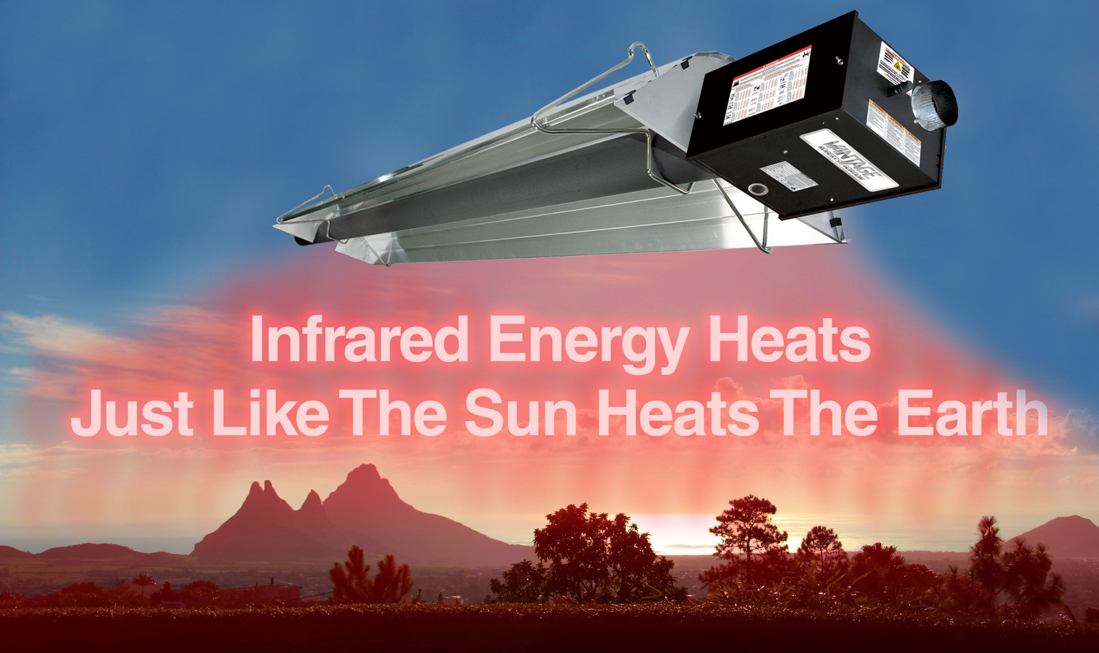

Slide 2

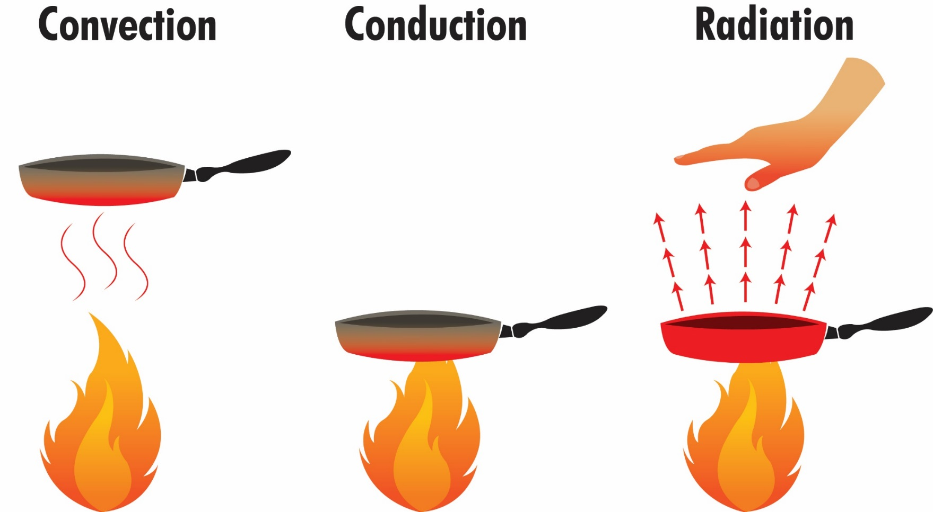
Infrared Heating Utilizes
All Methods Of Heat Transfer

Slide 3
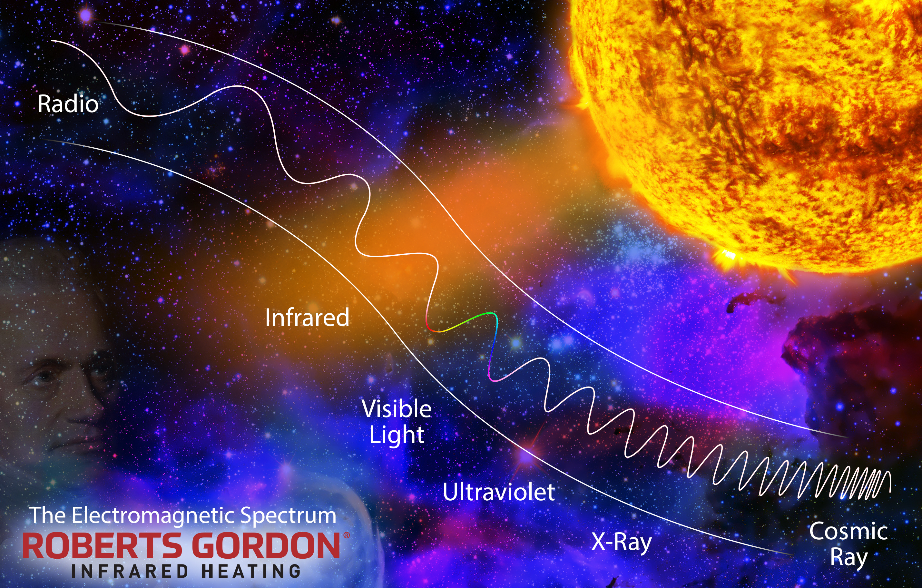

Slide 4
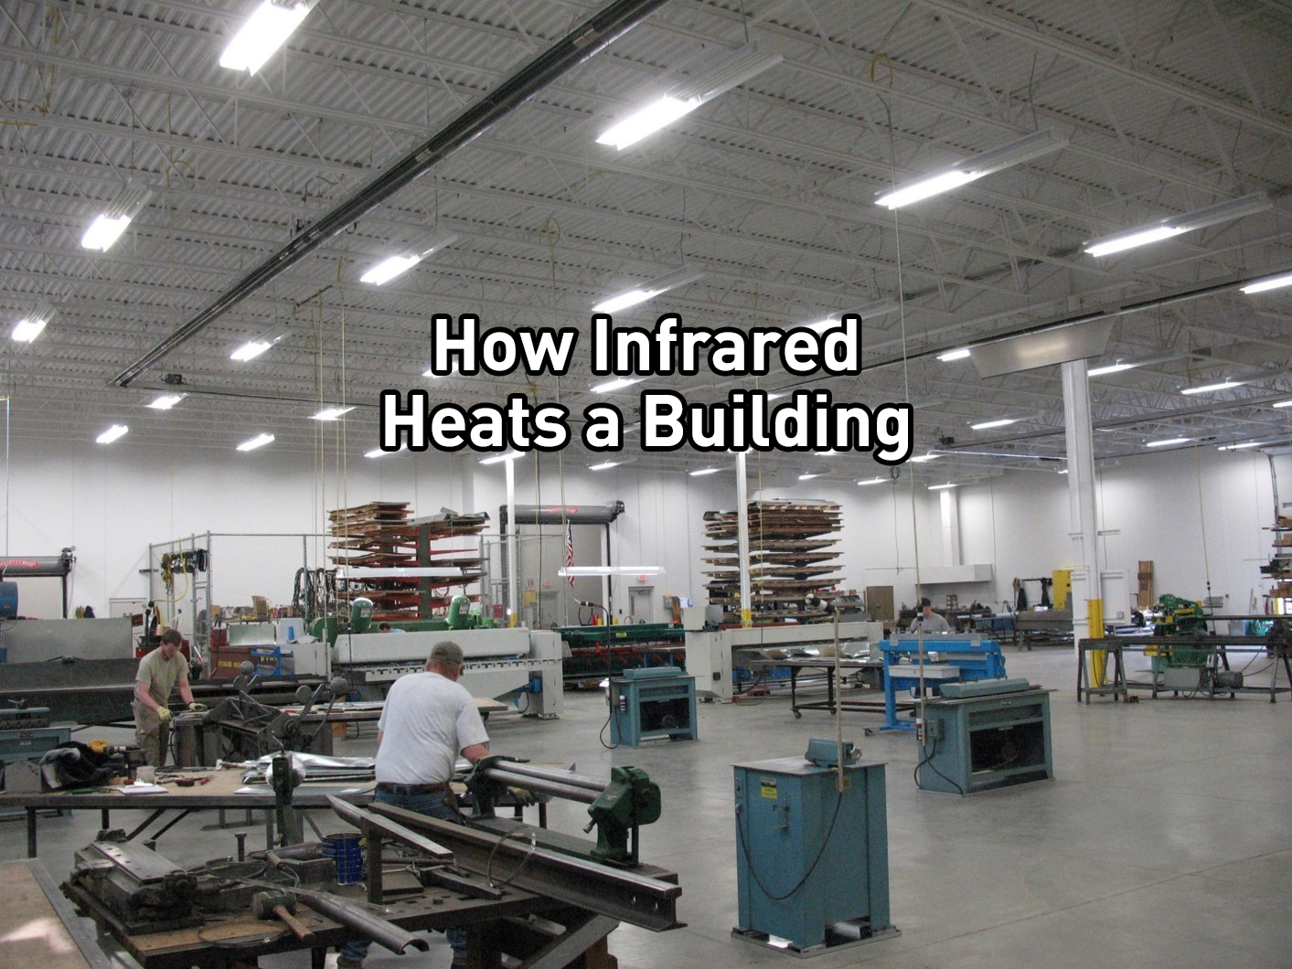

Slide 5
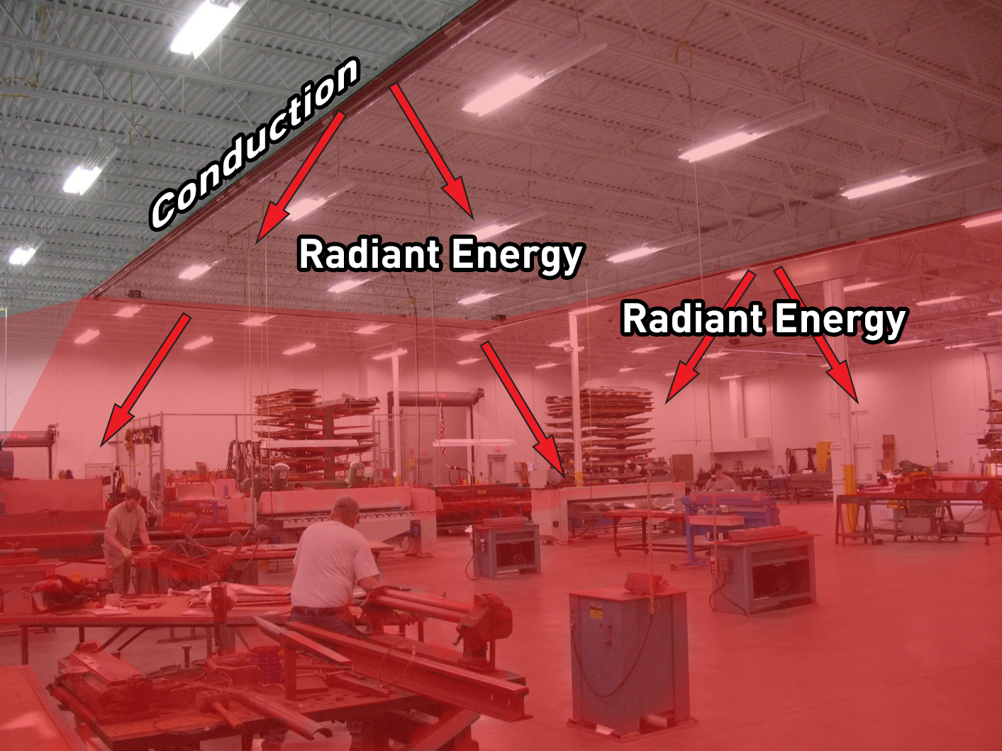

Slide 6


Slide 7
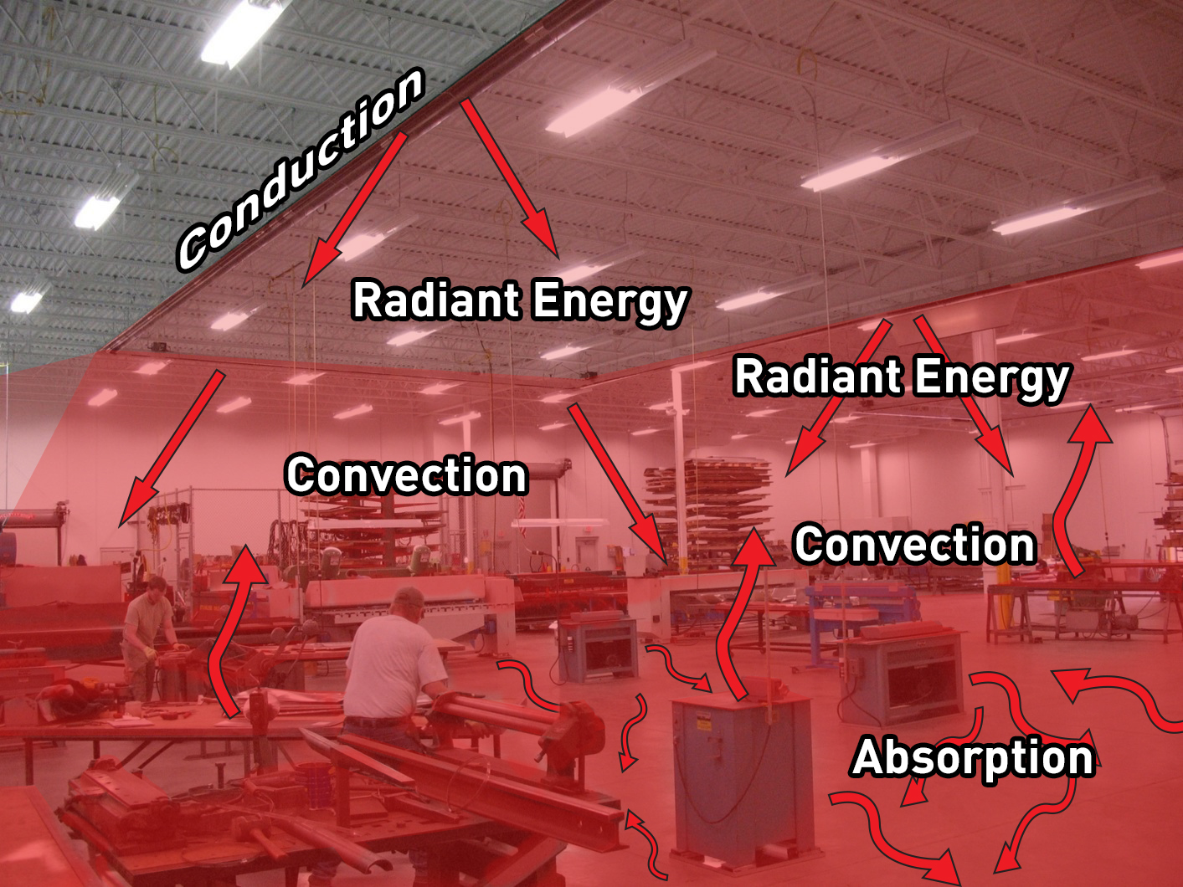

Slide 8
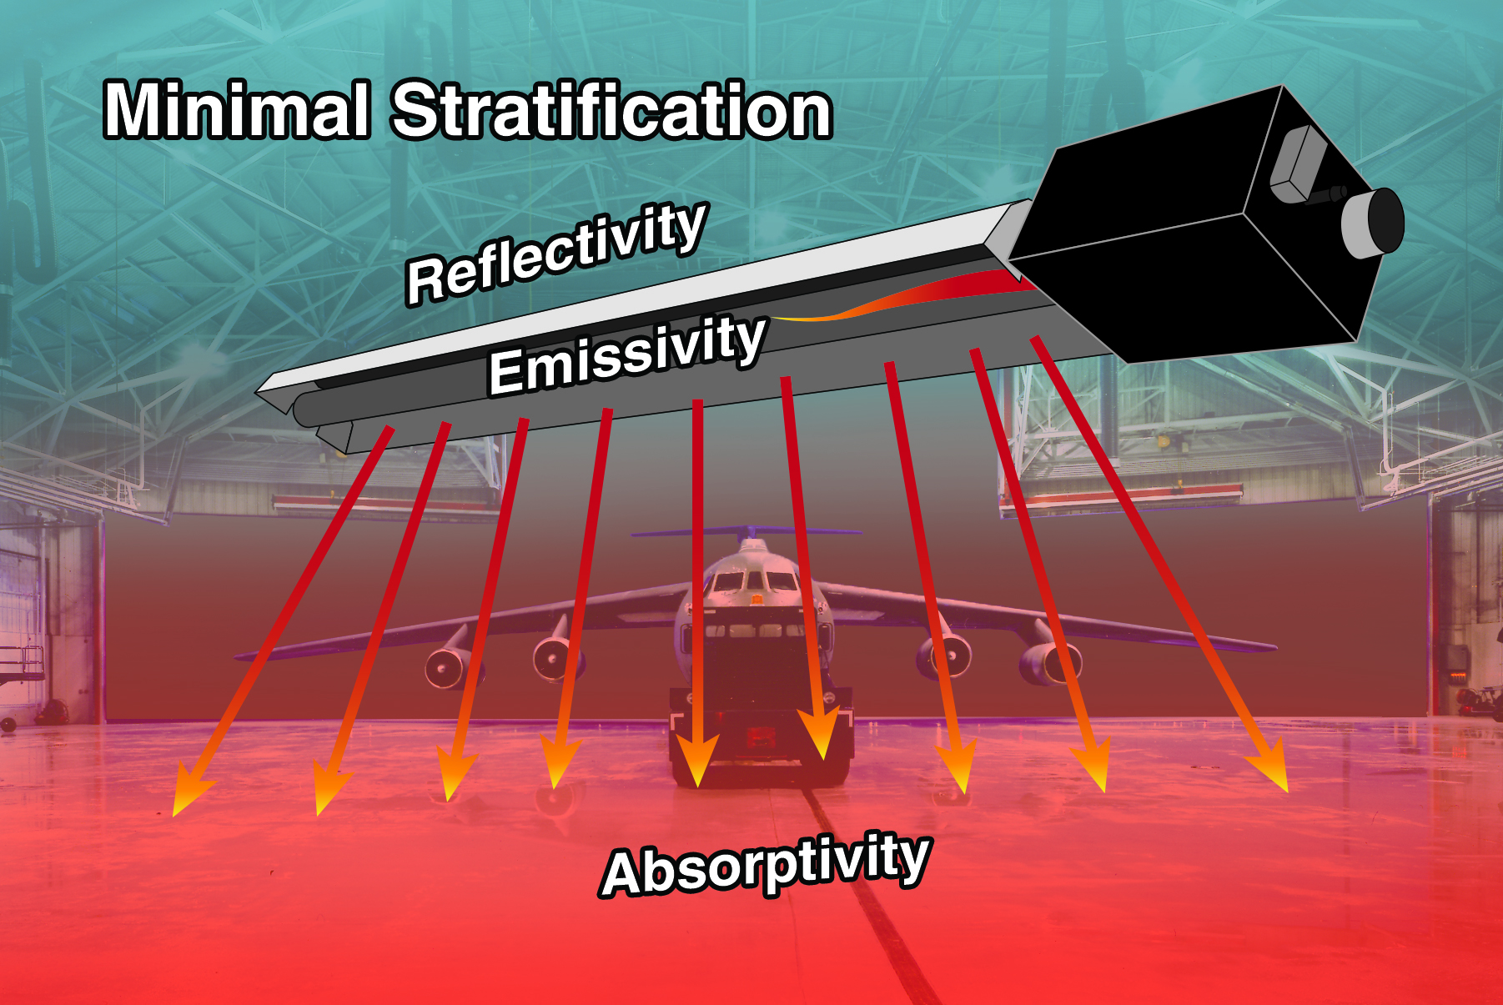

Slide 9
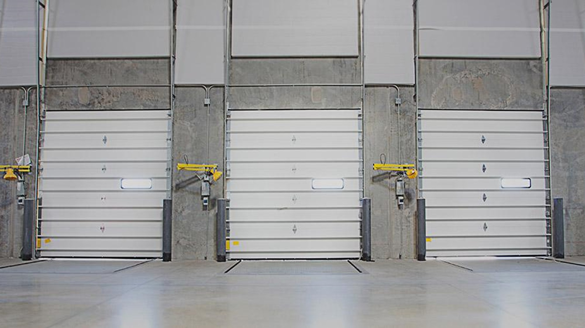
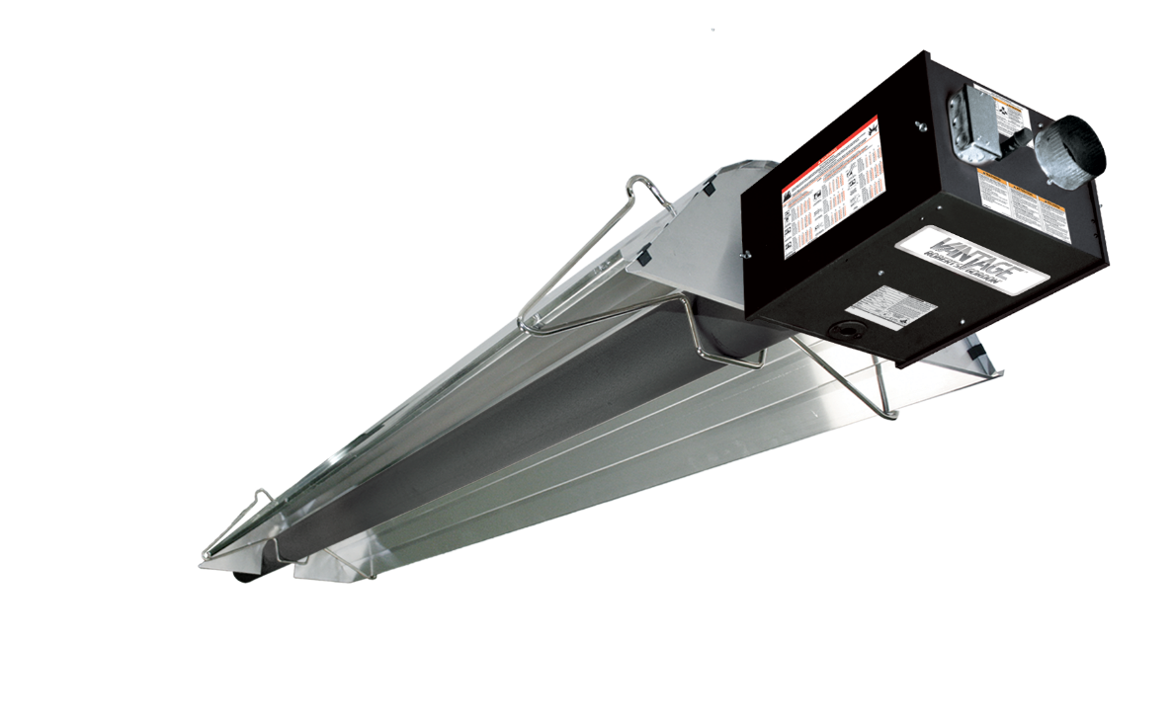
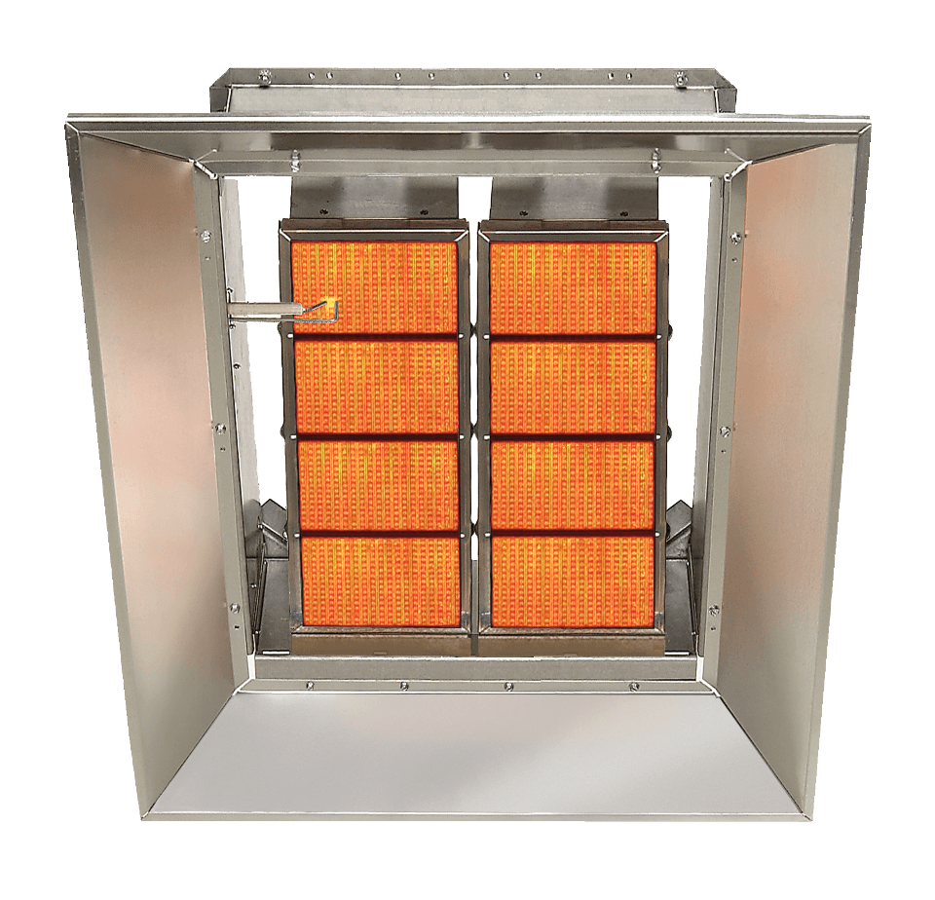
Absorption of infrared in
concrete
Vs.
70%
85%

Slide 10
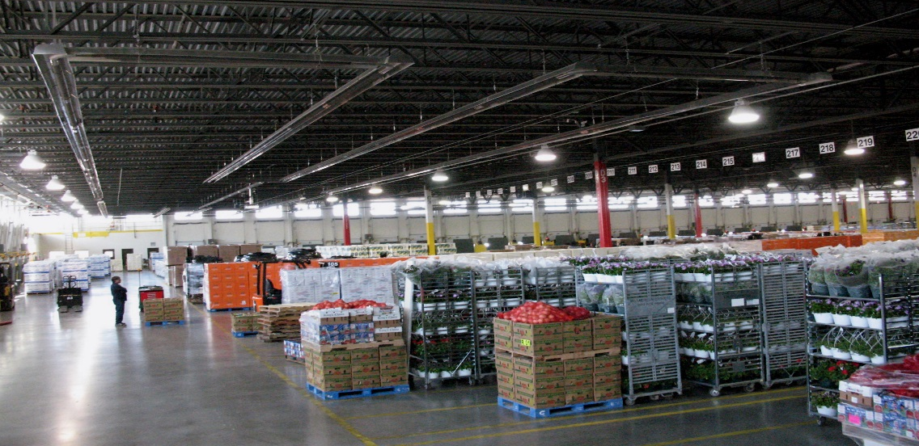
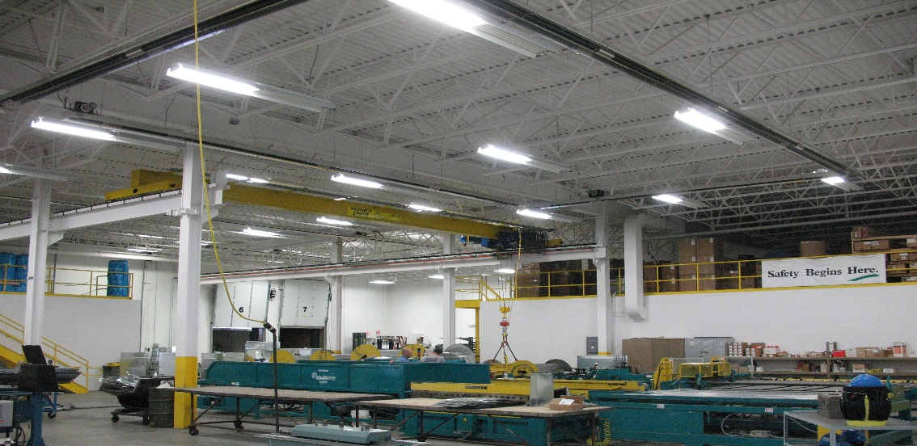
Infrared Design Concepts
Sufficient “Charge”
  Floor must exchange energy with surroundings
Heat distribution
  Must heat floor evenly to increase MRT
Design for comfort
  Receive gentle blanket of infrared heat
Notes:
Radiant heat design methods typically start with a focus around comfort. In order to maximize fuel efficiency along with comfort, these 3 design concepts are most important.

Slide 11
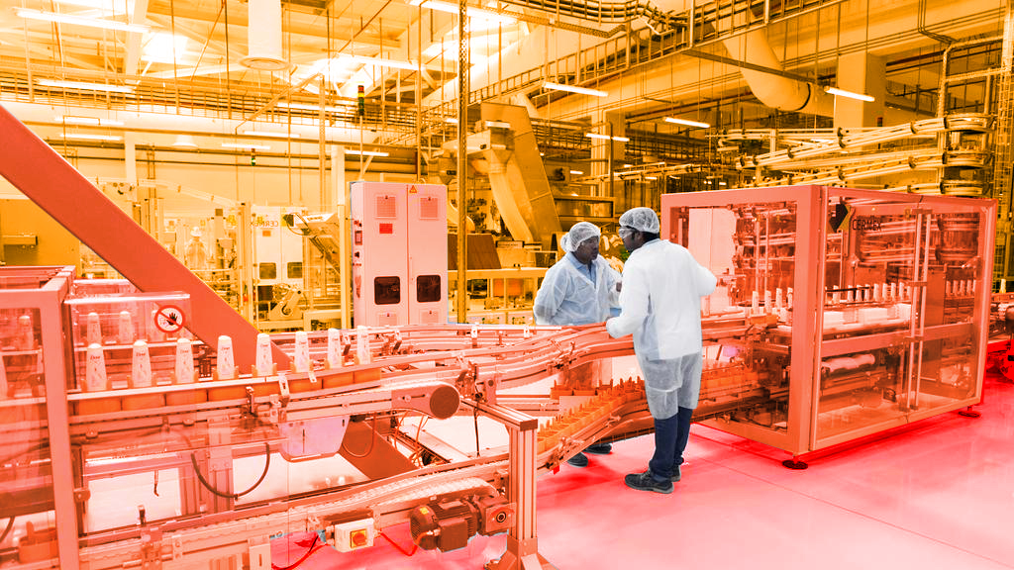
Increasing the Mean Radiant Temperature (MRT) improves the Operative Temperature (t_{o})
Notes:
Radiant energy received by the occupants directly from the heater or indirectly from the surrounding objects will help increase the Mean Radiant Temperature (MRT). Just like directly sunlight, the increased MRT allows the occupants to feel comfort at a reduced air temperature.
The Operative Temperature is largely influenced by the Mean Radiant Temperature. Radiant heaters are fantastic at increasing the MRT because radiant heaters heat objects directly. Those objects in turn absorb the energy and will then re-radiant that energy.

Slide 12
ASHRAE 55
OPERATIVE TEMPERATURE (T_{o}) calculations
t_{o}
MRT + t_{a}
Formula:
=
2
Air Heating (example)
MRT = 65°F Ta = 75°F
65
°F
+ 75
°F
T_{o}
=
= 70
°F
2
Notes:
Operative Temperature – is a term from the ASHRAE standard 55 “ Thermal Environmental Conditions for Human Occupancy” as well as the ASHRAE fundamentals Chapter 9 “Thermal Comfort” With Radiant heating, we know we will get “equivalent perceived comfort at a lower air temperature”. For many years we have used this formula to help explain how it is possible to have comfort at a lower air temperature. We have used analogies such as standing in the sun on a cool day versus the shade.
So in the air heated case, using air as the heating medium, we have to heat the air somewhat higher than the desired temperature so that we can get the objects warm enough to satisfy the equation.
In the “Air Heating” formula, it explains that in order to achieve a perceived comfort of 70ºF, a higher air temperature (75°F) is required to increase the MRT to 65°F. This combination is required to achieve a perceived comfort of 70°F.
In the radiant heated case- we have always taught that you can get the same comfort at a lower air temperature if you can raise the MRT. Raising the MRT in the Radiant case is easy because we heat the objects directly and the air is subsequently heated convectively from the objects.
The “Infrared Heating” formula shows increased MRT (75°F) creates an air temperature of 65°F through convection. This combination of a higher MRT and a lower air temperature creates a perceived comfort of 70°F.
This is what we have known and taught for years. It’s the foundation for fuel savings and the foundation for the ASHRAE infrared heat-loss correction factor.

Slide 13
ASHRAE 55
OPERATIVE TEMPERATURE (T_{o}) calculations
t_{o}
MRT + t_{a}
Formula:
=
2
Radiant Heating (example)
MRT = 75°F Ta = 65°F
75
°F
+ 65
°F
T_{o}
=
= 70
°F
2

Slide 14
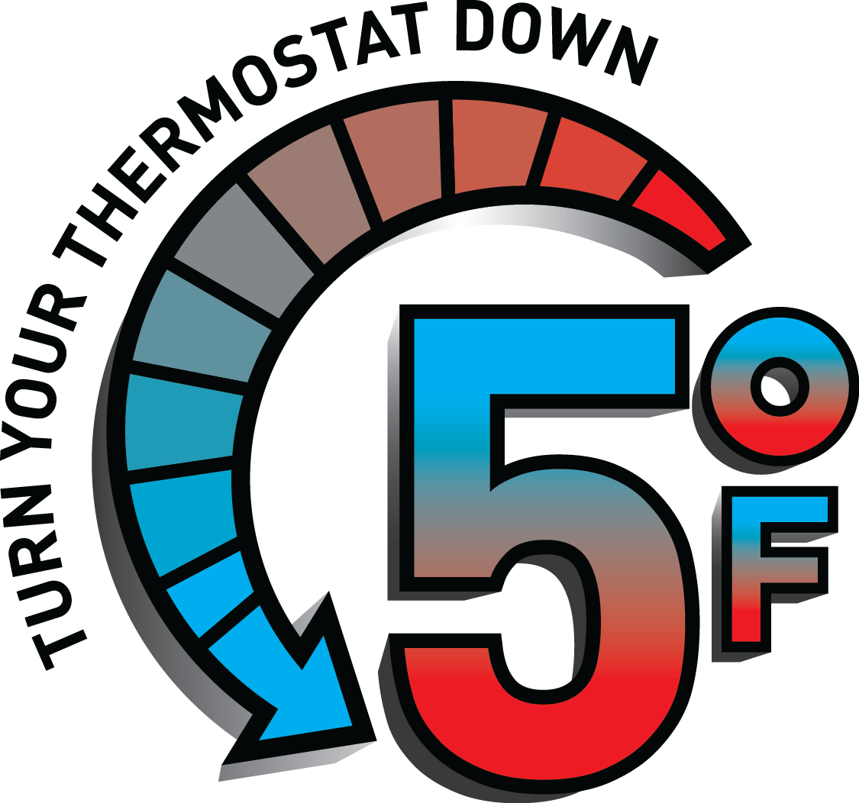
Turning the Thermostat Down
REMEMBER:
“Equivalent perceived comfort at lower air temperatures”
Infrared Heating
75
°F
+ 65
°F
T_{o}
=
= 70
°F
2
  For every degree that you lower the thermostat setting, you save approximately 3-4% in fuel usage
Notes:
It has been well documented that for every 1 degree that you lower your thermostat, you can save 3 to 4% on your fuel usage.
As described in the “operative temperature” slide shown previously, because infrared heats the air and occupants in the space directly, and the fact that thermostats work by sensing air temperature, it is normal to lower the thermostat setting approximately 5 degrees and have a perceived comfort level as if the air temperature was 70 degrees.
It is this logic that influenced us to offer a thermostat with a 1 to 5 setting instead of temperature setting. Most occupants would want to turn the thermostat up to 70, which is too warm for a radiant heating application. We recommend the thermostat to be set to 3 which is actually approximately a 65 degrees F setting. But the occupants will feel as if the air temperature is 70° F.
With our new high efficiency reflectors, we recommend setting the thermostat to 2.5, which is a 60° F setting. This is because our new high efficiency reflectors will provide more radiant heat to the floor thus increasing the MRT and the operative temperature.

Slide 15

Adjustment Factor for
Infrared Equipment Sizing
“Recognizing the reduced fuel requirement for these applications, …. it is desirable for manufacturers of radiant heaters to recommend installation of equipment with a rated output that is 80 to 85% of the heat loss calculated by methods described in Chapters 17 and 18 of the 2013 ASHRAE Handbook – Fundamentals.”
- “Infrared Radiant Heating.” 2016 ASHRAE Handbook HVAC
Systems and Equipment. Atlanta, GA: ASHRAE,
2016. 16.1. Print.

Slide 16
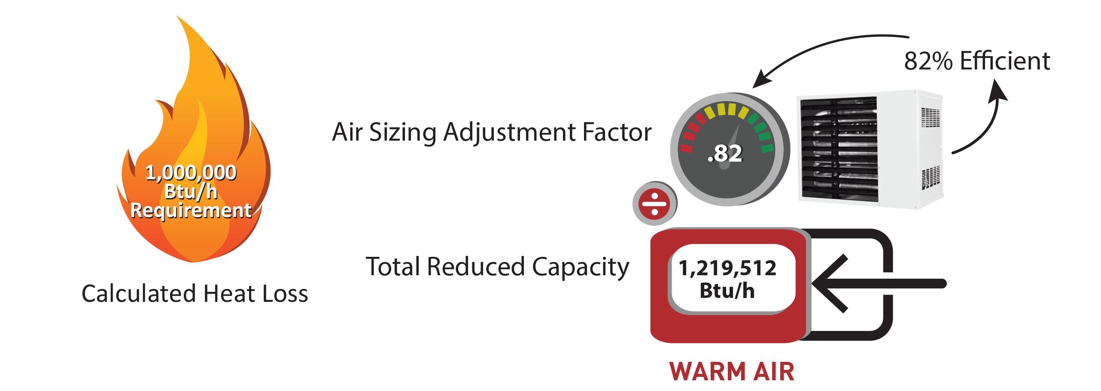
Adjustment Factor for
Air Equipment Sizing

Slide 17
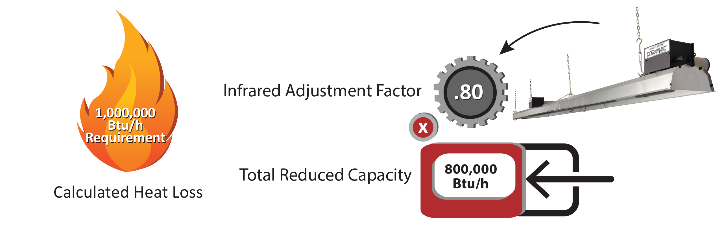
Adjustment Factor for
Infrared Equipment Sizing

Slide 18
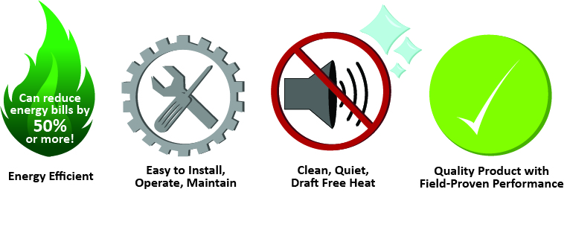
Benefits of Low-Intensity Infrared

Slide 19
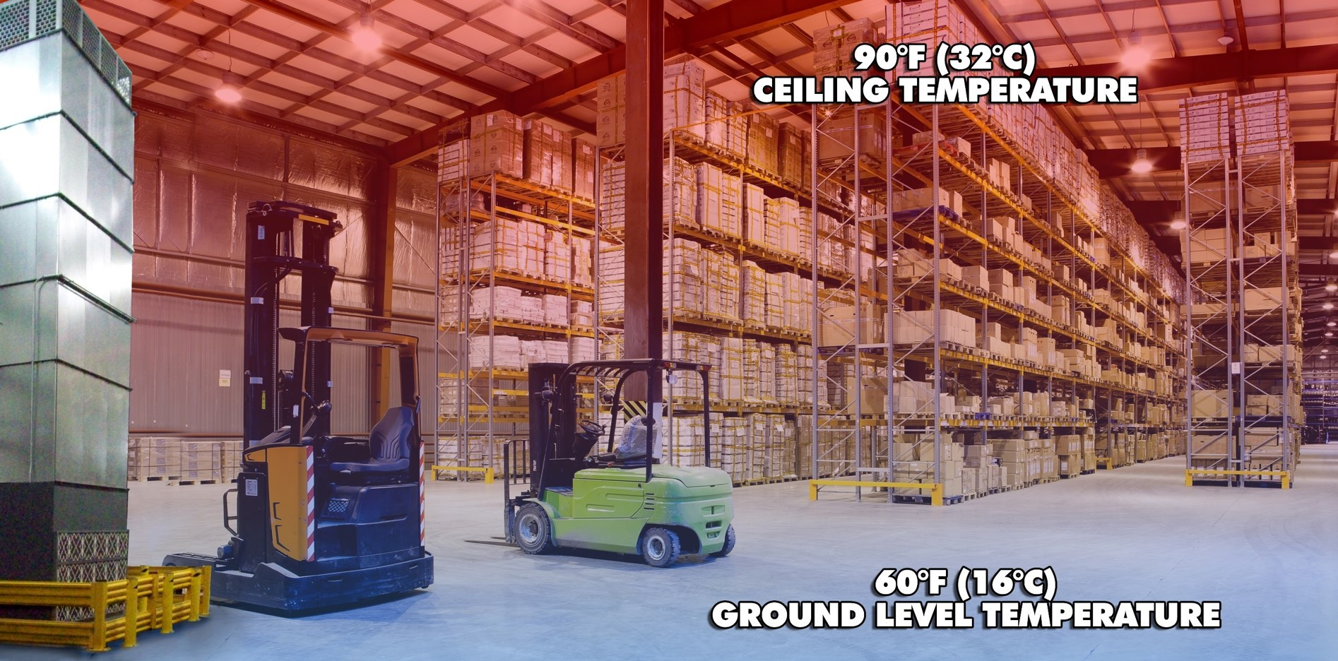
HOW WARM AIR HEATS A BUILDING
HOW WARM AIR HEATS A BUILDING

Slide 20
Degree Days
Buffalo | 6489
Norfolk | 3439
Dallas | 2137
Portland, OR | 4294
Louisville | 3917
Atlanta | 2451
Chicago | 6466
Green Bay | 7548
Degree Day Level (65 °F)
Application Type | 2000 | 4000 | 6000 | 8000
Comfort Space Heating | 5-25 | 10-35 | 25-50 | 30-60
Area Heating | 30-50 | 40-80 | 55-100 | 65-120
Station Heating | 45-65 | 80-150 | 100-175 | 120-200
Btu/h/ft-sq
Notes:
This slide is more of a pictorial presentation of the flow units by input, and by the flow units on a single branch of heaters. It helps visualize the system flow. Burners can be mixed with different inputs on a single branch. Highest input must be installed first.

Slide 21
Qualifying Questions
Building location?
  Climate plays a big role in determining total BTU required
Is there access to gas and electricity?
  IRH heaters run on 120vac and require NG or LP gas to operate
Are we heating the entire space, or focusing heat in a certain area (spot heating)?
Tell me about the building or space we are heating
Collect information about the space such as: dimensions (HxWxL), if loading docks – size of doors and how many, how often are the doors left open, etc..
What temperature are you looking to maintain?
Are there obstacles that would prevent the heaters from being installed in the preferred location?
Clearances, garage doors(open vs. close), car lifts, etc..

Slide 22
Clearances to Combustibles
Have non-stationary items been considered when laying out heaters?
Garage Doors – Do not place heaters above areas occupied by open overhead doors
Vehicle Lifts – Do not place heaters directly above lifts, since clearances diminish as the lift rises
Movable Cranes – Shielding may be required above movable (or even stationary) cranes
Notes:
Clearances are the required distances that combustible objects must be away from the heater to prevent serious fire hazards. Combustibles are materials, which may catch on fire and include common items such as wood, paper, rubber, fabric, etc. The stated clearances to combustibles represents a surface temperature of 90° F above the room temperature.

Slide 23
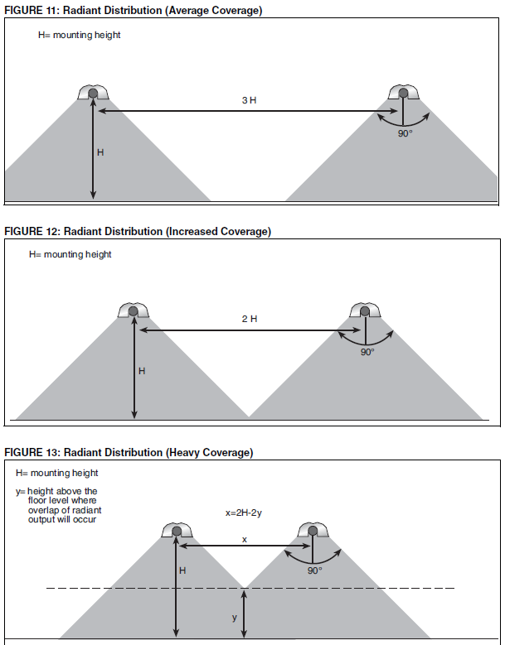
Infrared Distribution:
Notes:
Radiant heat distribution at occupant level must be considered in the burner and design selection process. Distribution of heat between radiant branches at floor level is more critical at the perimeter of buildings where the heat loss is the highest. Normal coverage of radiant heat is the height x 2
The aim of the Average Coverage is to provide average or lighter than average radiant intensity and works well for general building heating. The distance between radiant branches can vary between 2.5 to 4 (or more) times the mounting height. This distribution is commonly used in applications such as warehouses and lower heat loss areas of a building.
The aim of the Increased Coverage is to provide continuous radiant intensity through the whole space
And the Heavy Coverage, is aimed at spot heating the areas requiring the most heat (loading docks etc.) In loading bays, spot heating and areas of high heat loss, the horizontal distance (x) between branches can be as little as 0.5 times the mounting height.

Slide 24
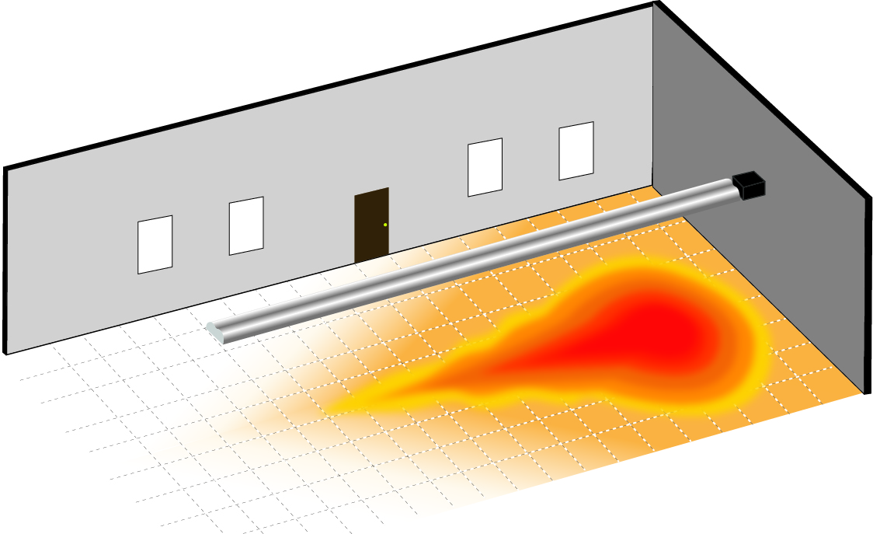
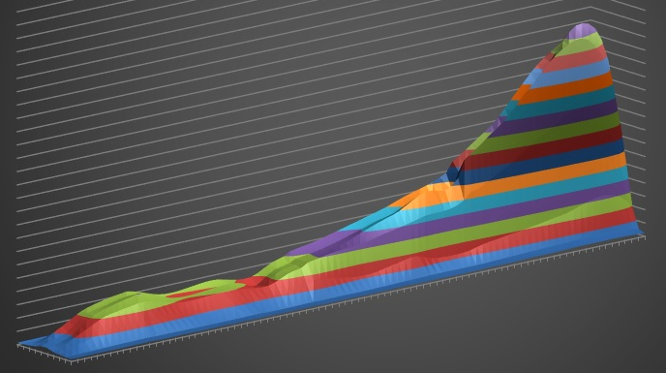
THE TEAR DROP
Burner end
Upside Down Tear Drop
Heat Pattern
100,000 BTU/h – 30’
Radiant Heat Output
Notes:
The image on the right shows the amount of radiant heat that a 100,000 BTU 30’ heater outputs. As you can see, there is a higher concentration of radiant output closer to the burner.
This creates an uneven heat distribution throughout the heat exchanger as you can see in the image on the left.
However, this can easily be resolved by a proper layout. If the room on the left required 200,000 BTU to satisfy the heat-loss, putting in a single 200,000 BTU heater could be a poor solution.

Slide 25
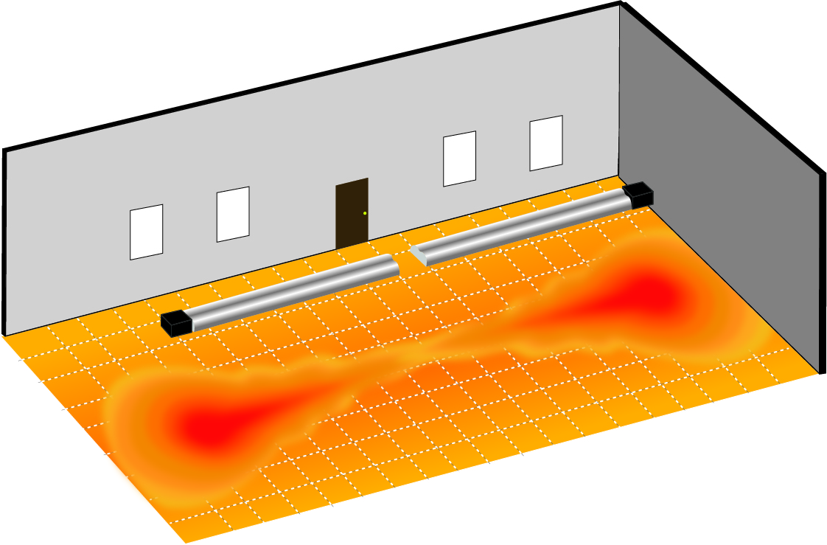
Proper layout and design
Notes:
A better solution would be to layout multiple heater with smaller inputs to even out the heat distribution.
If this was the same room that required 200,000 BTU to satisfy the heat-loss, laying out 2 – 100,000 BTU heaters opposite of each other would provide a better heat distribution throughout the space.

Slide 26
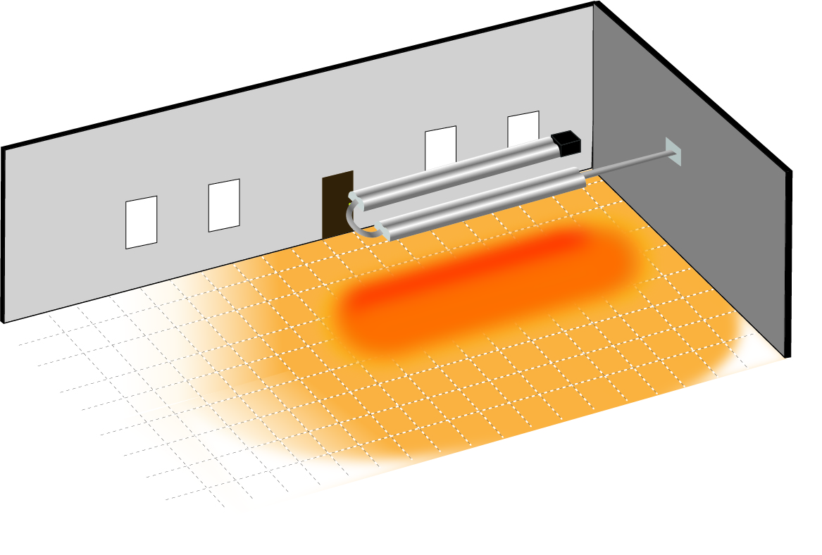
RADIANT DISTRIBUTION WITH A SINGLE UNIT (U-Tube)
Notes:
Unitary heaters can be used to your advantage by directing heat only where heat is needed.
Some applications only require specific areas to be heated, such as a work station. Other areas such as storage areas may not need heat.
This type of application is called spot heating.
Spot heating can be achieved with straight heaters. But to maximize heat distribution in a specified area, a U-tube design may be a better choice.

Slide 27
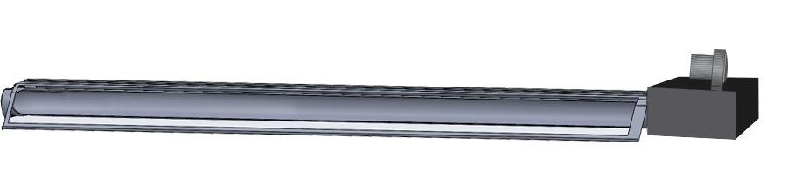

Slide 29
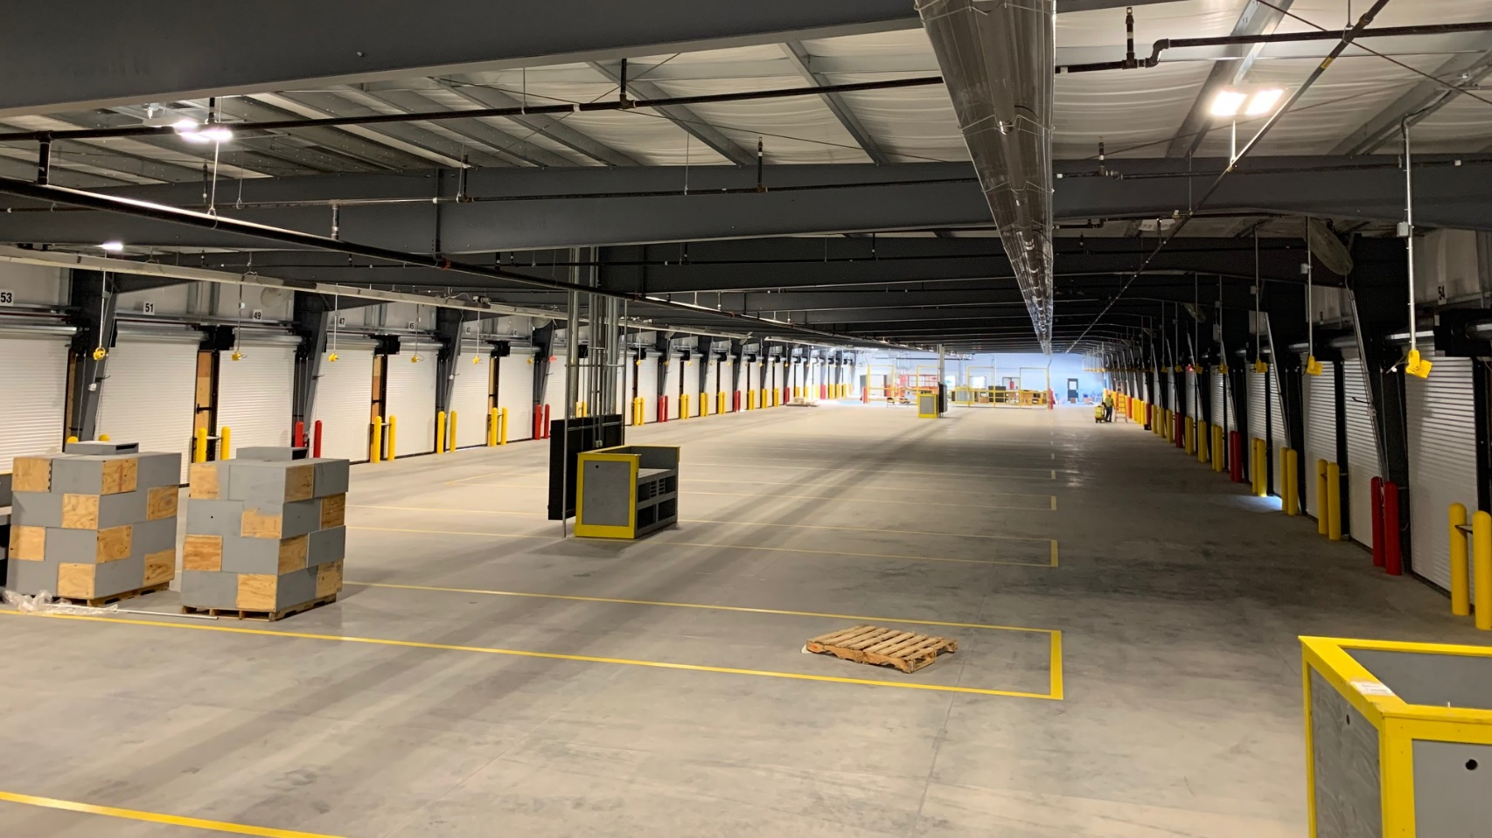
Notes:
The Vantage TF, or twin-fire heater, produces a flame from both sides of the burner giving you the advantage of having 2 separate heaters in a single enclosure. Saving contractors and end sures money by reducing equipment and installation costs with a single gas line and single electrical hook-up.
This is a highly specifiable product as no other manufacture in the industry offers anything like it.
With an output that ranges between 120,000 and an industry highest 380,000 BTU’s, the Vantage TF is fantastic for use in high heat-loss areas such as loading docks, or can be stretched to up to 120’ long for general space heating.
BTU’s range from: 120, 160, 200, 250, 300, 350, 380
Lengths: min 20’ (6m), max 60’ (18m) each side

Slide 30
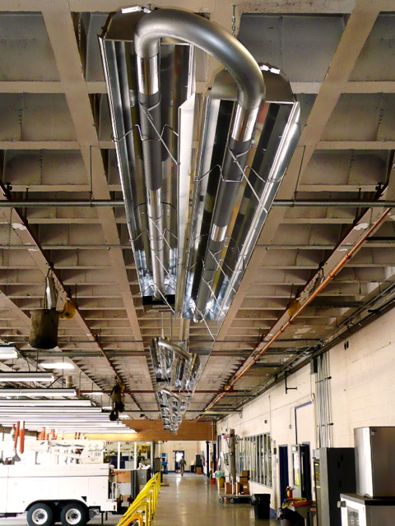

Slide 31
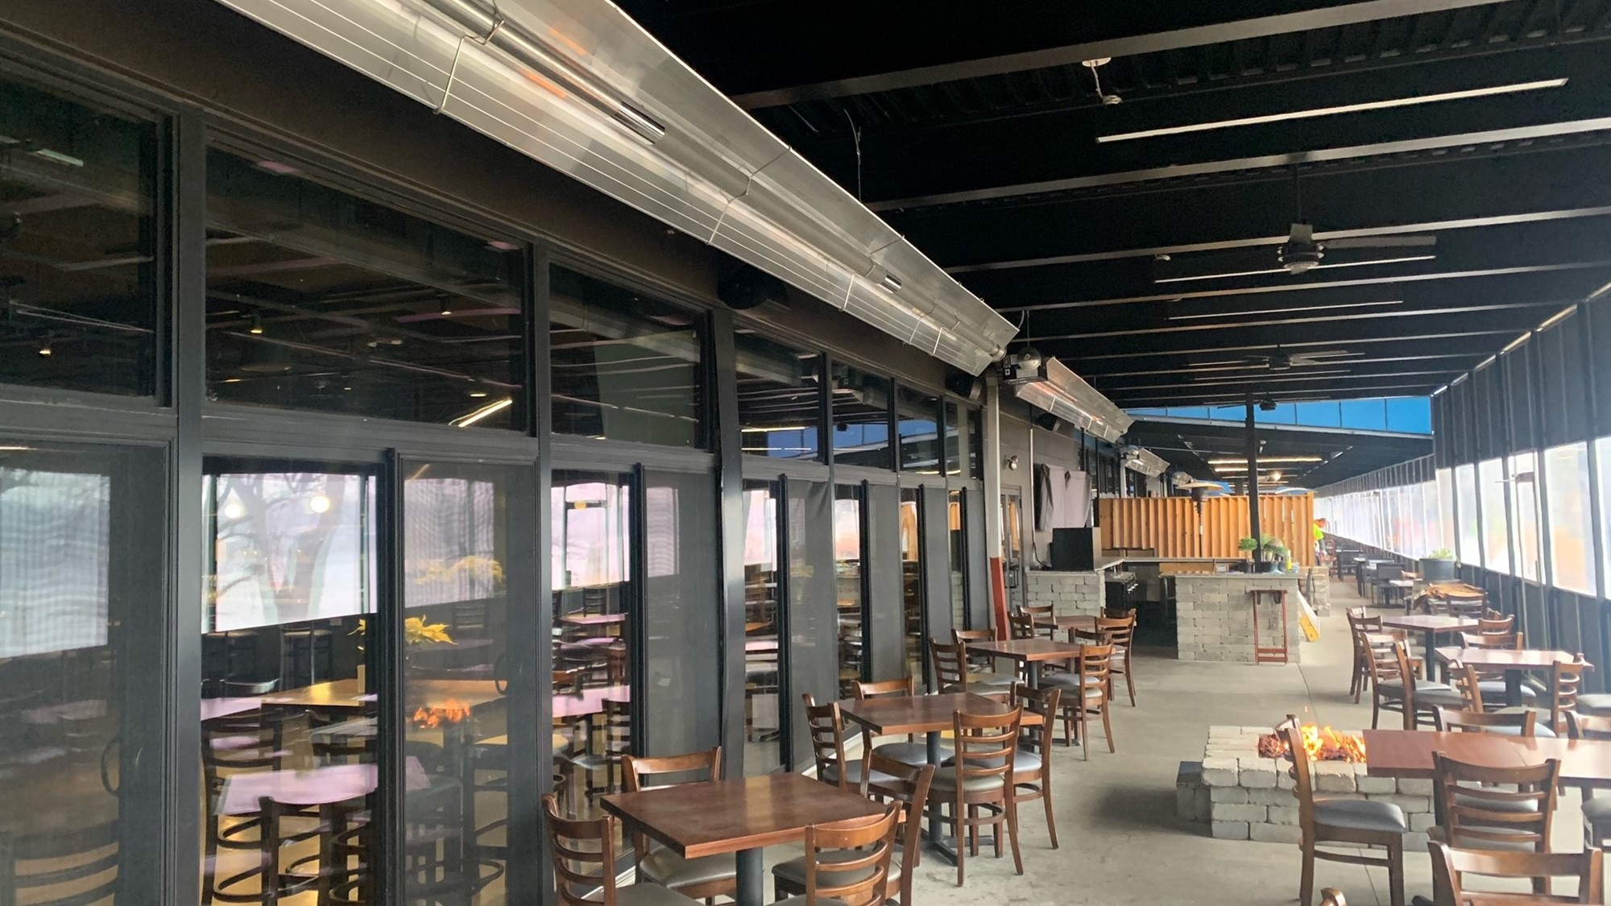

Slide 32
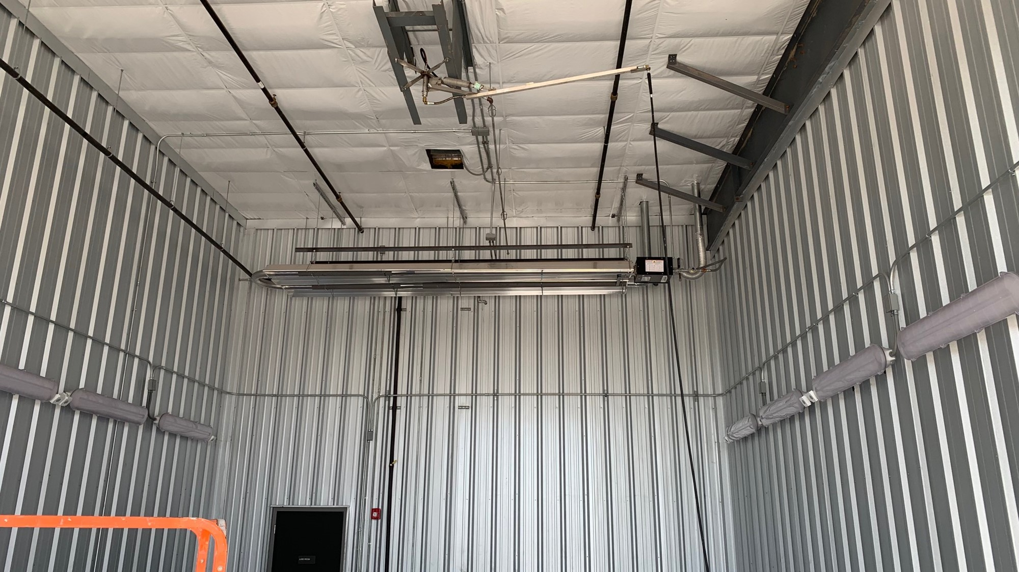

Slide 33
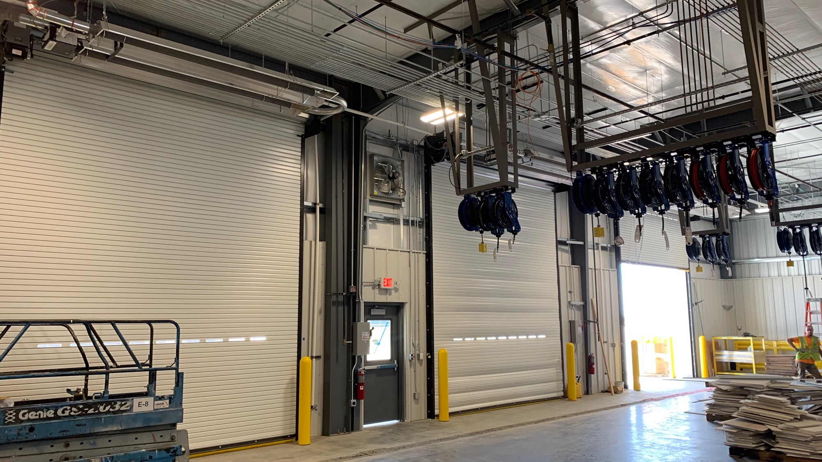

Slide 34
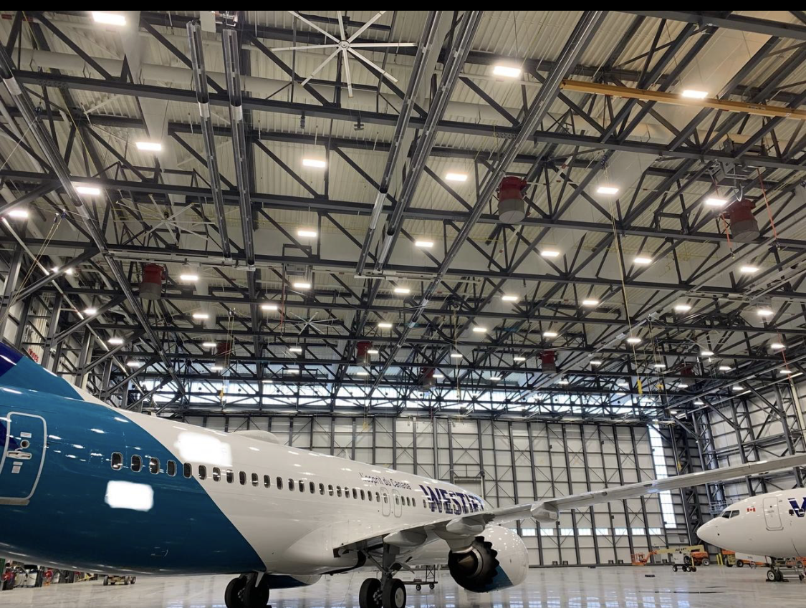

Slide 35
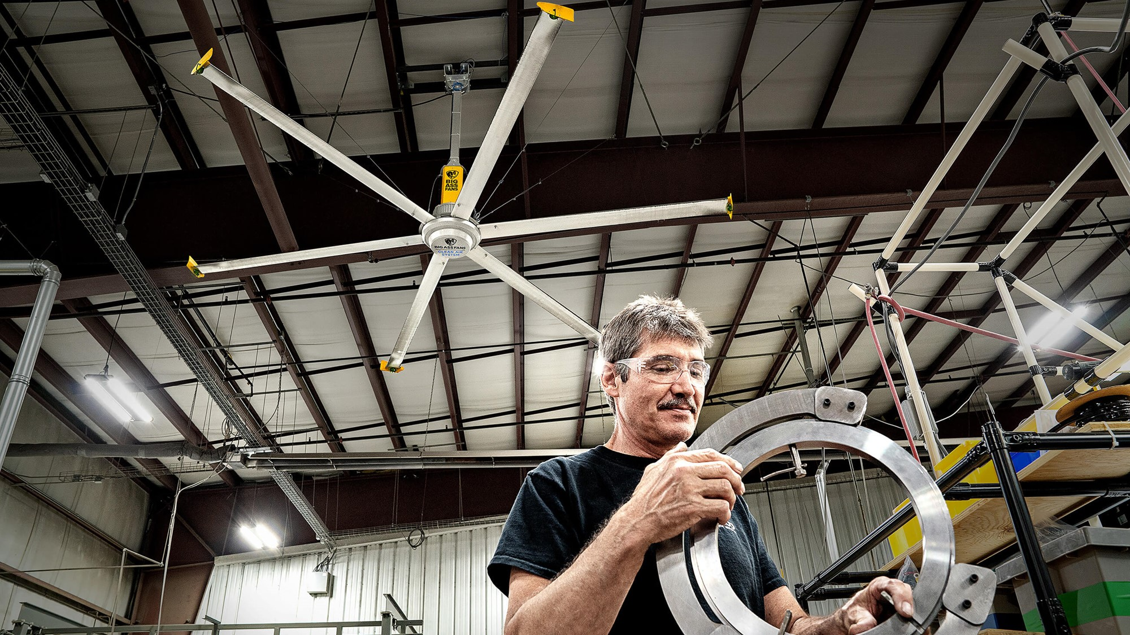

Slide 36
