Slide 1

Pricing Roberts Gordon Low-Intensity Heaters

Slide 2

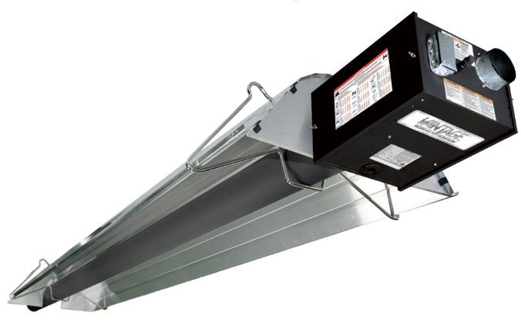
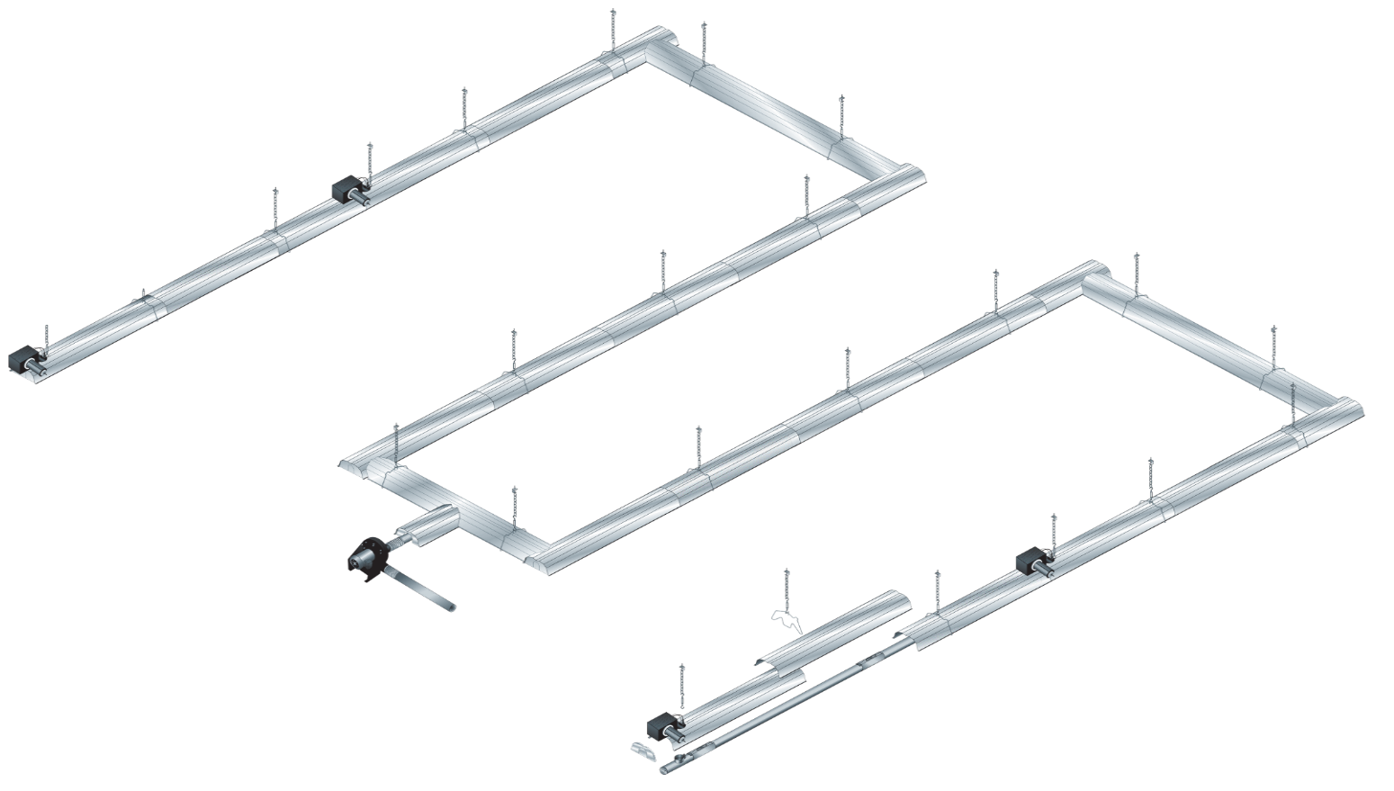
Unitary Heaters
Infrared Heating Systems

Slide 3
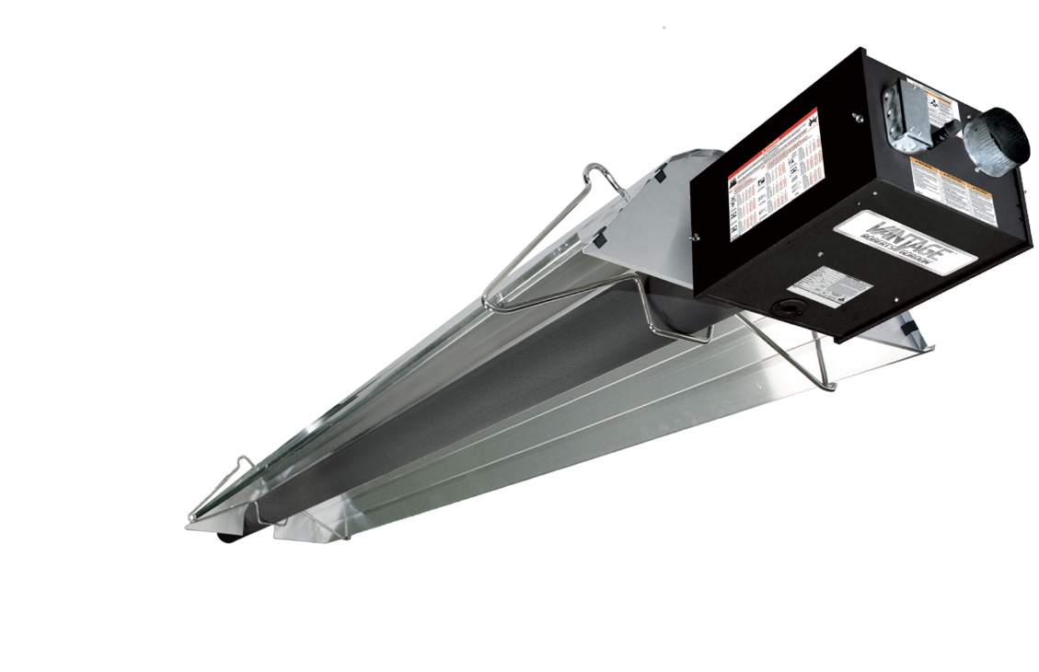
Unitary Heaters

Slide 4
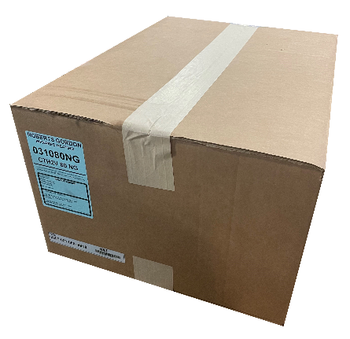
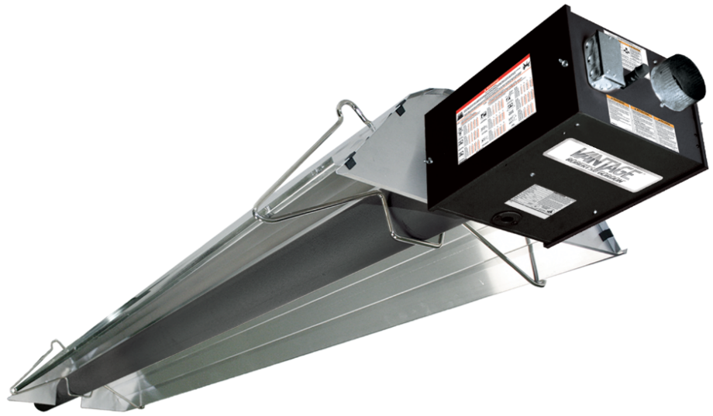
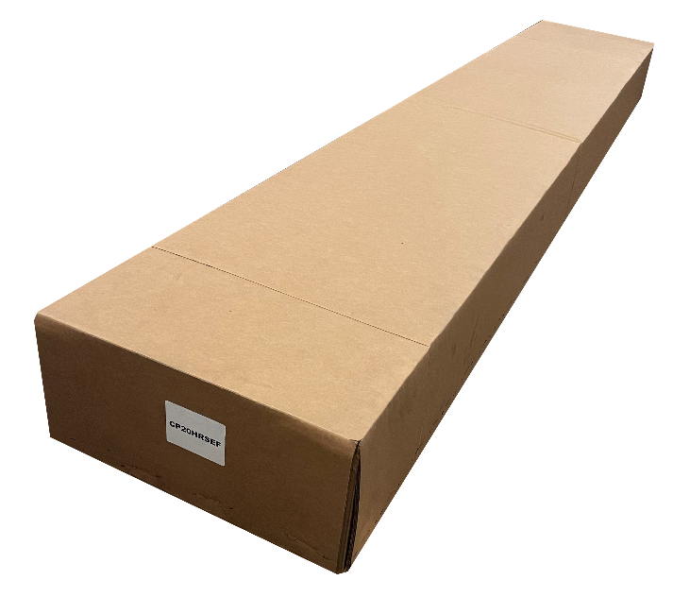
Burner Box
Heat Exchanger Package (Core/Extension Package)
Swirler Package (Select models/rates)
Notes:
Select models will also include a separate swirler package. The swirler package does not have to be selected separately as it is bundled into the burner box for the models that require it.

Slide 5
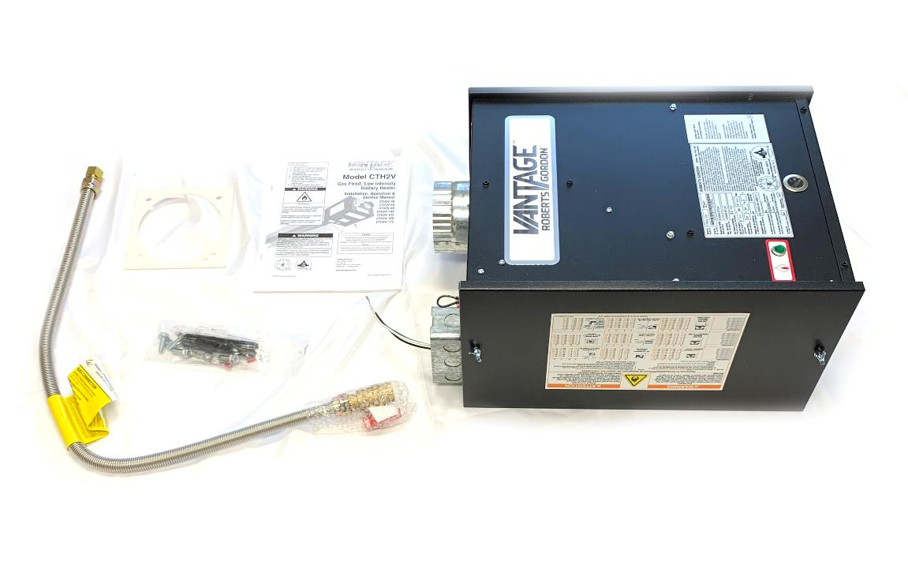


Turbulator included w/select models
SS gas line N/A w/ Canadian burners
Notes:
Includes gas line (US only), gas nipple, installation manual, burner gasket, and burner mounting hardware. Some models will include the turbulator

Slide 6
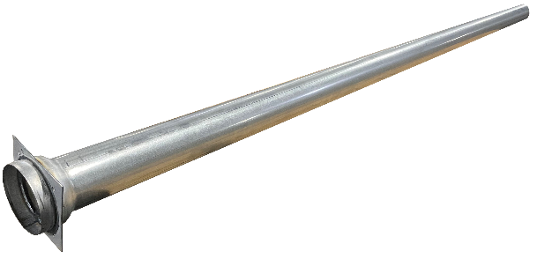


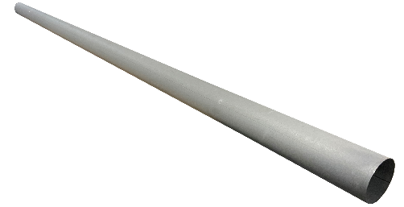
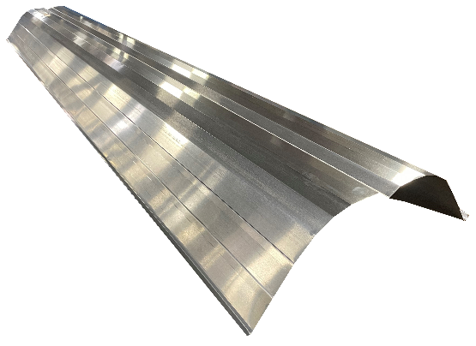
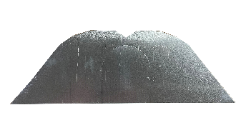




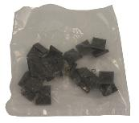
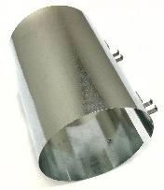
Core Packages Only
“Core” & “Extension”
Heat Exchanger Packages

Slide 7

“Core” & “Extension” Packages
Also known as “BOX 2’s”

Slide 8
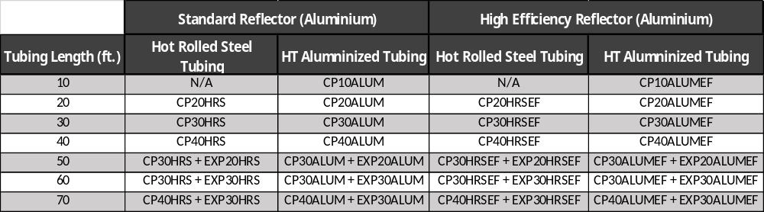
Length: Box 2 Combinations

Slide 9
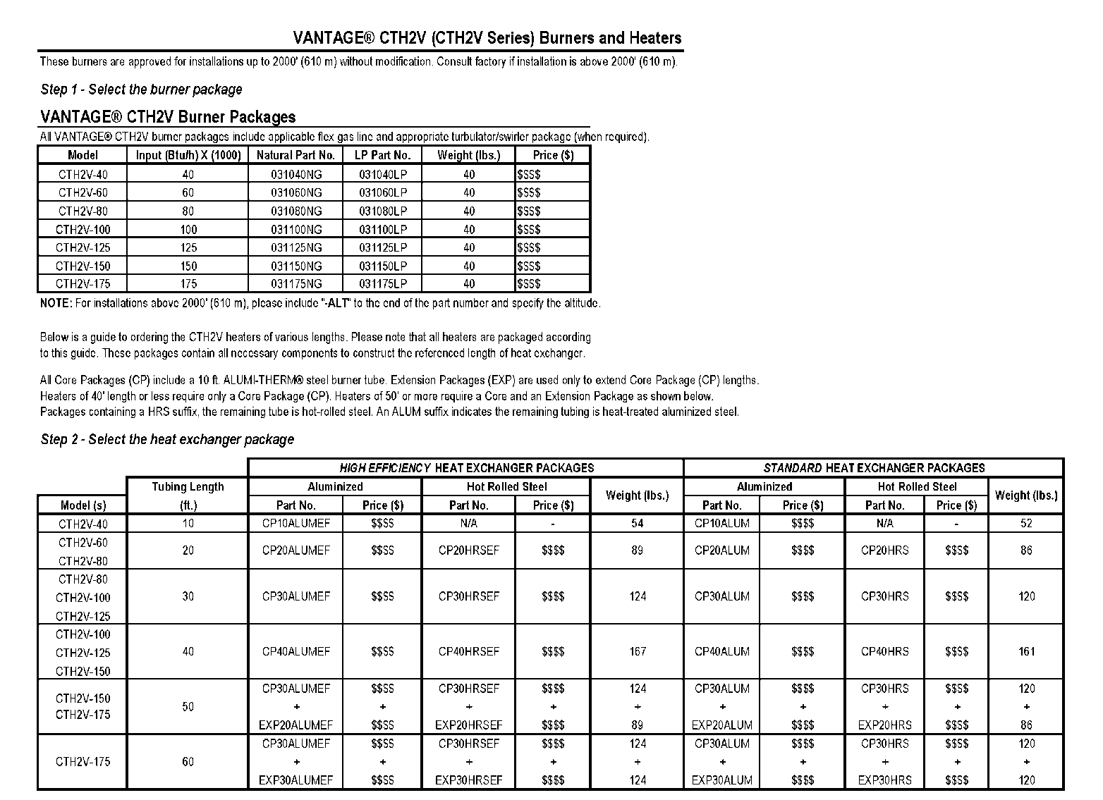
How to price a “Unitary Heater”

Slide 10
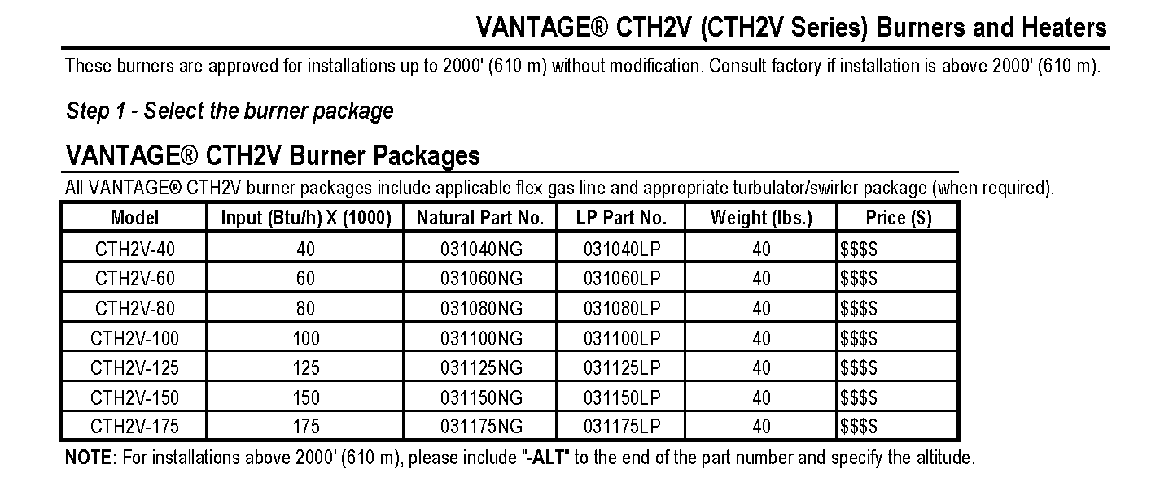

Slide 11
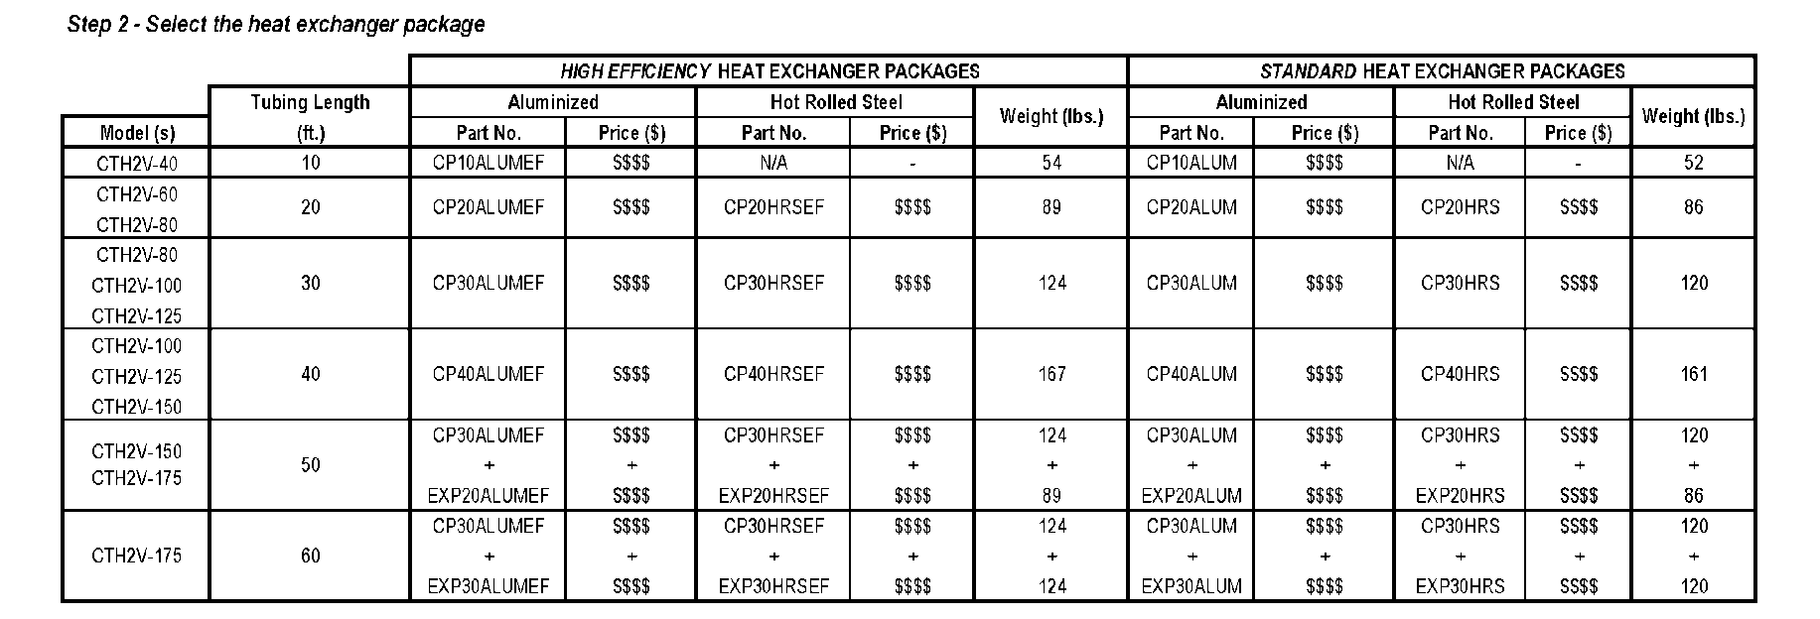

Slide 13
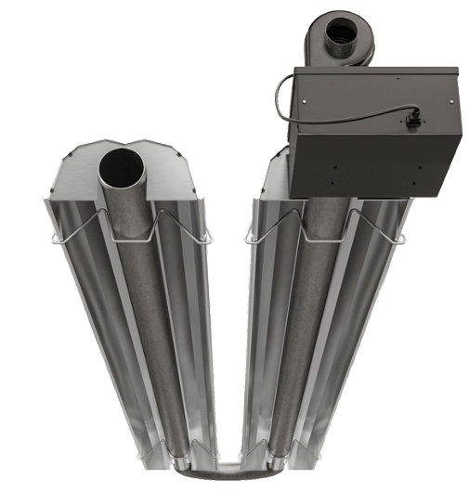
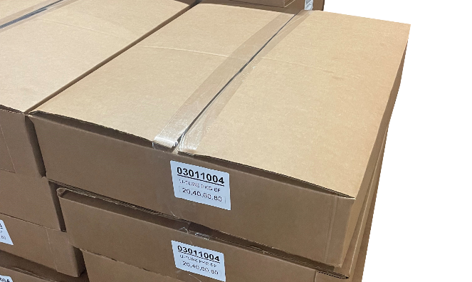
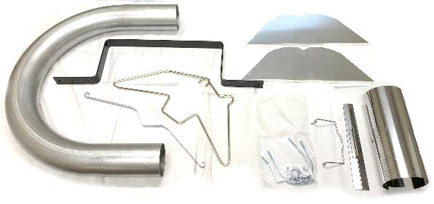
Common Accessories:
U-Tube Package

Slide 14
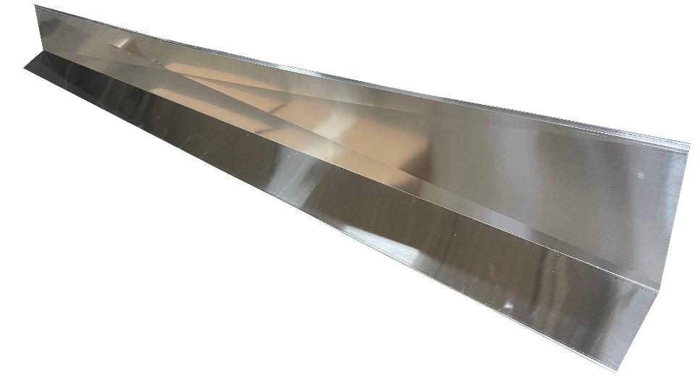
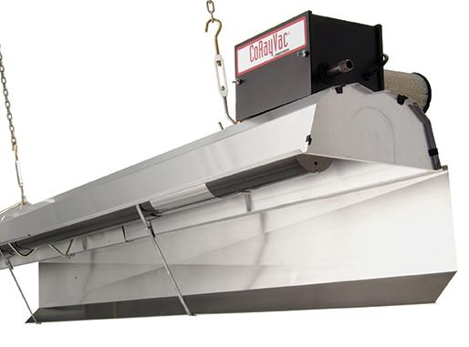
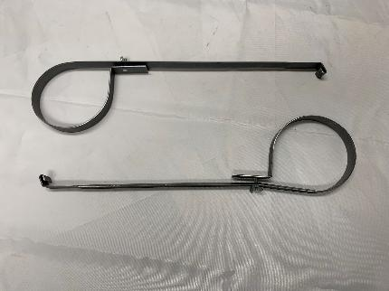
Common Accessories:
Reflector Side Extension

Slide 15
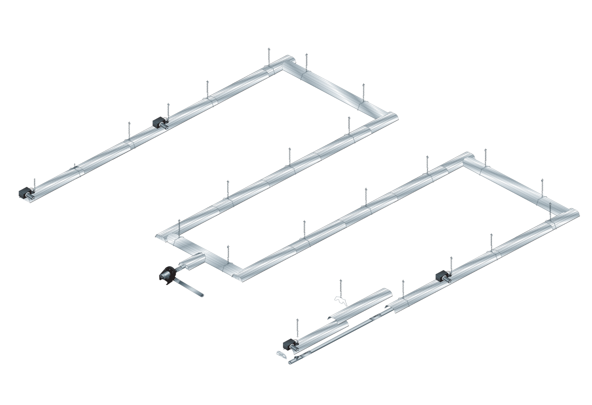
Infrared Heating Systems

Slide 16
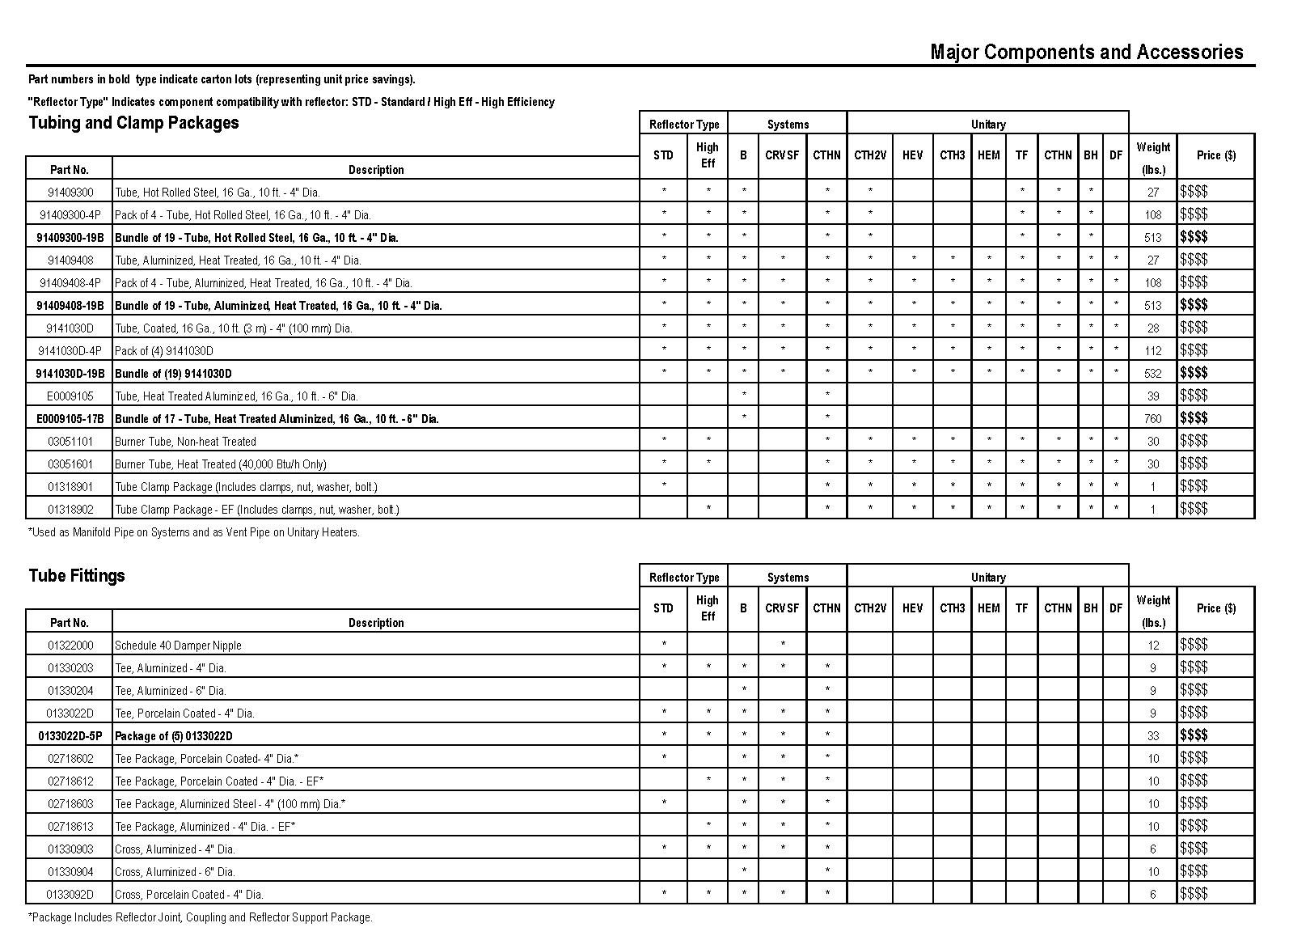

Slide 17
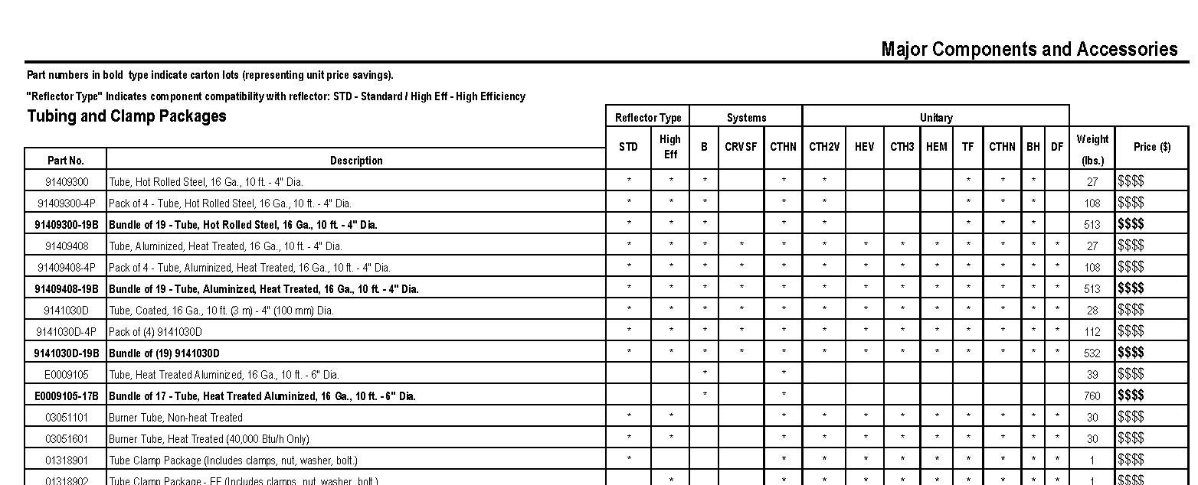

Slide 18
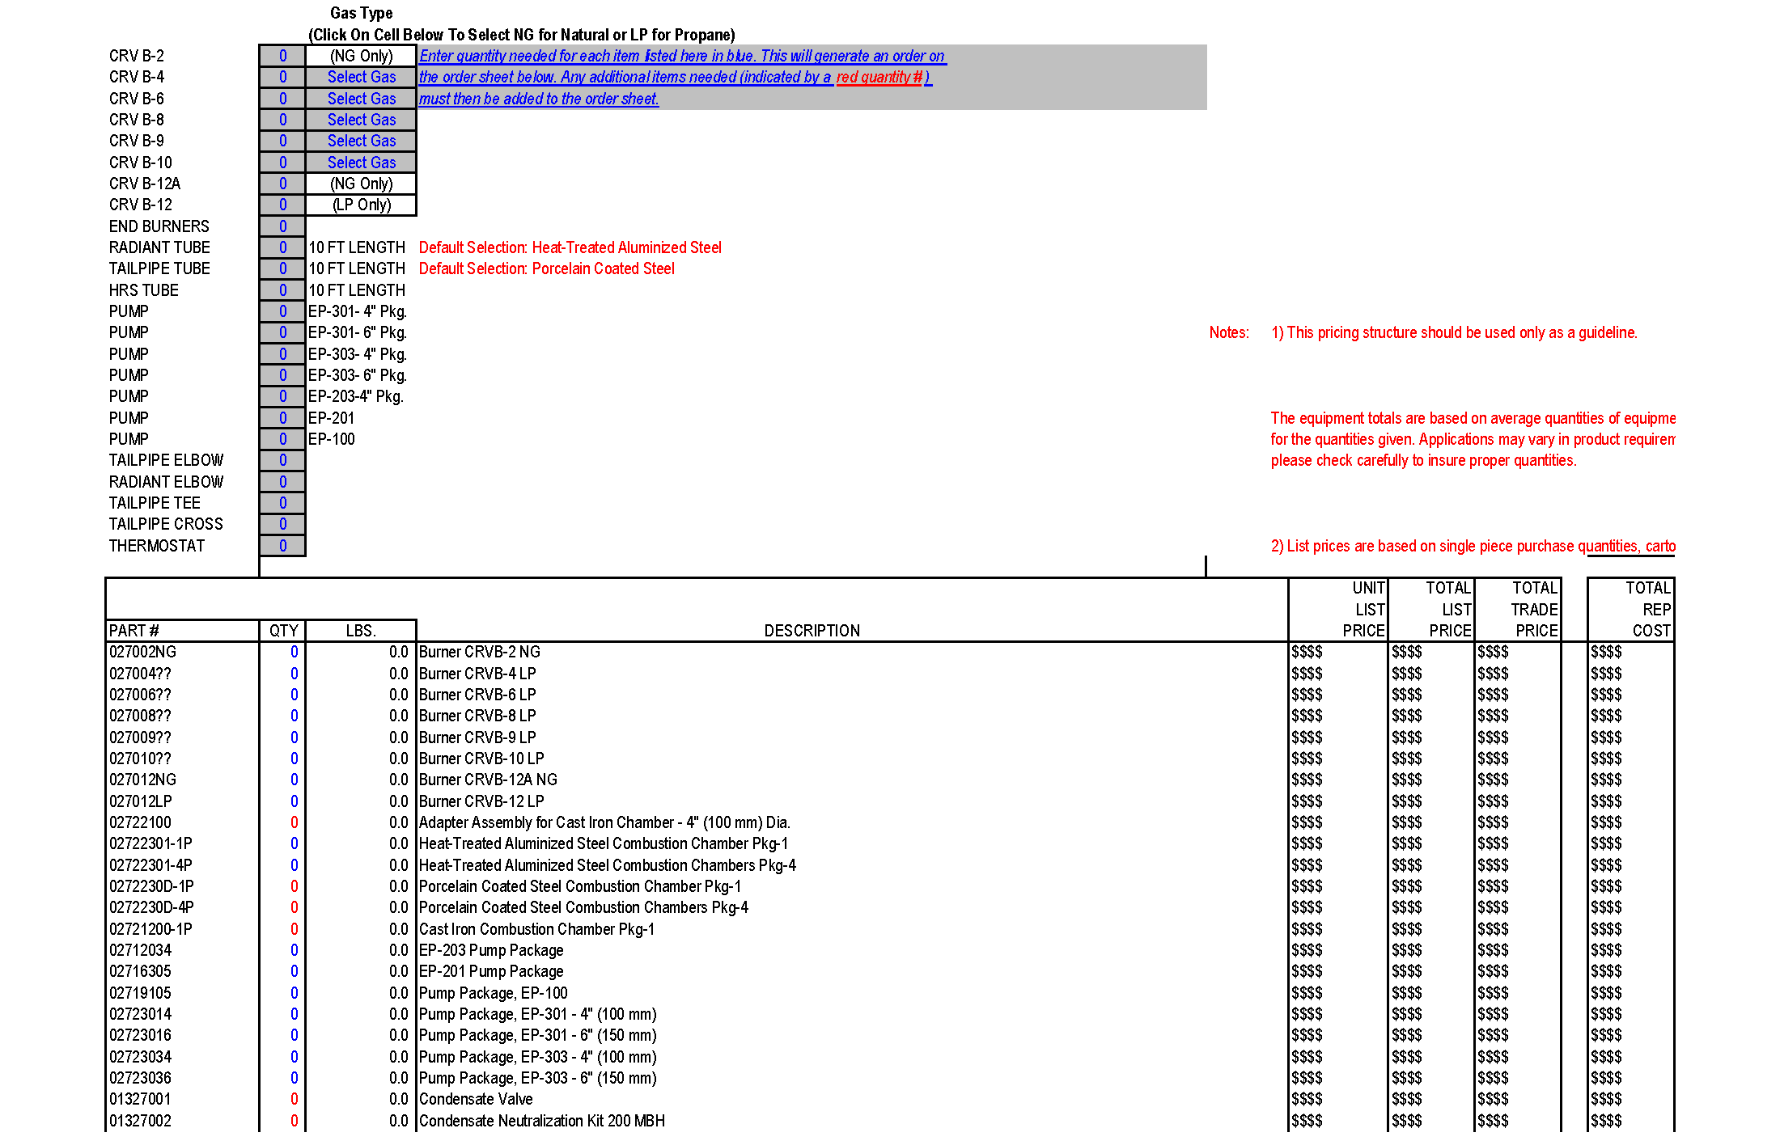
Excel Pricing File

Slide 19

Excel Pricing File

Slide 20
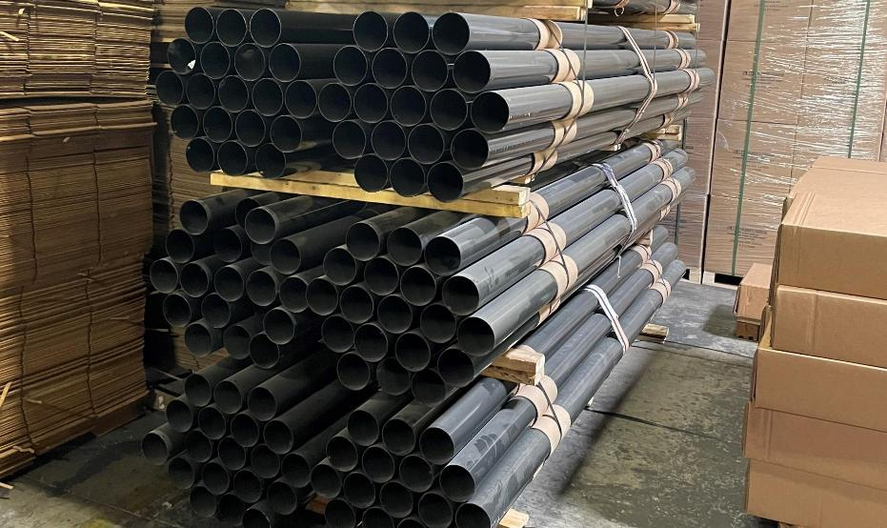
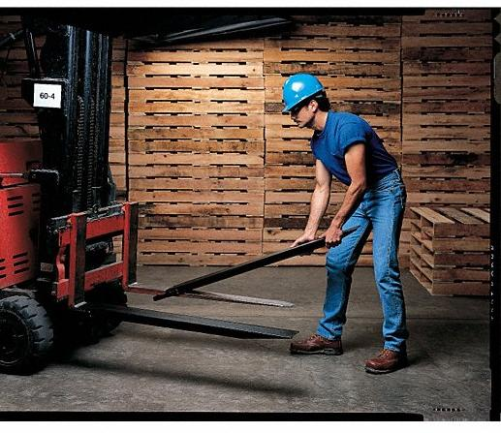
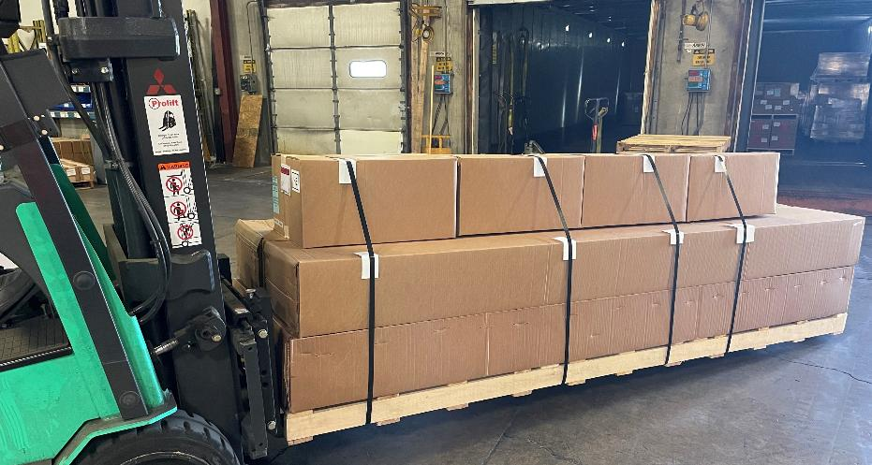


Slide 21
Thank you!
?’s

